Slide 1

Microsoft Virtual Academy
Free, online, technical courses
Take a free online course.
http://www.microsoftvirtualacademy.com

Slide 2
Windows Forensics
Erdal Ozkaya Raymond Comvalius
CISO Infrastructure Architect
Emt Holding NEXTXPERT

Slide 3
Module Agenda
What is Digital Forensics?
Reasons for a forensic requests
Types of forensic analysis
Incident Response
What is a hash value?
Forensic Imaging
Windows Forensic Analysis
Most Important Forensics areas in Windows
Example Case

Slide 4

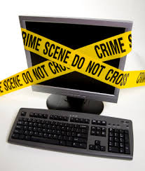
What is Digital Forensics?
Digital Forensics
Admissibility in the Court of Law…..

Slide 5
Types of Forensic Requests
Intrusion Analysis
Damage Assement
Suspect Examination
Tool Analysis
Log File Analysis
Evidence Search
Data as seen by Forensic Investigators using his sophisticated toolkit. May include deleted data, hidden data, unauthorized information and records of illegal activity!

Slide 6
Intrusion Analysis
Who gained entry?
What did they do?
When did this happen?
Where did they go?
Why the chosen network?
How did they do this?
Data as seen by Forensic Investigators using his sophisticated toolkit. May include deleted data, hidden data, unauthorized information and records of illegal activity!

Slide 7
Digital Forensics Process
Evidence Preservation
Evidence Acqusition
Evidence Examination
Evidence Analysis
Reporting

Slide 8
Incident Response Process
Plan & Identify
Initiate
Record
Evaluate & Analyze
Contain
Mitigate & Identify
Escalate
Recover
Review & Report
Lessons Learned

Slide 9
First responder
First person at the scene of the incident should collect and preserve as much as evidence as possible

Slide 10
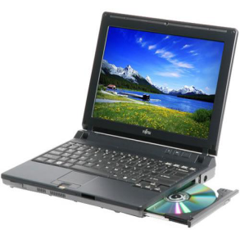
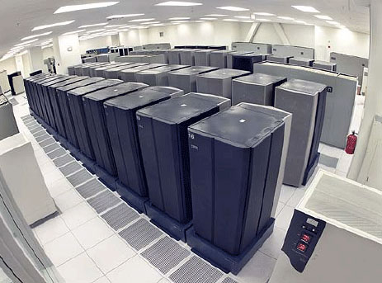

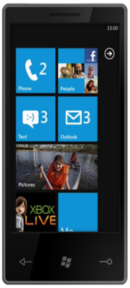


Incident Response
Acquisition
Desktop
Laptop
Server
Cloud
Tablet
Smart Phone
Network

Slide 11
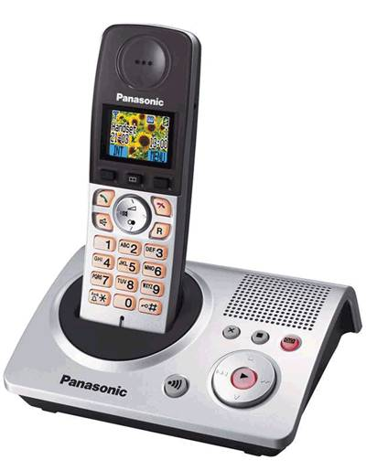
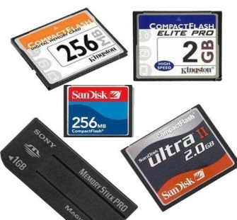
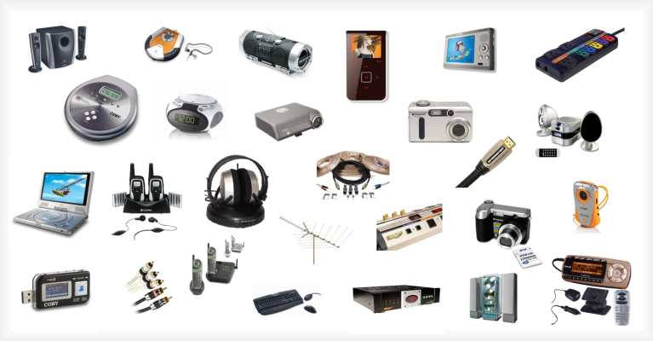
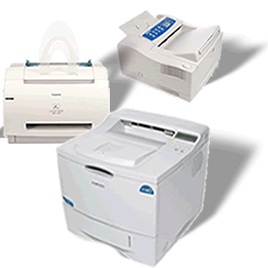
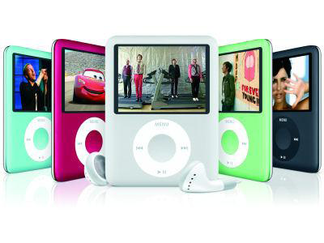
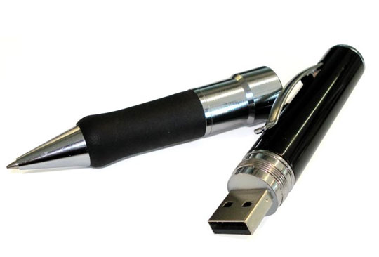
Incident Response
Acquisition
Flash Memory
Telephone
CD/DVD/BluRay
Many other electronic devices with storage capability
Fax/Printer
Copy Machine
MP3 / MP4 Player
USB Drive

Slide 12
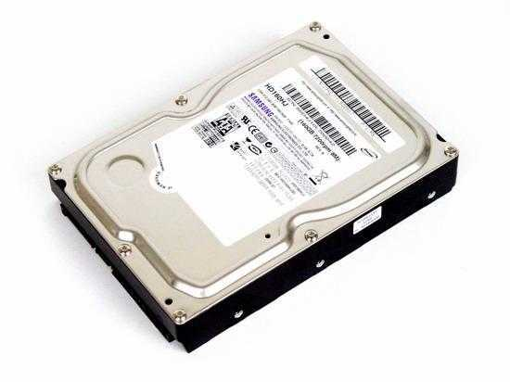
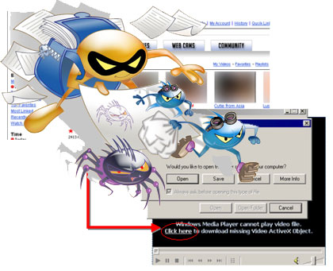
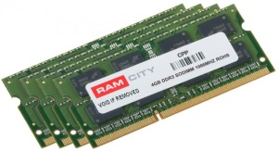
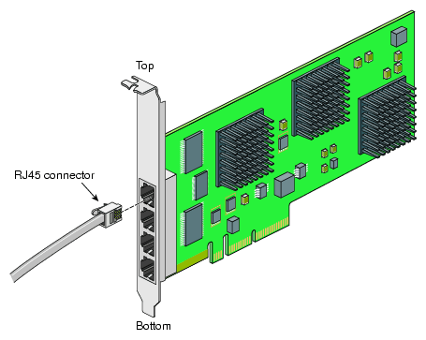
Incident Response
Acquisition
IMAGE HDD
BOOT COMPUTER
GET SYSTEM STATE REPORT
GET WORKING PROCESSES
GET OPEN PORTS LIST
IMAGE RAM
IF THE SYSTEM IS SHUTDOWN
CAPTURE NIC TRAFFIC

Slide 13
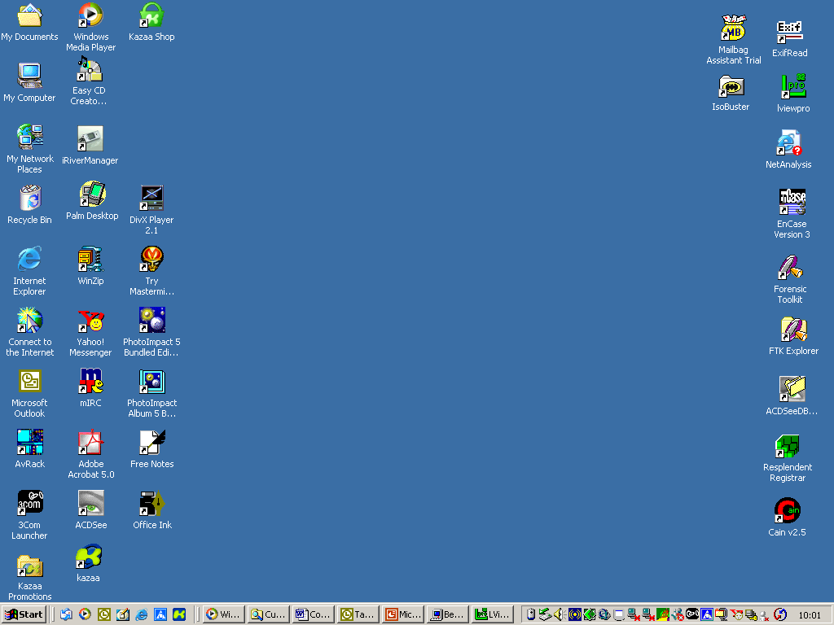
Incident Response
What are these?
What is happening?
System tray?
Executed applications?

Slide 14
Incident Response
Acquisition
GET SYSTEM STATE REPORT
GET WORKING PROCESSES
GET OPEN PORTS LIST
IMAGE RAM
CAPTURE NIC TRAFFIC
IF THE SYSTEM IS WORKING
IMAGE HDD

Slide 15
Demo-1: Drive Imaging

Slide 16
Demo-2: RAM Imaging

Slide 17
Demo-3: Network Traffic Capturing

Slide 18
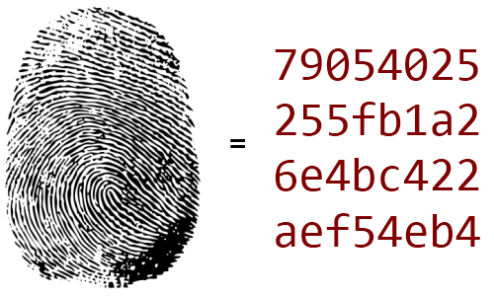
What is Hash Value?
  The integrity of digital evidence
  The authentication of digital evidence
  The non-repudiation of digital evidence
  The accuracy of digital evidence
  The accountability of digital evidence
Hashing
MD5 and SHA1

Slide 19
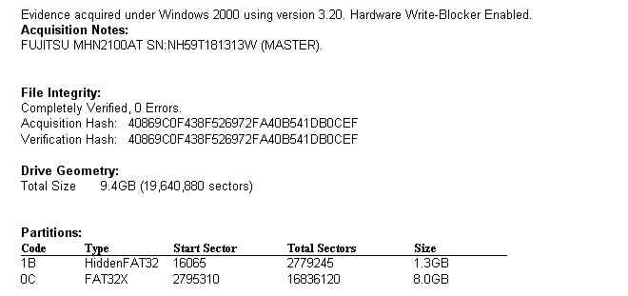
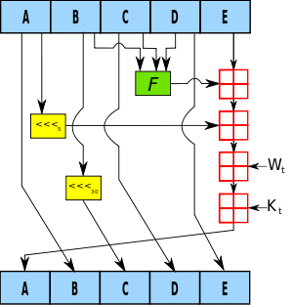
What is Hash Value?
MD5 (Message Digest Algorithm) is an algorithm that is used to verify data integrity through the creation of a 128-bit message digest from data input that is claimed to be as unique to that specific data as a fingerprint is to the specific individual.
SHA-1 (Secure Hash Algorithm) is the most commonly used form of SHA series of cryptographic hash functions, designed by the National Security Agency of USA and published as their government standard.

Slide 20
Forensic Imaging

Slide 21
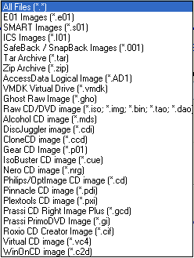
Most Common Forensic Image Formats
*.001
*.E01
*.EX01
*.ISO
*.CUE
*.AD1
*.S01

Slide 22
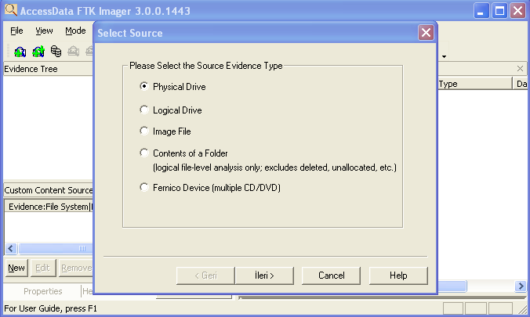
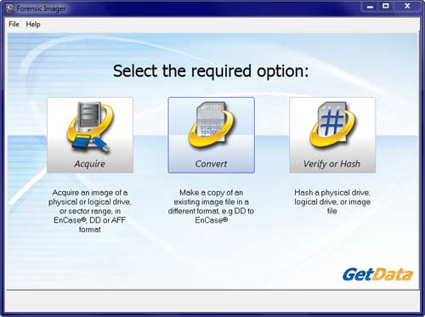
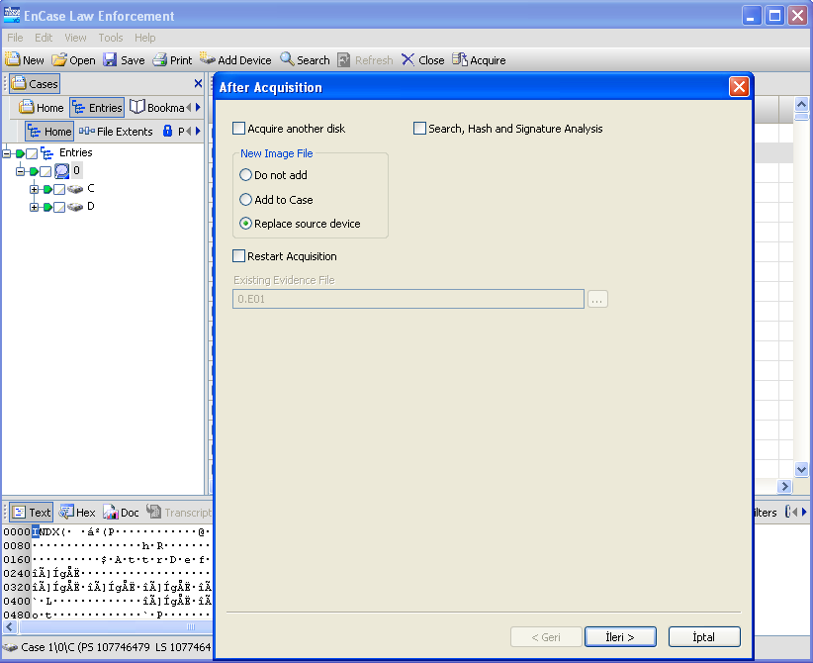
Forensic Imaging Software for Free
Access Data FTK Imager
Forensic Imager
Guidance Software EnCase Imager

Slide 23
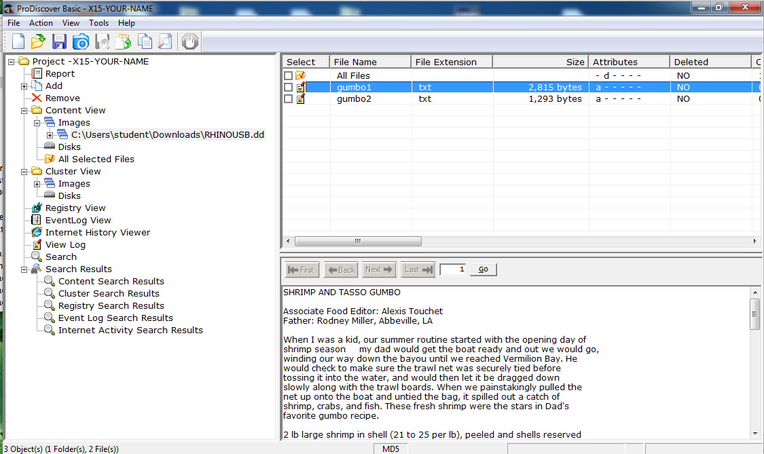
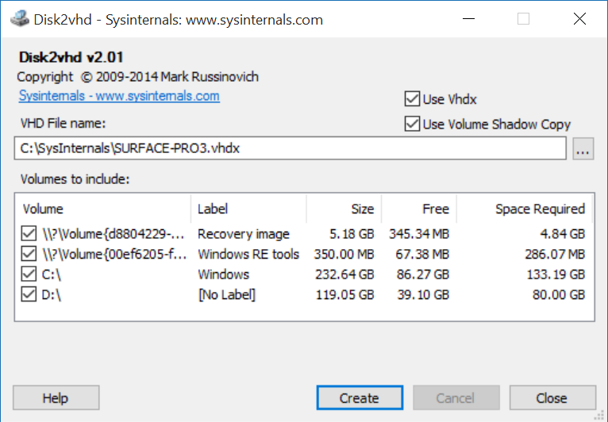
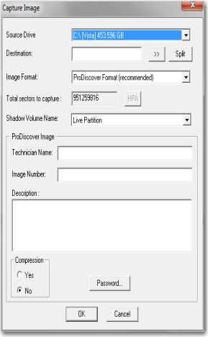
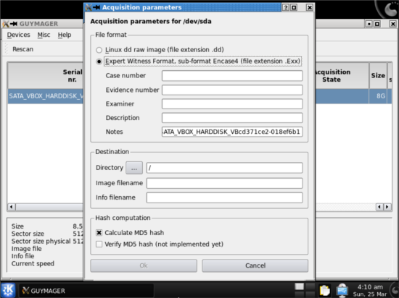
Forensic Imaging Software for Free
TechPathways Prodiscover Standart
Disk2vhd
Linux GUYMAGER

Slide 24
Important Windows forensic areas

Slide 25
Windows Forensic Analysis
Most Important Forensics areas in Windows
File signatures, extensions and attributes
File system properties
Operating system installation date and time
Processes baseline
User logon, shutdown, password change date and time

Slide 26
Windows Forensic Analysis
Most Important Forensics areas in Windows
Event logs (*.evt, *.evtx)
Registry
Prefetch files
Printer spooler
Shortcut file links

Slide 27
Windows Forensic Analysis
Most Important Forensics areas in Windows
Restore points (Volume shadow copies)
Thumb.db files
Recycle bin files and info2 files
Unallocated clusters, slack space
E-mails

Slide 28
Windows Forensic Analysis
File signatures, extensions and attributes
File extensions can be changed
File attributes can be changed
Files can be deleted
File names can be renamed
Files can be encrypted or password protected

Slide 29
Windows Forensic Analysis
Created, Modified, Last Accessed date and time
Files can be manipulated
File properties can be changed
Files can be deleted or recovered
Files can be moved

Slide 30
PowerShell File System Forensics
Create XMLs for all files on a drive
Get-Childitem c:\ -recurse –exportCliXml <file>
Details per file
Dir c:\SysInternals | where {$_.name –eq 'autoruns.exe'} | fl *
MD5 hashes using PowerShell Community Extensions at http://pscx.codeplex.com/
Import-Module pscx
Dir <folder> | Get-Hash

Slide 31
Windows Forensic Analysis
Processes Baseline
Now what the expected processes are on your systems
Keep a history of what usually runs
Compare in case of doubt

Slide 32
Compare running processes
Create the XMLs
Get-process –exportCliXml <filename>
Compare the contents
Compare-Object $proc1 $proc2 -Property processname
Get process details
$proc1 | where {$_.processname -eq 'notepad'} | fl *

Slide 33
Windows Forensic Analysis
Operating system installation date and time
HDD can be reformatted
HDD can be changed
HDD can be wiped
HDD can be overwritten from an image file

Slide 34
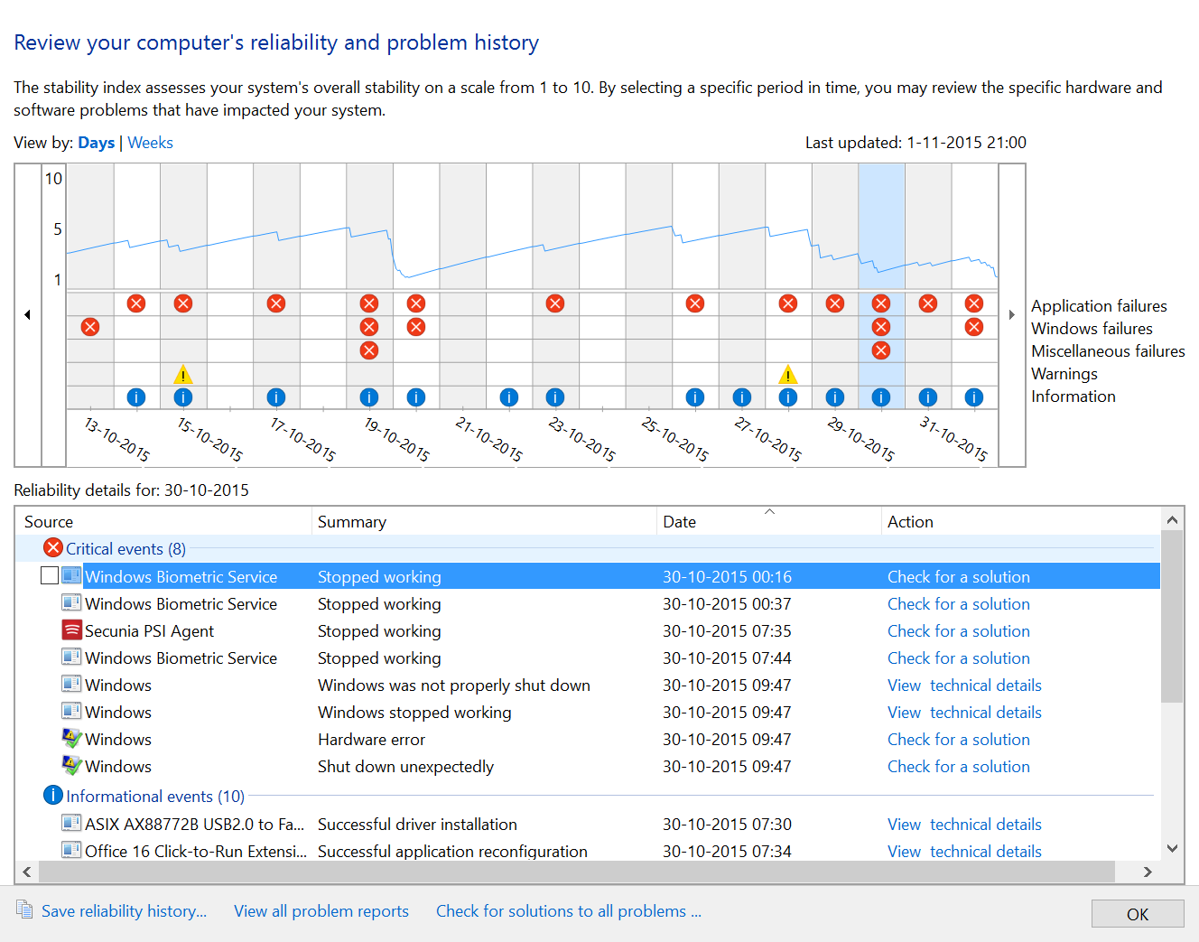
Windows Forensic Analysis
History of software installs and crashes

Slide 35
Windows Forensic Analysis
User logon, shutdown, password change date and time
Who logged on the system? When?
How many times logged on? Which times?
Which account is logged on that day?
When user password is changed?
What is shutdown time?
Any dirty shutdown?

Slide 36
Windows Forensic Analysis
Event logs (*.evt, *.evtx)
System event logs
Security event logs
Application event logs
Setup event logs
PowerShell event logs
Hardware Event logs
Other event logs

Slide 37
Get eventlog details
Security logs can only be read by local admins
Export the logs first
$logs = "system","application","security"
$logs | % {get-eventlog -LogName $_ | Export-Clixml "\\hyperv1\shared\$_.xml"}
Import the logs
$seclog = Import-Clixml "\\hyperv1\shared\security.xml"
$seclog | select -Last 5
Analyze the contens of the security event log
$seclog | group eventid –noElement| sort count

Slide 38
Windows Forensic Analysis
Registry
NT user hive (Ntuser.dat)
System hive
Software hive
SAM file
User control set 0/1

Slide 39
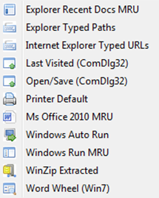
Windows Forensic Analysis
Registry files
NT user hive (Ntuser.dat)

Slide 40
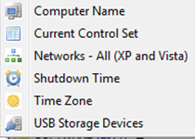
Windows Forensic Analysis
Registry files
System hive

Slide 41
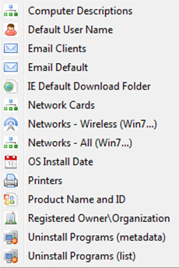
Windows Forensic Analysis
Registry files
Software hive

Slide 42
Windows Forensic Analysis
Prefetch Files
Microsoft created a Prefetch cache to improve boot and application launch time.
By caching commonly used applications the OS can determine to apportion system resources in anticipation that the user will access the application.
When an application is launched the system updates an entry in the path C:/Windows/Prefetch with the name of the application and a file extension (.pf).

Slide 43
Windows Forensic Analysis
Printer spooler files
On Windows systems you may find these two files in the C:\Windows\System32\spool\Printers folder.
.SPL - The print job’s spooled data is contained in a spool file.
.SHD - The shadow file contains the job settings

Slide 44
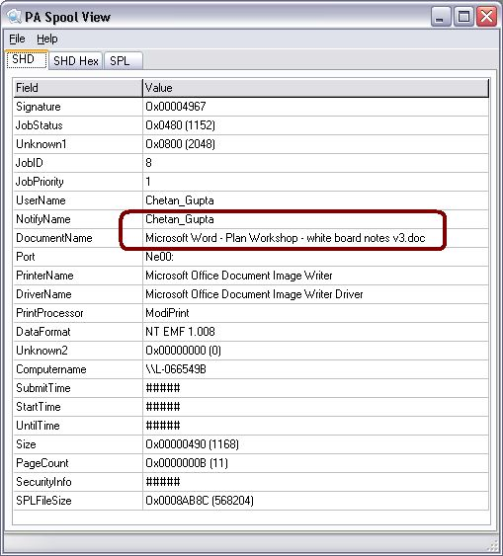
Windows Forensic Analysis
Spooler files
Splview.exe - available at http://undocprint.printassociates.com
This tool allows you to view the metadata of the print job!

Slide 45
Windows Forensic Analysis
Shortcut file links
The INFO2 file contains records that correspond to each deleted file in the Recycle Bin;
Each record contains the record number,
The drive designator,
The timestamp of when the file was moved to the Recycle Bin,
The file size,
File’s original name and full path, in both ASCII and Unicode.
Files sent to the Recycle Bin are maintained according to a specific naming convention
D<original drive letter of file><#>.<original extension>

Slide 46
Windows Forensic Analysis
Restore points (Volume shadow copies)
Restore points are created to allow users a choice of previous system states. Each restore point contains the necessary information needed to restore the system to the chosen state. Restore points are created before key changes are made to the system.
System Restore has an automatic restore point space-management feature that purges the oldest restore points to make room for new ones, while still enabling the user to recover from any recent destructive changes.

Slide 47
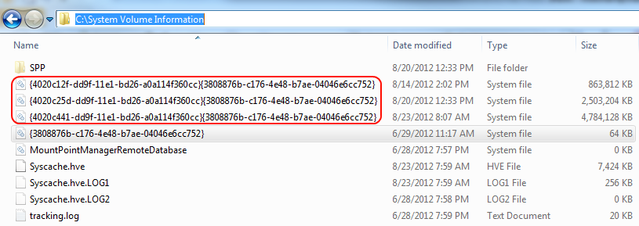
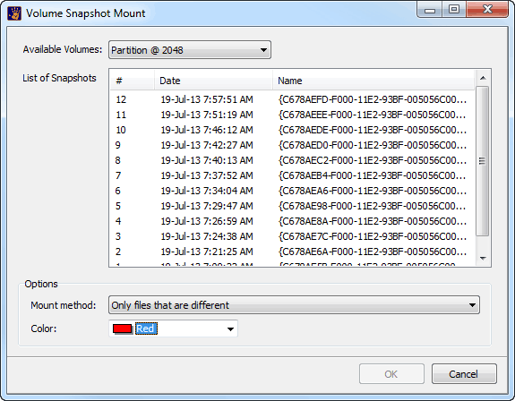
Windows Forensic Analysis
Restore points (Volume shadow copies)

Slide 48
Windows Forensic Analysis
Thumb.db files
Thumbs.db contains cached thumbnails of the images in a folder.
OLE embedded data present in the Thumbs.db file
In many cases, the images may have been deleted from the directory but they may still be available in the thumbs.db cache!

Slide 49
Windows Forensic Analysis
Recycle bin files and info2 files
The INFO2 file contains records that correspond to each deleted file in the Recycle Bin;
Each record contains the record number,
The drive designator,
The timestamp of when the file was moved to the Recycle Bin,
The file size,
File’s original name and full path, in both ASCII and Unicode.
Files sent to the Recycle Bin are maintained according to a specific naming convention
D<original drive letter of file><#>.<original extension>

Slide 50
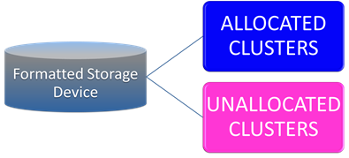
Windows Forensic Analysis
Unallocated clusters, slack space
Unallocated clusters (also referred to as unallocated space or free space) are the available drive storage space that is not allocated to file storage by a volume. Unallocated clusters can be a valuable source of evidence in a computer forensics examination because they can contain deleted files or remnants of deleted files created by the Operating System and / or computer users.
Slack space is the unused space in the last cluster of a file where the logical size of the file does not fill the complete cluster. The file slack can contain fragments of old data previously stored in that cluster.

Slide 51


Windows Forensic Analysis
E-mails
MS Outlook *.PST files
MS Outlook *.OST files
Outlook Express *.dbx files
Web based email cache files

Slide 52
Demo-4: A forensic image analysis with a forensic analysis software

Slide 53
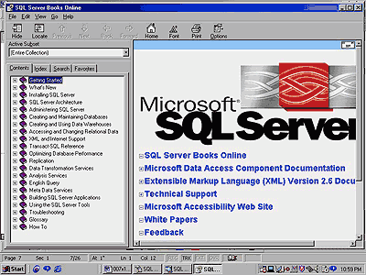
Example Case: Unauthorized access to SQL database, admin password is changed, user permissions are taken, and cleared.

Slide 54

Windows Forensic Analysis
Unauthorized Access, Data sabotage
Unauthorized access to SQL database server, admin password deleted and all user permissions are cleared.
Information is retrieved.
To protect the privacy of case, administration is informed.
Digital Forensic Tools are prepared.
During imaging of SQL server RAM and HDD’s, SQL server log files and event logs are deleted. And also other servers log files deleted too???
INSIDER SUSPECT

Slide 55

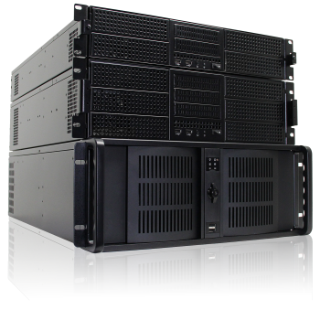
Windows Forensic Analysis
Unauthorized Access, Data sabotage
20 computers were imaged whose owners were working at IT department.
Totally 20 PC’s and 1 server and 1 RAM image files had to be analyzed!
How and where to start?
Which methods do we have to use?

Slide 56
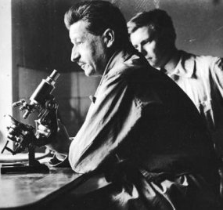
Windows Forensic Analysis
Unauthorized Access, Data sabotage
Edmond Locard’s Exchange Principle
Core Principles
A crime cannot occur without leaving a trace
With contact between two items, there will be an exchange
Every contact leaves a trace
Evidence Dynamics…

Slide 57
Windows Forensic Analysis
Unauthorized Access, Data sabotage
Is there any one who deleted Windows event logs?
DEEP DIGITAL FORENSICS INVESTIGATION
ONLY ONE PERSON DELETED

Slide 58
Windows Forensic Analysis
Unauthorized Access, Data sabotage
Delete, clear, erase, eraser, SQL log, event log….
Keyword search
Files are recovered.
SQL log ve Event log recovery
Timeline analysis is finished.
Event date and time chart
Windows Remote Desktop is used!!
Installed software

Slide 59
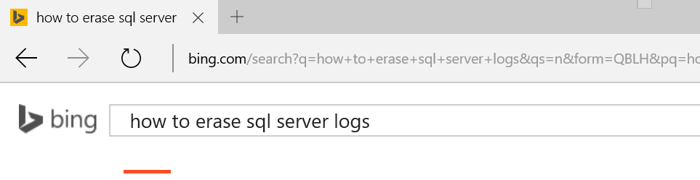
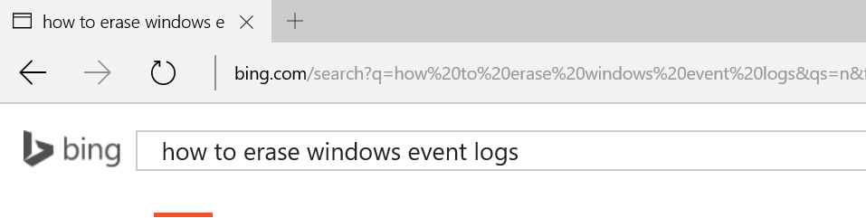
Windows Forensic Analysis
Unauthorized Access, Data sabotage
Suspect deleted his PC logs 30 minutes later SQL server logs are deleted.
Suspect firstly delted SQ server logs and then his PC logs are deleted. Why?
Before deleting SQL server logs, suspect search something on Google. ☺

Slide 60
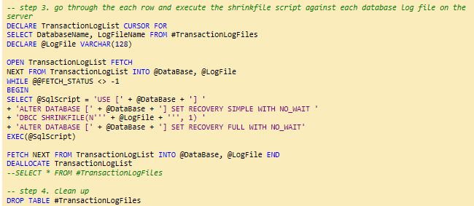
Windows Forensic Analysis
Unauthorized Access, Data sabotage
Firstly he found a script to delete SQL server logs. He uploaded this script to SQL server and changed the name of file to «123.dat».

Slide 61

Windows Forensic Analysis
Unauthorized Access, Data sabotage
SQL server logs are analyzed and there is an error belonging to a Canon mx340 printer. The same error was occured the same date and time at suspect’s PC.

Slide 62

Windows Forensic Analysis
Unauthorized Access, Data sabotage
Named «Book1.xls» MS Excel file is closed before saving at SQL server, and it made an error at the logs. The same error also occured at the same time at suspect’s PC?

Slide 63
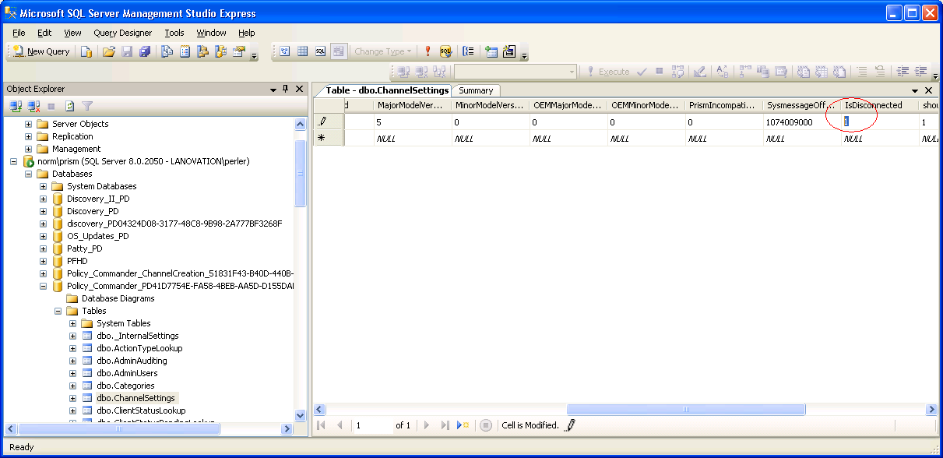
Windows Forensic Analysis
Unauthorized Access, Data sabotage
The End: E-mail analysis-Confession

Slide 64
Summary

Slide 65


TechNet Virtual Labs
Deep technical content and free product evaluations
Hands-on deep technical labs
Free, online,
technical courses
At the TechNet Evaluation Center you can download free, trial versions of Microsoft software, with no feature limits. Dozens of trials are available – all at no cost.
Try Windows Server 2012 R2 for up to 180 days. Download the Windows 8.1 Enterprise 90-day evaluation. Or try Microsoft Azure at no-cost for up to 90 days.
Microsoft Hands On Labs offer virtual environments that will take you through guided, technically deep product learning experience.
Learn at your own pace in labs that you can complete in 90 minutes or less. There is no complex setup or installation is required to use TechNet Virtual Labs.
Microsoft Virtual Academy provides free online training on the IT scenarios that are important to your company and your career.
Learn at your own pace and boost your IT skills with over 100 courses across more than 15 Microsoft technologies including Windows Server, Windows 8, Microsoft Azure, Office 365, virtualization, Windows Phone, and more.
Download Microsoft software trials today.
Find Hand On Labs.
Take a free online course.
Technet.microsoft.com/evalcenter
Technet.microsoft.com/virtuallabs
microsoftvirtualacademy.com

Slide 66


© 2013 Microsoft Corporation. All rights reserved. Microsoft, Windows and other product names are or may be registered trademarks and/or trademarks in the U.S. and/or other countries.
The information herein is for informational purposes only and represents the current view of Microsoft Corporation as of the date of this presentation. Because Microsoft must respond to changing market conditions, it should not be interpreted to be a commitment on the part of Microsoft, and Microsoft cannot guarantee the accuracy of any information provided after the date of this presentation. MICROSOFT MAKES NO WARRANTIES, EXPRESS, IMPLIED OR STATUTORY, AS TO THE INFORMATION IN THIS PRESENTATION.

