Slide 1
Microsoft Dynamics
Employee Self-Service
Notes:
As many of you already know, one of the biggest sales plays for Microsoft Dynamics Service solution this year is Employee Self-Service. As you can see in this title slide, we have neither CRM nor Parature in the solution name because this is not CRM or even a service application for agents. It is a knowledge platform for the enterprise. So what does that mean…

Slide 2
Employee Self-Service from Microsoft
Accessible and consistent knowledge for all employees
Self-Service
Portals
Office 365
Outlook / Word
Self-Service for any employee inquiry – HR, IT, Finance, Legal, Customer Service
Mobile
3rd Party
Applications
Employee
Knowledge Platform
Knowledge everywhere – Portal, Mobile, Office 365, Enterprise applications
Notes:
The whole concept behind Employee Self-Service is that we’re providing a place to create and maintain knowledge articles to address the most important and common employee needs and inquiries. The question may be internal in nature, such as HR and IT, or it can be information useful for all employees to assist customers…even if you’re not in a dedicated service role. Only after you build an effective knowledgebase, you can deliver the right answer, at the right time, across multiple channels including portals, devices, productivity tools and applications you use every day.

Slide 3
Benefits of higher employee engagement
Improves Customer Satisfaction
Empower employees with knowledge for every customer interaction.
Increases Employee Productivity
Boost employee productivity with quick access to consistent and organized knowledge.
Reduces Service Effort
Reduce assisted-service costs by providing employees with FAQs knowledgebase.
Employee
Self-Service
Enhances Products & Services
Analyze knowledge queries to improve products and services for customers.
Supports Corporate Compliance
Reinforce adherence to organizational policies and procedures.
Notes:
There are some intuitive benefits to empowering every employee with enterprise knowledge – such as increasing employee productivity, improving customer satisfaction, and reducing service cost. But there are also less often thought-of benefits to enterprise knowledge such as looking for patterns in customer inquiries to improve the organization’s products and services and ensuring ease of access to corporate policies and procedures which can, at times, help the organization avoid costly incidents and liabilities.

Slide 4
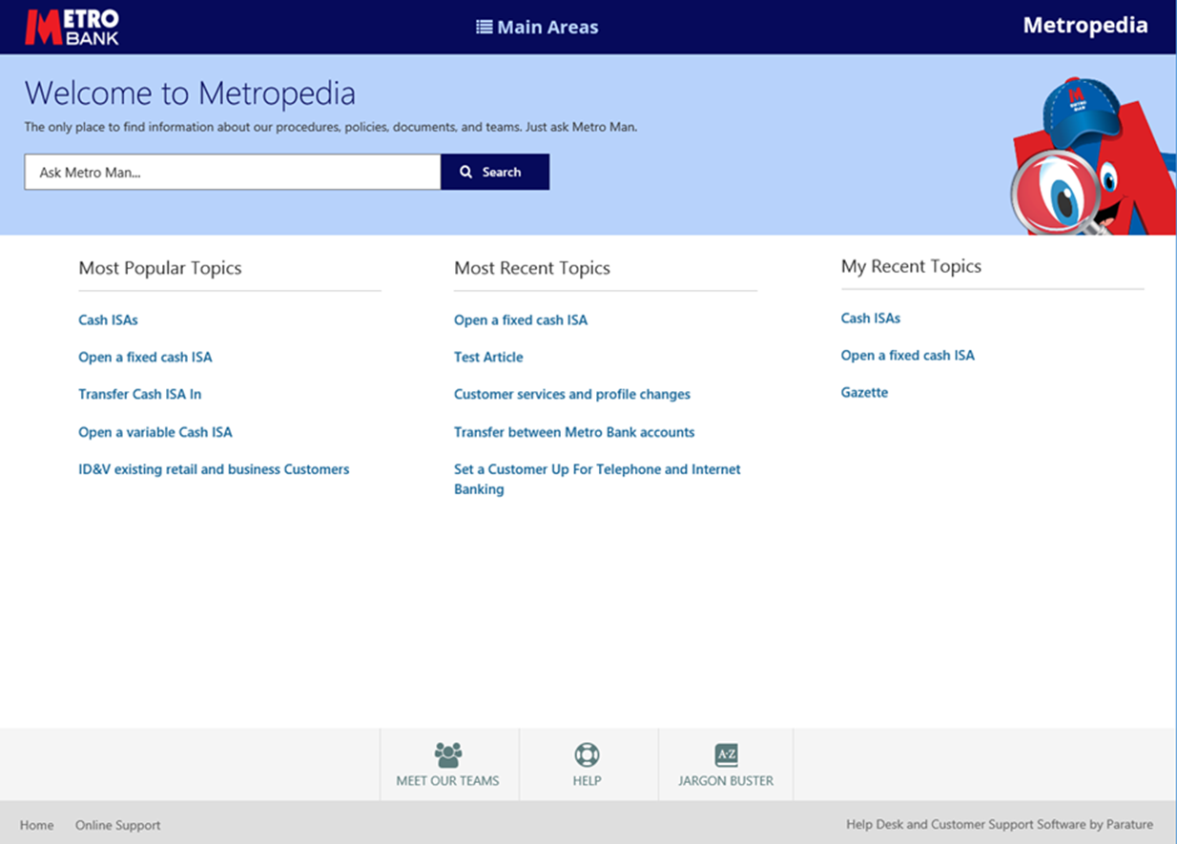
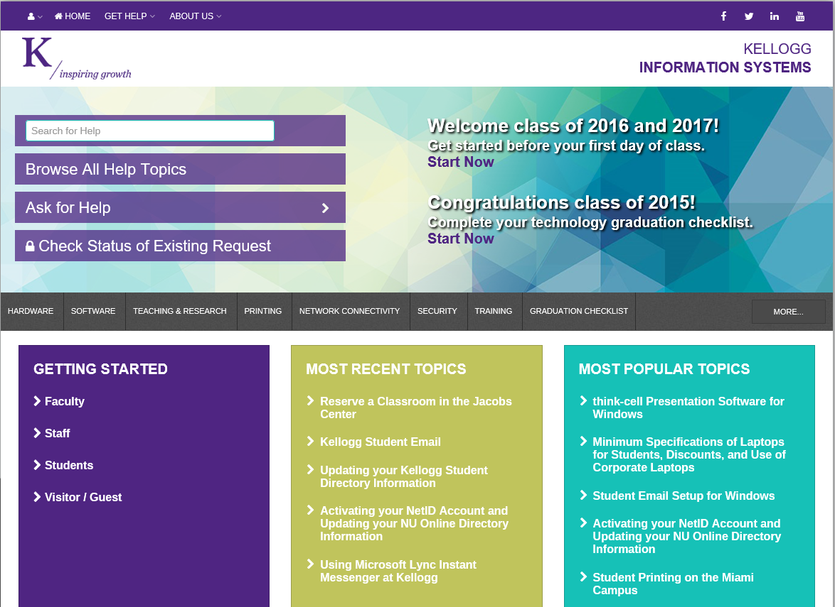
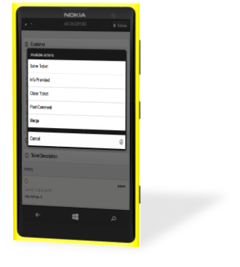
Accessible knowledge for employees and customers
Implement self-service portals for easily searchable enterprise knowledge
Delivered in any device across the globe
Real-time access 24/7 to the right answers at the right time
Notes:
We explained that an organization who chooses Microsoft Employee Self-Service can render knowledge pretty much everywhere they choose. We expect that self-service portals, both on the desktop and mobile devices, to be one of the most common and heavily-utilized channels for employees to search for answers.

Slide 5
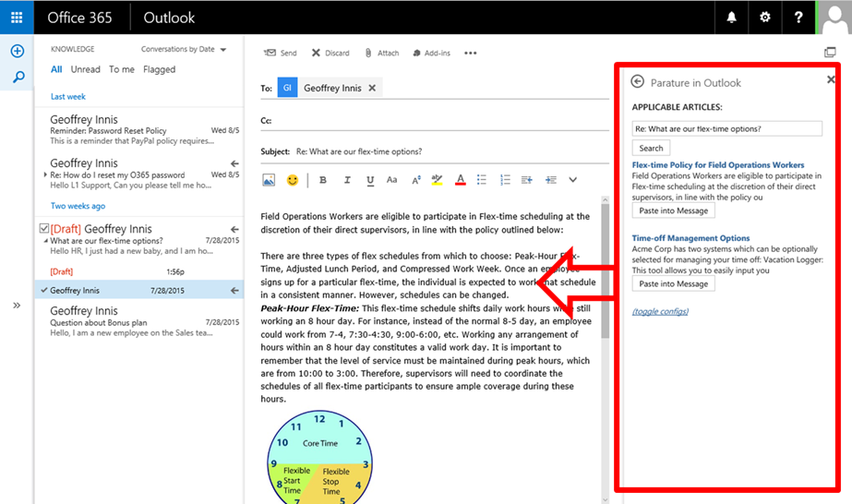
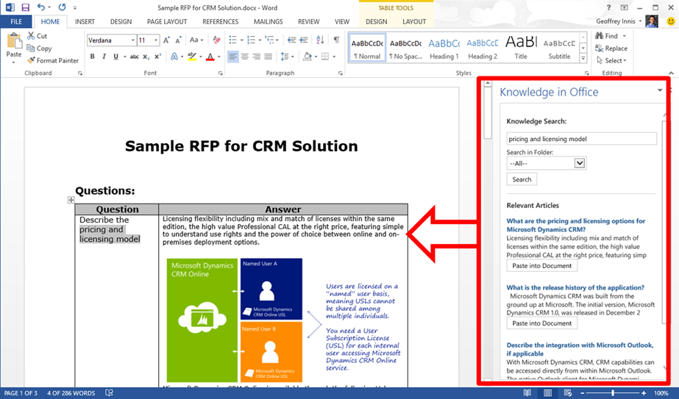
Contextual Knowledge in Office 365 - Outlook, Word
Integrate knowledge directly in your everyday productivity tools
Access articles while composing messages or documents
Fast and consistent responses without switching apps
Notes:
In addition, the Employee Self-Service knowledge platform, with integration, can provide the ability for organizations to render contextual knowledge right in the Office tools, such as Outlook and Word, without switching to a different application.

Slide 6
Employee Self-Service Solution
Platform
Baseline Project Effort
Underlying platform for Employee Self-Service is Parature at this time.
Future option to underpin ESS with CRM but no committed timeline at this point.
There is baseline project effort involved to implement self-service portal and integrate knowledge to Office tools.
Implementation and Support
Solution Accelerator
Microsoft partners will implement and support the portal and Office integration as project configuration/customization.
Microsoft will provide partners a solution accelerator (not product) for Outlook integration to Parature knowledge.
Solution Accelerator will not be provided directly to customers.
Notes:
In terms of the product and solution that make up Employee Self-Service, it is underpinned by Parature at this time. There will be an option, in the future, to underpin ESS with CRM.
It is also important to note that there is a project effort to implement Employee Self-Service, and our partners will implement and support the self-service portal and the integrations to various productivity tools and applications as appropriate for each customer.
In terms of integration to Office, Microsoft will provide a solution accelerator, not an out of the box product, for integration of knowledge to Outlook. It will be made available to partners only with some baseline functionality that can be further customized.

Slide 7
Employee Self-Service Pricing for December 2015
Increase employee engagement, powered by knowledge
Multi-Channel Service
Dynamics Employee Self-Service
Read knowledgebase articles
Chat with support teams
Submit support cases
Limited accounts & contacts rights
Access knowledgebase
Escalate support via chat and cases
Dynamics CRM Online Enterprise
Enterprise Case Management
Multi-channel Chat
Social Media Engagement
Knowledgebase Publisher
Create and analyze surveys
$3.00*
/user/month
$150
/user/month
* Requires one or more Dynamics CRM Online Enterprise users to configure and populate Knowledgebase
Notes:
There will be a dedicated SKU for Employee Self-Service to be launched in December 2015. In addition to per employee per month license fee noted here, the customer must have at least one Enterprise user to set up the knowledge base (administrator license if you will). Please note that the deployment does not need to be company wide or on O365 – that is just how we’ll sell it.

