Slide 1
Market Smarter Microsoft Dynamics Marketing 2016

Slide 2
Learning Objectives
Key capabilities
Six building blocks
Differentiators
Marketing Resource Management
Campaign Management
Integrated Marketing
SMS Marketing
What is it
Why is this exciting for marketers and our sellers
Notes:
What can you expect to takeaway from this session? Three things:
First, what are the six building blocks that constitute the key capabilities of Microsoft Dynamics Marketing.
Second, I will highlight the differentiators for Dynamics Marketing, and
Third, I will highlight new functionality, in particular the new SMS Marketing functionality that will become available in the upcoming release.
Because we have very limited time today, I will not walk you through the full BDM deck this time and I highly recommend you to watch again the recording of the blitz from this spring to get a good understanding of how the marketing landscape is changing and to get a deeper insight in our solution.

Slide 3
Session Agenda
Microsoft Dynamics Marketing key capabilities
What’s new: SMS Marketing
Key takeaways
Essential resources
Notes:
The agenda today follows the learning objectives:
Microsoft Dynamics Marketing key capabilities including differentiators, where and when we win
What’s new, highlighting SMS Marketing, followed by
Key takeaways, and
Essential resources

Slide 4
Microsoft Dynamics Marketing
Marketing Resource Management
Lead Management
Social Marketing
Multi-Channel Campaigns
Sales Collaboration
Marketing Intelligence
Notes:
KEY TAKE AWAY
Microsoft Dynamics Marketing key capabilities.
When I present our solution to customers and I have time for only one slide, this is the slide that I will show.
The slide expresses how our goal is to deliver a single marketing cloud for marketing organizations across marketing planning, execution and analytics – across all channels- including email, SMS, social or traditional.
Our solution, Microsoft Dynamics Marketing consists of six building blocks that can be used individually and in combination. I will not go into the details of these six blocks today but urge you to understand the needs and benefits of each of these blocks and how they differ for different customers. You need to understand these differences and the scenarios we can deliver for B2B versus B2C, large enterprises versus small and medium, and for different industries such as retail, manufacturing or services.
Let me however highlight what customers are typically looking for and what customers Dynamics Marketing is best suited for.
Marketing Resource Management customers: B2B and B2C customers of any size (small, medium, large enterprise), standalone and/or integrated with other marketing solutions.
Campaign Management customers: small and medium size B2B and B2C customers as well as divisions of large enterprises who are interested in a campaign management solution with a strong integration with Microsoft Dynamics CRM for lead management, nurturing, and analytics.
Integrated Marketing Management customers: mid-market customers are particularly interested in an integrated marketing solution including Marketing Resource Management, Campaign Management, Analytics, including integration with Microsoft Dynamics CRM for lead management, nurturing, and analytics.
While customer conversations usually start in only one or maybe two of our key capabilities, let me emphasize again that our goal is to deliver a single marketing cloud for marketing organizations across marketing planning, execution and analytics – across all channels- including email, SMS, social or traditional. The customer will get most value from our solution –and you have the highest chance of closing a new Dynamics Marketing deal- when we bring these key capabilities together. That’s why I will always highlight our Analytics and Reporting capabilities and walk through scenarios for sales collaboration and lead management. I will typically start a demo for example with showing Marketing Dashboards in PowerBI and I will share the ebooks about lead management we created in collaboration with SiriusDecisions.
Building block TALKING POINTS
Looking at planning, we deliver robust marketing resource management, where you can manage your marketing plan and budget across all channels and initiatives, including our new interactive marketing calendar. You can manage your marketing workflows and approvals across internal and external teams. And you can manage your digital marketing assets from a central repository.
From an execution perspective, we’ve got multi-channel campaigns – so you can build your top of funnel with multi-stage, multi-wave campaigns with our visual campaign designer, and you can personalize engagement based on customer segment and behavior.
We also have lead management, so you can score leads, based on demographics and behavior to pass only sales-ready leads to your sales team. And you can nurture leads with automated processes to foster interest and pull them through your marketing and sales funnel.
A key differentiator for us is Sales and Marketing collaboration. We break down the silos between sales and marketing by providing each sales rep unprecedented visibility into marketing activities at account and individual contact level with the ability to provide input into targeting of their key accounts.
Social marketing includes the breadth of understanding social sentiment and engaging on social channels, using social to amplify awareness and campaigns, as well as collaborating across internal and external teams
And marketing intelligence (analytics), which pulls it all together, with role-based, preconfigured, customizable dashboards so you can understand in-depth campaign performance and marketing impact and understand your marketing ROI.

Slide 5
Why Microsoft Dynamics Marketing
Integrated Marketing
Single cloud for end-to-end marketing planning, execution and analytics
Operational Excellence
Budgets, financials, plans, projects, campaigns, programs, assets, vendors, workflows and approvals
True Multichannel
Marketing across email, digital, social, SMS, events, and traditional
Sales & Marketing Collaboration
Break down silos with “outside-in” view of marketing
Notes:
KEY TAKEAWAY
Summarizing again the “why Dynamics Marketing” with this slide from the Dynamics Marketing BDM deck:
we deliver an integrated marketing cloud for marketing organizations across marketing planning, execution and analytics – across all channels- including email, SMS, social or traditional.
Our MRM –marketing resource management- delivers best in class functionality for operational excellence for B2B and B2C customers of any size (small, medium, large enterprise), standalone and/or integrated with other marketing solutions
We deliver true multichannel capabilities across email, social, SMS, events and traditional, and
We deliver unique sales and marketing collaboration with One Microsoft, including a strong integration with Microsoft Dynamics CRM for lead management, nurturing, and analytics.
These last two slides are part of a more complete BDM deck. Because we have very limited time today, I will not walk you through the full BDM deck this time and I highly recommend you to download the full updated deck AND to watch the recording of the blitz from this spring to get a good understanding of how the marketing landscape is changing and to get a deeper insight in our solution.
TALKING POINTS
What this means is that unlike other vendors who focus on only operational marketing or marketing execution, we offer a single cloud solution for all marketing functions integrated out of the box in a single solution.
Companies can use this framework to:
Budget and Plan their customer engagement strategy, determine the appropriate marketing mix and allocate resources to support
Design campaigns, offers, advertising, promotions, creative content and the customer experience
Execute on programs, campaigns, leads, branding and customer engagement strategy
Measure and optimize the marketing mix to better support the customer engagement strategy
What makes us different is that while it’s great to have this vision of an end-to-end integrated marketing management solution, you can start more focused and expand over time. Our solution for Marketing Operations, also called Marketing Resource Management, is world-class as testified by Gartner and SiriusDecisions. In the Gartner Magic Quadrant for MRM solutions, we are ranked the highest in the Challenger quadrant and SiriusDecisions positioned us as the only MRM vendor for mid-size companies.
Multi-channel campaign management offers a unique value in that it truly allows for creating campaigns across all channels, digital and traditional, including event management. This is different from some other vendors who address only digital marketing. While digital marketing is the fastest growing tactic and has the most visibility, please keep in mind that it counts for only about 15% of all marketing spent today.
Lastly, when it comes to sales and marketing collaboration, we offer a strong value proposition that no other vendor can match. I want to highlight four areas here:
Out of the box integration with Dynamics CRM; and this includes the integration on custom fields
Our lead scoring and nurturing capabilities are very much undervalued as they are market leading from a usability viewpoint and with the flexibility to accommodate different lead generation strategies and lead scoring models by product, segment, and campaign
We provide all CRM users with full visibility into the marketing calendar, with the ability to drill down to individual contacts and their interaction with the campaign, including the ability to block your contacts from being targeted by marketing. This is huge for a sales person.
CRM users can initiate a marketing workflow such as the creation of content and campaigns and track the progress. This is done through a portal and doesn’t consume any additional seats. This can be done by any CRM user but also any other user, even outside the company, such as agencies and contractors.

Slide 6
What’s new? SMS Marketing
Notes:
What’s new in the Microsoft Dynamics Marketing 2016 release (Autumn 2015):
With the autumn release, marketers can truly go mobile. As a modern mobile marketer, you can create powerful SMS campaigns as well as integrate SMS marketing in your multi channel campaigns. Come Autumn, MDM will support both outbound and inbound SMS marketing in select markets. This means ability to:
configure inbound SMS campaigns with SMS keywords to get SMS opt-ins
maintain a database of opt-in and opt-out preferences of your marketing contacts
send outgoing promotional SMSs to opted in contacts for SMS
tracking performance of your SMS campaigns
This capability truly stands out MDM in mobile marketing space and enhances its positioning as one of the best omni-channel integrated marketing management clouds for the modern marketer.
SMS marketing is initially released in the following markets: USA, Canada, UK, Singapore
Compete: included (Salesforce/ET) or not, third party (Marketo, ClickDimensions)

Slide 7
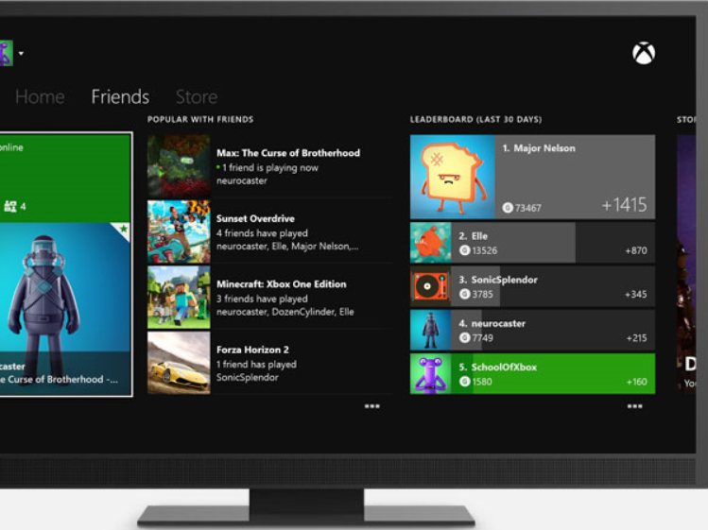
What is SMS Marketing?
SMS marketing (short message service marketing) is a technique that uses permission-based (“opt-in”) text messaging to spread promotional messages.
Subscribe to our ‘GOLD VIP’ text alerts today for early access to all the best deals in the XBOX Store.
A
B
Text GETGOLD to 45678
A
Opt-In Today and get 5% off your next purchase.
Up to 4 messages per month
Message and data rates apply
Text STOP to cancel anytime
Text HELP or call 1-800-123-4567 for support
Short code
The number 45678 in the example, to which the message is sent
Keyword
The string that invokes specific action (opt-in, opt-out, poll etc.) when sent to specified short code
A
B
Notes:
How does SMS text message Marketing work?
We like to answer this question with a quick scenario :
Step 1 – A person sees an add on TV, in an email, on a billboard, or in print that directs them to text a keyword to a 5-digit shortcode. For this example let’s use an XBOX store. The instructions on the ad you see here in the orange box says “Text GETGOLD to 45678” and “opt-in today and get 5% off your next purchase!” These instructions could be placed on a website, in an email, on a billboard, or anywhere else.
Step 2 – The person creates a text message on their phone. The “to” phone number will be 45678 and the message body will be “GETGOLD”
Step 3 – That message is received by Dynamics Marketing that stores the person’s phone number and immediately sends back a response, something like “Thank you for subscribing to GOLD VIP. Show this message to get 5% off your next purchase.”
Step 4 – At some point in the future the XBOX shop can log in to Dynamics Marketing and send a text message out to everyone who has subscribed. They could do this to announce new promotions or new services.
Similar to email marketing the goal of SMS marketing is to build a database of subscribers and then message them in the future with specials, promotions, news, etc. The software used to run text message marketing campaigns is integral part of Dynamics Marketing and very similar to an email program. In fact, in Dynamics Marketing you can create an multichannel program that includes both email, SMS, as well as other channels in one campaign.
_______________
Additional detail
SMS Marketing Best Practices
A couple important things to remember when starting and running a text message marketing campaign:
Always make sure messages sent to your subscriber database say “reply STOP to stop” (or something similar) at the end. Just like with email marketing it’s crucial that subscribers can remove themselves, or opt-out, from the list. Dynamics Marketing handles this automatically so they do not need to be removed by hand.
It’s a good idea to let subscribers know by entering a contest or texting in for something else they will be added to a marketing database. Adding some copy that says “By entering this contest you will signed up for our mobile club and receive no more than two messages per month” near the instructions is usually sufficient.

Slide 8
Why marketers and their customers like SMS Marketing
Averages & KPIs | Email | SMS | SMS Effectiveness**
Message open rate | 22%¹ | 99%¹ | 5x higher
User response time | 2.5 days² | 90 seconds² | 2,400x faster
Link ClickThrough rates* | 4.2%³ | 19%³ | 4x higher
Messages received by an individual each month | 1,216⁴ | 178⁴ | 7x less
Proportion that is spam | 90%¹ | 1%¹ | 90x less
Notes:
http://www.business2community.com/digital-marketing/sms-versus-email-marketing-0957139
http://www.smartinsights.com/mobile-marketing/sms-marketing-campaigns/
http://tweakyourbiz.com/marketing/2014/04/02/sms-vs-email-marketing-gloves/
http://technews.tmcnet.com/channels/textmessagingresource/articles/371821-text-messaging-might-be-best-marketing-vehicle-2014.htm
* CTR of messages delivered
** Numbers rounded whole
“SMS marketing has “staggering” response rates.” LinkedIn. https://www.linkedin.com/pulse/sms-marketing-has-staggering-response-rates-andrew-birmingham.

Slide 9
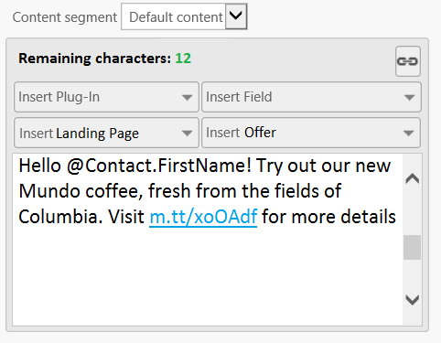
SMS Marketing in Dynamics Marketing
SMS Marketing campaign
Outgoing SMS sent to Marketing List(s)
SMS tile on Campaign Automation canvas
Tracking and reporting
Nurture
Customers respond
Response tracking and routing
SMS design
SMS delivery
Follow-ups
Notes:
With Outbound, very similar to an email blast, a marketing list can be used as part of an automated campaign in MDM, via the campaign canvas.
Again, important to call out, CANNOT SEND WITHOUT OPT-IN. So a typical use case would be, customer receives email with short code and keyword, opts in, and receives example communications part of that automated campaign.
I’ve added a more detailed walk through at the end of this deck for later review, also would recommend viewing the Fall Preview recording on Connect to learn more.

Slide 10
Key Takeaways
Understand Dynamics Marketing offering
Six building blocks
Understand when and where we win
Marketing Resource Management
Campaign Management
Integrated Marketing Management
Opportunity with new SMS Marketing
Opportunities for large deals
Differentiators: single vendor, single platform
Notes:
We have covered a lot in this session today. If there are 3 things I want you to take away from this session, they are:
SMS scenarios
USA based B2C
200,000 messages per month = 20 credit packages at $200 each = $4,000/mo
Dedicated short code $2,000/mo
TOTAL
$6,000 /mo
UK based B2C
50,000 messages per month at 8 credits/message = 40 credit packages at $200 each = $8,000/mo
Shared short code included
TOTAL
$8,000 /mo

Slide 11
Essential Resources
Marketing Assets
BDM Presentation
Datasheet
Test Drive
Videos and eBooks
Sales Assets
Sales Guide
Battlecard
//CRM – marketing on Infopedia
PartnerSource
Help & Training
Help & Training Portal
Yammer
Notes:
Here are some resources that you will find helpful. If all else fails, feel free to contact me on Yammer or by email.
Videos and ebooks: http://www.microsoft.com/en-us/dynamics/marketing-customer-center/videos-ebooks.aspx
Series of three eBooks in collaboration with SiriusDecisions
New product videos for each of the six building blocks can be found on the Dynamics Marketing website or on Youtube
Help & Training portal http://www.microsoft.com/en-us/dynamics/marketing-customer-center/default.aspx

