Slide 1
Microsoft Azure: Infrastructure as a Service (IaaS)

Slide 2
Module 3: IaaS VMs
Microsoft Azure VMs
Notes:
After this lesson, you will be able to:
Objective
Objective
Why should you learn this material?
<Insert a paragraph explaining why it is useful to learn this material.>
Recent rollout of IaaS capability in Microsoft Azure:
An expansion of the VM Role
Requirement of a more robust solution
The underlying concept is that the pVM is an on-ramp for Microsoft Azure, allowing applications such as SQL Server, SharePoint, and Active Directory (AD) to be run
[EDITOR] Gaiyasi:
Thursday, October 03, 2013 Does PVM stand for Parallel Virtual Machine?
[EDITOR] Biju
08 October 2013 Kindly validate the edits.

Slide 3
Active Directory, BitLocker, BizTalk, DirectX, Hyper-V, Internet Explorer, Microsoft, Outlook, Server logo, SharePoint, SkyDrive, SQL Server, Windows, Microsoft Azure, Windows Intune, Windows PowerShell, Windows Server, Windows Vista, Xbox 360 and Zune are either registered trademarks or trademarks of Microsoft Corporation in the United States and/or other countries. Other Microsoft products mentioned herein may be either registered trademarks or trademarks of Microsoft Corporation in the United States and/or other countries. All other trademarks are property of their respective owners.

Slide 4
How to View This Presentation
Switch to Notes Page view:
Click View on the ribbon and select Notes Page
Use page up or page down to navigate
Zoom in or out as needed
In the Notes Page view you can:
Read any supporting text, now or after the delivery
Add your own notes
Take the presentation files home with you

Slide 5
Introduction and Logistics
Your trainer
You
Your role
Your company
Your experience in this technology area
Your goals for this workshop
Start and end times
Facilities (bathrooms, smoking)
Meals
Computers, phones, tablets, etc.
Please set to vibrate
What’s on your desk?

Slide 6
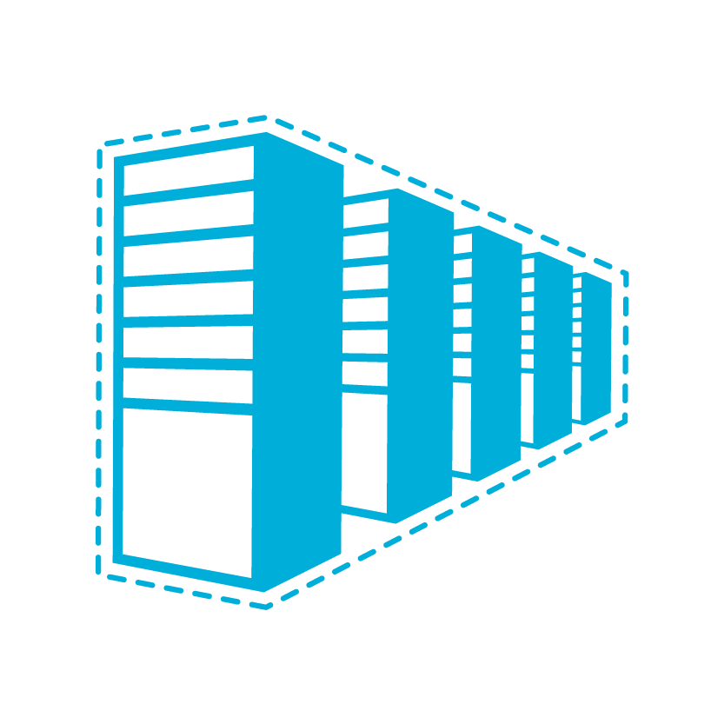
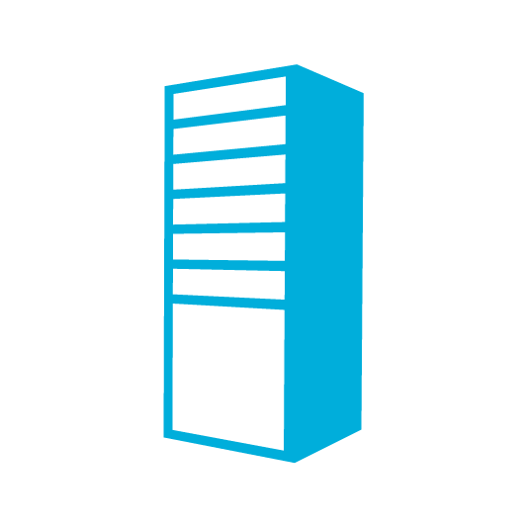
A Continuous Offering from Private to Public Cloud
Physical
Virtual
IaaS
PaaS
SaaS
Notes:
If you visualize a spectrum consisting of the components that we are currently hosting on-premises and in the cloud, we would start with physical on the far left, and move to Software as a Service (SaaS) on the far right. Infrastructure as a Service (IaaS) sits in the middle of this spectrum, and offers a set of products that offer IaaS.
With Platform as a Service (PaaS),that is to say. in which we have been implementing and deploying, has been used by developers
With IaaS, the approach is more for IT Pros, since it involves extensive use of PowerShell
Includes support for key server applications
Whether you want to provision an image and build off it, or
If you want to create your own image from Hyper-V
[EDITOR] Biju
08 October 2013 Kindly validate the change.

Slide 7
Overview
Support for key server applications
Easy storage manageability: Page blob
High availability features
Advanced networking
Integration with compute Platform as a Service (PaaS)
Notes:
Microsoft Azure Virtual Machines is a new addition to IaaS provided by Microsoft Azure. What is on offer is an easier and flexible solution for:
Quickly moving an existing workload from on-premises to the cloud
or
Building new applications that have dependencies on applications that will only run on a server with persistent local storage
That storage is easily managed in Microsoft Azure, as it is stored as a page blob in Microsoft Azure storage, which is a familiar concept that has been around since the early days of Microsoft Azure. All storage is in your storage account — all in the same place.
Virtual Machines are highly available since we offer redundancy for hardware, both on and off the rack, and in separate geo-replicated data centers
The Microsoft Azure IaaS platform comes with advanced networking features that allow for communication both between instances within Microsoft Azure, and the use of Microsoft Azure as an extension of on-premises hardware
In addition, Virtual Machines integrates well with compute PaaS, which will be discussed in-depth later in this presentation

Slide 8
IaaS Workloads: All About the App
Line of Business (LoB) applications:
Custom applications
Customer Relationship Management (CRM)
Content Management Server (CMS)
Enterprise Resource Planning (ERP)
Business Intelligence (BI)
Application Infrastructure:
File servers
Databases
Identity
Source control
Developer, Testing and Staging environments:
Quickly provision and un-provision entire environments
Hybrid applications:
Applications that span your data center and the cloud
Notes:
Usually, one of the first questions from customers is:
What kind of apps can I put in a Microsoft Azure Virtual Machine?
This slide discusses that topic.
Of course, a customer’s scenario may be a little different and will require individual attention to ensure that there are no issues, but the whole point of IaaS is to be able to put any application that runs on the Windows Platform into a Virtual Machine (VM). In addition, we have support for Linux (discussed later).

Slide 9
Provisioning to the Cloud
Getting Started
Select Image and VM Size
New Disk Persisted in Storage
Windows Server
Boot VM from New Disk
Management Portal(s)
Linux
>_
A0 – A11
Scripting
(Windows, Linux and Mac)
Blob Storage
D1 – D4/D11 – D14
G1 – G5
Azure Resource Manager (ARM)
Cloud
REST API
Notes:
Slide Objective
Explain the workflow for provisioning VMs in the cloud.
Notes
Cloud First Provisioning means exactly what it says—building a VM in the cloud first.
There are three methods of starting this process. Build a VM from:
The portal
Command line
Programmatically calling the Representational State Transfer Application Programming Interface (REST API)
Once you choose your provisioning method, select the image and instance size to start.
ARM - http://blogs.msdn.com/b/scicoria/archive/2015/02/12/azure-resource-manager-creating-an-iaas-vm-within-a-vnet.aspx
The new disk will be stored in blob storage and your machine will boot.

Slide 10
Supported Windows Server Applications
Microsoft BizTalk Server - Microsoft BizTalk Server 2013 and later versions
Microsoft Dynamics AX - Microsoft Dynamics AX 2012 R3 and future updates
Microsoft Dynamics GP - Microsoft Dynamics GP 2013 and later versions
Microsoft Dynamics NAV - Microsoft Dynamics NAV 2013 and later versions
Microsoft Forefront Identity Manager - Microsoft Forefront Identity Manager 2010 R2 SP1 and later versions
Microsoft HPC Pack - Microsoft HPC Pack 2012 and later versions
Microsoft Project Server - Microsoft Project Server 2013 and later versions
Microsoft SharePoint Server - Microsoft SharePoint Server 2010 and later versions are supported on Windows Azure Virtual Machines.
Microsoft SQL Server - 64-bit versions of Microsoft SQL Server 2008 and later versions
Microsoft System Center - Microsoft System Center 2012 SP1 and later versions are supported for the following applications:
•App Controller
•Configuration Manager
•Endpoint Protection
•Operations Manager
•Orchestrator
•Server Application Virtualization
•Service Manager
Microsoft Team Foundation Server 2012 and later versions
Microsoft Exchange
For the most up to date list : http://support.microsoft.com/kb/2721672
http://support.microsoft.com/kb/2721672
Notes:
http://support.microsoft.com/kb/2721672
Windows Server
Windows Server 2008 R2 and later versions are supported for the following roles:
AD Domain Services
AD Federation Services
AD Lightweight Directory Services
Application Server
DNS Server
Fax Server
Network Policy and Access Services
Print and Document Services
Web Server (that is to say., Internet Information Services - IIS)
Windows Deployment Services
Windows Server Update Services
File Services
[EDITOR] Biju
08 October 2013 Kindly list the versions as MS Style prohibits “or later” expressions.

Slide 11
Linux on Microsoft Azure
Supported Versions:
SUSE SLES 11 Service Pack 3+ (SP3)
openSUSE 13.1+, 13.2
CentOS 6.5, 6.6, 7.0+ by OpenLogic*
Ubuntu Server 12.04.1+,14.04, 14.10, 15.04, 15.10
Oracle Linux 6.4+, 7.0
Specific versions are endorsed:
Integration Components
Testing and validation by partners
Bring other variants at your own risk**
*Image provided by OpenLogic based on CentOS 6.5 – 7.1
**Interoperation work will be Required
Notes:
Change in
M 02-IaaS - VirtualMachines.pptx, Slide 11
Slide Objectives
Provide an understanding of which distributions of Linux are offered in the Microsoft Azure
Speaker Notes
On this page you will find the details about the support we provide for Linux images:
http://support.microsoft.com/kb/2941892/en-us
http://azure.microsoft.com/en-us/documentation/articles/virtual-machines-linux-endorsed-distributions/
VM images of these distributions are provided by partners who are experts in each distribution
Other distributions of Linux can be installed as Bring-Your-Own-Linux. However, some interoperation work will be needed
VMDepot (The virtual machine images on this site are provided and licensed to you by community members. Microsoft Open Technologies does not screen these images for security, compatibility or performance, and does not provide any license rights or support for them.): http://vmdepot.msopentech.com/List/Index

Slide 12
What about Red Hat?
11/4/2015 – new announcement on partnership between Red Hat and Microsoft. http://news.microsoft.com/2015/11/04/microsoft-and-red-hat-to-deliver-new-standard-for-enterprise-cloud-experiences/
Landing site https://azure.microsoft.com/en-us/campaigns/redhat/

Slide 13
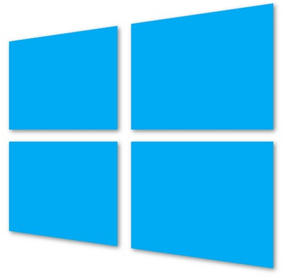
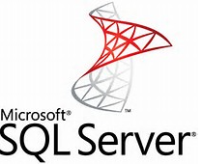
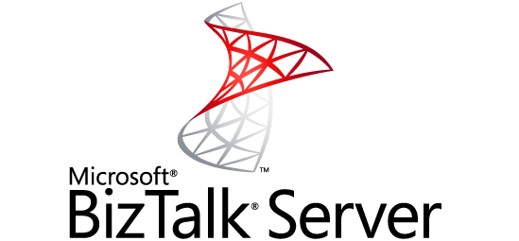
Gallery Images Available
Microsoft
Windows Server 2008 R2
SQL Server 2012 - 2014
Windows Server 2012
BizTalk Server 2013
SharePoint 2013 (trial)
Open Source
OpenSUSE 13.1
CentOS 6.5
Ubuntu 12.04/ Ubuntu 14.04 LTS
SUSE Linux Enterprise Server 11 SP2
Oracle
Version 11g and 12c
Notes:
Partners provide images; more will probably be available.
Note: None of these images have .NET 4.5 on them. However, there are workarounds to install this via startup tasks.
[EDITOR] Biju
08 October 2013 Seems ambiguous. Kindly clarify.

Slide 14
Server Roles that are Not Supported
Server Role
Hyper-V
Windows Deployment Services
Remote Access (Direct Access, Routing)
Rights Management Services
http://support.microsoft.com/kb/2721672
Notes:
http://support.microsoft.com/kb/2721672
Every on-premises network/machine configuration is not supported in Microsoft Azure.
Hyper-V: It makes no sense to have Hyper-V capability on a machine that is hyper-vised in Microsoft Azure, so this is not supported
Dynamic Host Configuration Protocol (DHCP)/Network Load Balancing (NLB): Both of these use broadcasting to work, which is very difficult to implement in any cloud (including competitors)
Failover Clustering: Requires a floating IP, but Microsoft Azure assigns a specific IP
BitLocker encryption: Requires Trusted Platform Module (TPM) chip compatibility and the Microsoft Azure commodity machines do not have this. You can currently enable bitlocker on a data disk though
Client Operating System (OS): We support on server operating systems at this point. In addition, the client OS license does not transfer to the cloud
[EDITOR] Biju:
08 October 2013 “Hypervisor” is being used in verb form here. Kindly replace with the appropriate word. For example, “hypervisor enabled”
[EDITOR] TWB_Trevor:
08 October 2013 This claim needs to be validated or the expression “including competitors” can be removed.
[EDITOR] Biju
08 October 2013 Should this be “ We support Microsoft Azure on server….”
[EDITOR] TWB_Trevor:
08 October 2013 Has “Virtual Desktop Services” intentionally not been explained?

Slide 15
Server Features that are not Supported
Server Feature
BitLocker Drive Encryption (C: Drive only)
Internet Storage Name Server
Multipath I/O
Network Load Balancing
Peer Name Resolution Protocol
SNMP Services
Storage Manager for SANs
Windows Internet Name Service
Wireless LAN Service
Notes:
http://support.microsoft.com/kb/2721672
[EDITOR] Biju:
08 October 2013 “Hypervisor” is being used in verb form here. Kindly replace with the appropriate word. For example, “hypervisor enabled”
[EDITOR] TWB_Trevor:
08 October 2013 This claim needs to be validated or the expression “including competitors” can be removed.
[EDITOR] Biju
08 October 2013 Should this be “ We support Microsoft Azure on server….”
[EDITOR] TWB_Trevor:
08 October 2013 Has “Virtual Desktop Services” intentionally not been explained?

Slide 16
Demo: Getting Started with VMs
Notes:
Use the demo steps listed in the Demos\IaaS folder.
[EDITOR] Biju
08 October 2013 Kindly provide the document name.

Slide 17
Module 3: IaaS VMs
VMs and Cloud Services (Classic)

Slide 18
IaaS Virtual Machines
VMs are roles with exactly one instance
Implicit Cloud Service
VM
Virtual
Machine
Notes:
The cloud service also acts as a container for VMs. With VMs, the production slot is the only one in use.

Slide 19
Cloud Services with VMs
Multiple VMs can be hosted within the same cloud service*
Need to manage firewalls
Current limit = 50 VMs per Cloud Service
Cloud Service
VM
VM
VM
VM
Notes:
VMs within the same cloud service have direct connectivity with each other. You do not have to configure internal endpoints through the service model because VMs default to allow all traffic on all ports between VMs. That does not mean that traffic will flow though. In IaaS, you will still have to manage the firewalls on your VMs to allow traffic between servers.
Service and subscription limits: http://azure.microsoft.com/en-us/documentation/articles/azure-subscription-service-limits/
For more information, see: http://blogs.msdn.com/b/jnak/archive/2010/01/22/windows-azure-instances-storage-limits.aspx
[EDITOR] TWB_Trevor:
08 October 2013 According to MSStyle, “hosted service” should not be used and “cloud service” should be used instead. Can the replacement be made here or is the context different?
Please note that if the term is changed here, it needs to be changed across the PPT.

Slide 20
Multiple Cloud Services Configuration
LB
WEB
AD/DC/DNS
SQL
AD 1
Cloud Service 2
80/443
VPN Tunnel
Corp Users
Cloud Service 1
Microsoft Azure
On-premises

Slide 21
Module 3: IaaS VMs
VM and Resource Groups (V2)

Slide 22
Reminder…Azure Resource Manager provides (IaaS V2)…
A Resource Group is a Unit of Management
Application Lifecycle Containment – Deployment, update, delete and status
Declarative solution for Deployment – “Config as Code”
Grouping – Metering, billing, quote: applied and rolled up to the group
Consistent Management Layer
Access Control – Scope for RBAC permissions
Notes:
Slide Objectives
Notes
Application Lifecycle Containment – You can deploy everything included in a resource group together, thereby maintaining versions of an application along with it’s resources.
Declarative Solution – RG’s are .json, declarative/configuration code
Consistent Management Layer – In the portal https://portal.azure.com, everything is controlled in a RG. RGs can be accessed via REST APIs and resource providers
[EDITOR] TWB_Trevor:
09 October 2013 It seems odd to use “finally” here, given that this is not a long process – or, at least, has not been described in great detail. Kindly consider removing it, or replacing it with something that clarifies context.

Slide 23
Azure Resource Groups
Tightly coupled containers of multiple resources of similar or different types
Resource groups can span regions
Every resource *must* exist in one and only one resource group
RESOU
R
CE G
R
OUP
Notes:
Resource Groups
When resources are in the container, they have a common lifecyle. You can deploy these things together, put RBAC on them together with one request and they can know about each other
Every resource must be in ONE resource group, important for RBAC
Don’t have to live in same location, can deploy to multiple regions
Resources can be heterogenous or homogenous

Slide 24
Resource Group logical view
Resource Group
Backend Pool (NICs)
Storage Account
VM
NIC
VM IP Address
VNet
Load Balancer
LB IP Address
Subnet
Disk (blob)
DependsOn
Network Security Group ACLS
(deployed to VM, NIC, or Subnet)
Notes:
A Resource group contains all resources that belong to the group.

Slide 25
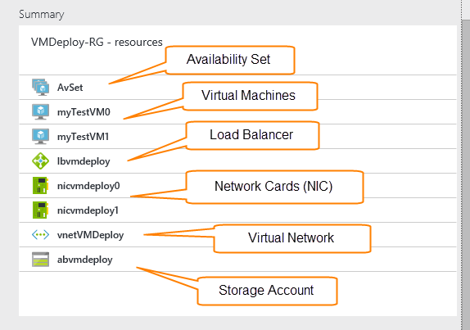
Portal View of Resource Group
Notes:
This is a physical view of a resource group in the portal https://portal.azure.com.

Slide 26
Resource Group Key Points
A resource can only be IN one resource group
You CAN share resources in a resource group with other resource groups, ie, such as a storage account
Virtual machines in a resource group MUST be in a virtual network and MUST be in a subnet which by default has a network security group (NSG)
V2 virtual machines can only be placed in V2 storage accounts
Load balancers must be created either via ARM or PowerShell, it cannot be done in the portal

Slide 27
Demo: Resource Groups
Notes:
Look at current portal first – this is a singleton
Show the different pieces of the current portal, show how hard it is to find things
Log in to portal https://portal.azure.com
Need website + SQL database that already exists in a resource group
Browse, show blades, resource groups
Click on resource/application
Show overall containerization of resource group (note bugs may be present)
Show monitoring, billing
Show alert rules (don’t create one, just show one that exists)
Go to Home screen and show how to customize tiles
Discuss Templates
Show the gallery in the portal https://portal.azure.com. The gallery is just where you click on either the New button or Everything to show the list of things that can be created.
New portal is run entirely with ARM and some things are not available
Deploy a new web app
Chose new ASP.Net starter site
Create
Name it
Set hosting plan
Put the hosting inside a new resource group
Also show Virtual Machine gallery images – VM templates – including Linux
Show the deployed website and explain the deployment

Slide 28
Module 3: IaaS VMs
VM Availability

Slide 29
Service Level Agreements (SLA)
For Cloud Services, we guarantee that when you deploy two or more role instances in different fault and upgrade domains, your Internet facing roles will have external connectivity at least 99.95% of the time.
For all Internet facing Virtual Machines that have two or more instances deployed in the same Availability Set, we guarantee you will have external connectivity at least 99.95% of the time.
For Virtual Network, we guarantee a 99.9% Virtual Network Gateway availability.
"NO SLA" under the single instance
Notes:
Slide Objectives
You need an Availability Set (AS) for a 99.95% Service Level Agreement (SLA).
Speaker Notes
Microsoft will provide at least 90 days' notice for adverse material changes to any of the SLAs listed above (content from: http://azure.microsoft.com/en-us/support/legal/sla/).
A cloud service must have at least two instances of every role to qualify for the Azure Service Level Agreement, which guarantees external connectivity to your Internet-facing roles at least 99.95 percent of the time. With at least two VMs performing the same workload grouped into an Availability Set, you get a 99.95% SLA.
More information:
It's better to report the SLA per month as the billing cycle is monthly based which is 20 minutes / month per VM
http://azure.microsoft.com/en-us/support/legal/sla/
No SLA for single VM see:
https://tr19.techreadytv.com/sessions/AZR326.aspx

Slide 30
Fault and Update Domains
Fault domains:
Represent groups of resources anticipated to fail together, i.e. same rack, same server
Fabric spreads instances across fault at least two fault domains
The number of fault domains is controlled by the Azure Fabric
Anticipated to fail together: share power source and network switch
IaaS V2 – 3 fault domains by default
Update domains:
Represents groups of resources that will be updated together
Host OS updates honor service update domains
Specified in service definition
Default of five (up to 5)
IaaS V2 – more than 5 update domains
Fabric spreads role instances across update domains and fault domains
Notes:
Slide Objective
Discuss achieving very high availability with Microsoft Azure
Notes
To achieve high availability and fault tolerance, we have adopted fault and upgrade domains for deploying and upgrading applications. A fault domain is essentially a single point of failure. Thus, a rack of hardware in a data center can be a fault domain, since a power outage of the rack will take out the collection of hardware. Under this assumption, Microsoft Azure deploys role instances of an application into at least two fault domains be default, which ensures fault tolerance.
When possible, Microsoft Azure distributes role instances of an application evenly into multiple update domains, with each update domain as a logical unit of the application’s deployment. This means that host updates honor those update domains, ensuring the least possible impact to the running service. You can control many update domains using an attribute in the service definition.
Points to Remember
A fault domain is a physical unit of failure, and is closely related to the physical infrastructure in the data centers
In Microsoft Azure, the rack can be considered a fault domain. However, there is no 1:1 mapping between fault domain and rack
Microsoft Azure is responsible for deploying the instances of your application in different fault domains
This only applies if you run more than one instance
Now, Microsoft Azure ensures that your application uses at least two fault domains. However, depending on capacity and VM availability, your application may be spread across more than two fault domains
As a developer, you have no direct control over how many fault domains your application will use, but the way you configure it may impact your availability
You can have up to 5 Update domains. Cannot adjust past this.
[EDITOR] TWB_Trevor:
08 October 2013 Microsoft Azure Fabric was changed to just “Microsoft Azure” because MSStyle recommends that “fabric” be used sparingly in customer-facing content.
In other slides/notes pages of this PPT, Fabric has been changed to “Microsoft Azure” as applicable to the context. Where the context was not clear, a comment has been added.

Slide 31
VM Availability Sets
Update domains are honored by host OS updates
Fault Domain
Fault Domain
Rack
Rack
VM
VM
Availability Set
IIS1
IIS2
UD #1
UD #2
Availability Set
VM
VM
SQL1
SQL2
UD #1
UD #2
Notes:
Slide Objective
Explain Availability Sets
Notes
Availability Sets tell the Fabric Controller (FC) to place VMs in the same set on different racks for faults and in separate upgrade domains for updates.
This essentially tells the FC not to take down the guest OS of all VMs in the same set for host updates.
When you first come into the slide, you will see four separate VMs.
<Click> the VMs with IIS (1 and 2) are grouped into an AS. It is up to you to find out how these machines are grouped
<Click><Click>, as in the previous slide, it shows machines being separated into fault domains even though they may belong to a different AS
<Click><Click>, shows how the machines within an AS are separated within update domains
[EDITOR] TWB_Trevor:
08 October 2013 This was originally “take the guest OS down”. Kindly confirm that the edit has not affected technical accuracy.

Slide 32
How Does this Relate to the SLA?
Availability Set
VM
VM
VM
No SLA*
SLA 99.95
* No guaranteed SLA for single VM instance
Notes:
How does this relate to the SLA?
We have something new now called Availability Sets, which are similar to fault domains. You can specify VMs together, running in an AS and be able to realize a 99.95 SLA around that. When you are provisioning VMs; you will see that you can group them together in Availability Sets.
The figure on the slide does not represent SQL Clustering (currently not available in Microsoft Azure), it represents what may be a failover setup, mirroring etc.
[EDITOR] TWB_Trevor:
08 October 2013 Should “SQL Clustering” be changed to “SQL Server clustering”? Note that the image on the slide shows instances of SQL Server.
[EDITOR] Biju
08 October 2013
Does this feature qualify to be termed new as per LCA guidelines. Kindly refer http://lcaweb/marketing/contentguide/Pages/RedFlag.aspx

Slide 33
End-to-End Highly Available Solution
Redundancy at every level
SQL-AVSET
SQL
Server
IIS Web Application
IIS-AVSET
Internet
Web VM
SQL Mirroring
LB
IIS Web Application
Web VM
SQL
Server
Notes:
The slide represents high availability in terms of:
Having multiple web roles in an IIS application but having it load balanced by Microsoft Azure
AS for the SQL Servers. Notice that this is not load balanced because we can only point to one (no SQL Clustering)
[EDITOR] TWB_Trevor:
08 October 2013 Should “SQL Clustering” be changed to “SQL Server clustering”? Note that the image on the slide shows instances of SQL Server.

Slide 34
Module 3: IaaS VMs
Understanding Disks

Slide 35
VM Disk Layout – Windows OS
OS Disk
Persistent
SATA
Drive C:
* Max. size of C:\ drive – 1,023GB
Notes:
Maximum size of C:\ drive is 1023 GB

Slide 36
VM Disk Layout – Windows OS (continued)
Temporary Storage Disk
Local (Not Persistent)
SATA
Drive D:

Slide 37
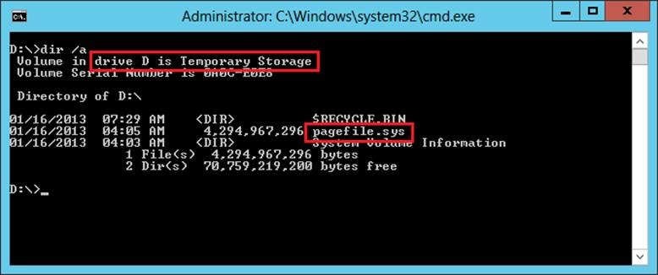
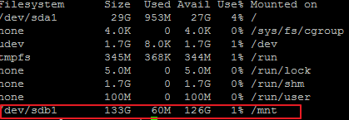
VM Disk Layout – Linux (continued)
Temporary Storage Disk
Local (Not Persistent)
SATA
Drive D:
Windows:
Linux:
Notes:
Change in
M 02-IaaS - VirtualMachines.pptx, Slide 16 (as we have more and more customers with Linux it could be interesting to show, how it looks like in Linux)
Slide Objectives
Explain Temporary Storage Disk in Azure for Windows and Linux
Speaker Notes
The D drive is a temporary disk running on the local host machine. This disk is not fault tolerant and is non-persistent. If a hardware failure occurs you will lose this disk.
Don’t store data on the temporary disk. This disk provides temporary storage for applications and processes and is used to store data that you don’t need to keep, such as page or swap files. To remap this disk for a Windows VM, see Change the drive letter of the Windows temporary disk. (http://azure.microsoft.com/en-us/documentation/articles/virtual-machines-windows-change-drive-letter/)
In any linux distribution on Microsoft Azure, the sdb1 will be the temporary drive to be mounted. The mount point and directory mounted might be different between linux distribution .
On Windows the pagefile will be stored on the temporary disk. On Linux the /dev/shm uses the swap file on /mnt/resources to do what on windows would be the pagefile.sys.
For more inforamtion see: http://blogs.msdn.com/b/wats/archive/2013/12/07/understanding-the-temporary-drive-on-windows-azure-virtual-machines.aspx

Slide 38
VM Disk Layout – Windows OS(continued)
Data Disk(s)
Persistent
SCSI
Customer-defined Letter

Slide 39
Persistent Disk Management – Windows OS
C:\ = OS Disk
D:\ = Non-Persistent Cache Disk
E:\, F:\. G:\ and all subsequent Data Disks—you will need to attach and format them
Capability | OS Disk | Data Disk
Host Cache Default | ReadWrite | None
Max Capacity | 1023 GB | 1 TB
Imaging Capable | Yes | No
Hot Update | Cache Setting requires a reboot | Change Cache without reboot, Add/Remove without reboot
Notes:
Persistent Disk Management
The OS Ddisk is up to 127 GB and the data disk is 1TB
The D:\ drive is for non-persistent cache
The C:\ drive is the OS disk
E:\ and all subsequent drive letters represent data disks
[EDITOR] TWB_Trevor:
08 October 2013 Kindly validate the edit
[EDITOR] TWB_Trevor:
08 October 2013 Is this supposed to be “Ddisk” or just “disk”?

Slide 40
Disk Caching – Windows OS
Modify using the Set-AzureOSDisk or the Set-AzureDataDisk cmdlets
Supported Cache Modes:
Disk Type | Read Only | Read Write | None
OS Disk | Supported | Default | Not Supported
Data Disks | Supported | Supported | Default
Temporary Disk | Not stored in Microsoft Azure Storage Blob Service
Notes:
Slide Objectives
Explain Disk Caching
Speaker Notes
Data Disks can have caching enabled on up to four disks.
Virtual Machine Disk Cache Preferences
Disk cache can be configured as Read only, Read Write or None (disabled).
· Read Only: Reads and writes are cached for future reads. All writes are persisted directly to the Microsoft Azure Storage Blob service.
· Read Write: Reads and writes are cached for future reads. Regular writes are persisted to the local cache. If Write-through, Forced Unit Access (FUA) or flush is asserted, the write will commit directly to the Microsoft Azure Storage Blob service.
· None (disabled): Bypasses cache completely. All disk transfers are completed against the Microsoft Azure Storage blob service.
Cache performance behavior
When host caching is enabled, all disk requests that result in a cache hit will be completed from the local host cache. The performance for all cache hits is ultimately limited by the physical host local hard disk performance.
In scenarios where the physical host’s hard disks are not saturated (still have some idle capacity), enabling host caching is likely to help reduce disk I/O latency. After the point of saturation is reached, new requests will have to be queued inside the host and wait for processing, causing latency to grow with the size of the resulting disk queue.
Testing shows that enabling Read Write cache for the OS disk helps improve overall operating system performance and boot times. This is the default setting for the OS disk.
For data disks, the performance benefit of host caching will depend on the pattern and intensity of the disk workload that is being generated. The general guideline is to leave host caching set to the default of None (disabled), because this bypasses the physical host local disks, thus being capable of providing the largest I/O rate.
General best practices to configure the cache
· Read Only – Applications that may not assert Write-through, Forced Unit Access (FUA) or flush correctly. Requires all writes to be persisted to Microsoft Azure Storage to prevent data loss or data corruption while still enabling read cache.
· Read Write – Offers the lowest disk latency for light workloads. Recommended for the OS disk and for data disks with sporadic disk access. Total workload should not frequently exceed the performance of the physical host local hard drives.
· None (disabled) – Bypasses the local cache completely. This will prevent the physical host local hard drives from becoming a bottleneck. Offers the best performance for I/O intensive workloads.

Slide 41
VM Sizes – Basic and Standard Tier
Each persistent data disk can be up to 1 terabyte (TB)
Typically, two data disks per available core
Tiers
Basic – no load balancing, auto-scaling or memory intensive models – best for dev/test scenarios – A0 – A4
Standard – full capabilities vs. Basic tier – A0 – A11
VM Size | CPU Cores | Memory | # of Data Disks
A0 | Shared | 768 MB | 1
A1 | 1 | 1.75 GB | 2
A2 | 2 | 3.5 GB | 4
A3 | 4 | 7 GB | 8
A4 | 8 | 14 GB | 16
A5 | 2 | 14 GB | 4
A6 | 4 | 14 GB | 16
A7 | 8 | 56GB | 16
A8 | 8 | 56GB | 16
A9 | 16 | 112GB | 16
A10 | 8 | 56GB | 16
A11 | 16 | 112GB | 16
Notes:
VM Sizes
http://msdn.microsoft.com/en-us/library/azure/dn197896.aspx
Sizes are available from extra small to extra large
Able to attach up to 16 TB to an XL VM, which can get up to 16 TB
That provides an option to scale to much larger databases using SQL Server in a VM.
Also describe the two tiers, best to use Basic tier for test environments
[EDITOR] Gaiyasi:
Thursday, October 03, 2013 Please confirm if this should be changed to “extra large”.
[EDITOR] TWB_Trevor:
08 October 2013 Kindly validate the edit
[EDITOR] Biju:
08 October 2013 Can this be written as ” Able to attach up to 16 TB to an XL VM, providing an additional capacity of 16 TB.”

Slide 42
Compute Intensive – A Series VMs
Hardware designed and optimized for compute and network intensive apps like HPC
Supported for Windows and Linux
A8 – A9 Ideal for MPI applications
A10 – A11 – Ideal for HPC parametric or embarrassingly parallel applications
VM Size | CPU | CPU Cores | Memory | # of Data Disks | # Network Adapters
A8 | Intel® Xeon® E5-2670 8 cores @ 2.6 GHz | 8 | 56GB | 16 | 2
A9 | Intel® Xeon® E5-2670 16 cores @ 2.6 GHz | 16 | 112GB | 16 | 2
A10 | Intel® Xeon® E5-2670 8 cores @ 2.6 GHz | 8 | 56GB | 16 | 1
A11 | Intel® Xeon® E5-2670 16 cores @ 2.6 GHz | 16 | 112GB | 16 | 1
Notes:
https://msdn.microsoft.com/library/azure/dn689095.aspx

Slide 43
Use cases for D-Series VMs
Workloads that replicate across multiple instances – ex. MongoDB
High I/O local and temporary cache
SQL Server 2014 Buffer Pool Extensions
The CPU cores are 60% faster in D series than A series, so for CPU bound workloads this could result in needing fewer cores to do the same work, and thus reduce cost
Data intensive type applications – Big Data and BI
Remember: The temporary, or D:\ drive on the VMs can lose the data if the physical disk failure occurs. This SSD drive replaces the previously know scratch D:\ drive

Slide 44
VM Sizes – D Series Standard Tier
Compute processers approx. 60% faster than A-Series Standard
Up to 800GB of local SSD Drive space
Local Drive is a temporary Drive!!
General Purpose
High Memory
Name | vCores | Memory (GB) | Local SSD (GB)
D1 | 1 | 3.5 | 50
D2 | 2 | 7 | 100
D3 | 4 | 14 | 200
D4 | 8 | 28 | 400
Name | vCores | Memory (GB) | Local SSD (GB)
D11 | 2 | 14 | 100
D12 | 4 | 28 | 200
D13 | 8 | 56 | 400
D14 | 16 | 112 | 800
Notes:
Link to more information
http://azure.microsoft.com/blog/2014/09/22/new-d-series-virtual-machine-sizes/
[EDITOR] Gaiyasi:
Thursday, October 03, 2013 Please confirm if this should be changed to “extra large”.
[EDITOR] TWB_Trevor:
08 October 2013 Kindly validate the edit
[EDITOR] Biju:
08 October 2013 Can this be written as ” Able to attach up to 16 TB to an XL VM, providing an additional capacity of 16 TB.”

Slide 45
VM Sizes – DS Series Standard Tier
DS-series and GS-series VMs can use Premium Storage
These VMs use solid-state drives (SSDs) to host a virtual machine’s disks and also provide a local SSD disk cache
Premium Storage is available in certain regions
Name | vCores | Memory (GB) | Max. Disk IOPS IOPS/MB sec
Standard_DS1 | 1 | 3.5 | 3200/32
Standard_DS2 | 2 | 7 | 6400/64
Standard_DS3 | 4 | 14 | 12800/128
Standard_DS4 | 8 | 28 | 25600/256
Name | vCores | Memory (GB) | Max. Disk IOPS IOPS/MB sec
Standard_DS11 | 2 | 14 | 6400/64
Standard_DS12 | 4 | 28 | 12800/128
Standard_DS13 | 8 | 56 | 25600/256
Standard_DS14 | 16 | 112 | 50000/512

Slide 46
VM Sizes – G Series
More memory and Solid State Drive (SSD) drives
Intel Xeon processor E5 v3 processor - Up to 800GB of local SSD Drive space
Used for applications and parallel processing that require increased computing power
General Purpose
Name | vCores | Memory (GB) | Local SSD (GB) | Persistent Data Disks Max
Standard_G1 | 2 | 28 | 412 | 4
Standard_G2 | 4 | 56 | 824 | 8
Standard_G3 | 8 | 112 | 1,649 | 16
Standard_G4 | 16 | 224 | 3,298 | 32
Standard_G5 | 32 | 448 | 6,596 | 64
Notes:
Link to more information
http://azure.microsoft.com/blog/2015/01/08/largest-vm-in-the-cloud/
[EDITOR] Gaiyasi:
Thursday, October 03, 2013 Please confirm if this should be changed to “extra large”.
[EDITOR] TWB_Trevor:
08 October 2013 Kindly validate the edit
[EDITOR] Biju:
08 October 2013 Can this be written as ” Able to attach up to 16 TB to an XL VM, providing an additional capacity of 16 TB.”

Slide 47
VM Sizes – GS Series
GS-series VMs can use Premium Storage
These VMs use solid-state drives (SSDs) to host a virtual machine’s disks and also provide a local SSD disk cache
Premium Storage is available in certain regions
General Purpose
Name | vCores | Memory (GB) | Max Disks | Max. Disk IOPS IOPS/MB sec
Standard_GS1 | 2 | 28 | 4 | 5000/125
Standard_GS2 | 4 | 56 | 8 | 10000/250
Standard_GS3 | 8 | 112 | 16 | 20000/500
Standard_GS4 | 16 | 224 | 32 | 40000/1000
Standard_GS5 | 32 | 448 | 64 | 80000/2000
Notes:
Link to more information
https://azure.microsoft.com/en-us/documentation/articles/virtual-machines-size-specs/
[EDITOR] Gaiyasi:
Thursday, October 03, 2013 Please confirm if this should be changed to “extra large”.
[EDITOR] TWB_Trevor:
08 October 2013 Kindly validate the edit
[EDITOR] Biju:
08 October 2013 Can this be written as ” Able to attach up to 16 TB to an XL VM, providing an additional capacity of 16 TB.”

Slide 48
Persistent Disks and Azure Storage High Durability
Microsoft Azure Storage (Disaster Recovery)
Microsoft Azure Storage
VM
VM
Notes:
The persistence is done in blob storage and in page blobs. Three copies of the content are saved in the data center because of page blob. There are also three copies in another data center in the same region. Therefore, if a VM goes down, another can be spun up.
Should one VM go down, another will take its place..

Slide 49
Azure Premium Storage
Premium storage account can be created via the Azure Portal https://portal.azure.com , Azure PowerShell or the Service Management REST API
Available in Regions West US, East US 2 and West Europe, East China, Southeast Asia, West Japan, East Japan
Supports on Azure Page Blobs that are used to hold persistent disks
Only support Locally Redundant Storage (LRS)
Must use DS-Series or GS-Series disks for VMs
Cannot be mapped to a custom domain
Storage analytics not currently supported
Notes:
The reason we are discussing Premium storage here is that is solves many of the problems customers have complained about with IOPS when trying to implement SQL Server in IaaS.
http://azure.microsoft.com/en-us/documentation/articles/storage-premium-storage-preview-portal/#scale
http://azure.microsoft.com/blog/2015/04/16/azure-premium-storage-now-generally-available-2/
Using Blob Service operations
http://msdn.microsoft.com/en-us/library/dn889922.aspx

Slide 50
Azure Premium Storage Scalability
Three types of Premium Storage disks
Scalability Targets
Notes:
First Table
When you provision a disk against a Premium Storage account, how much input/output operations per second (IOPS) and throughput (bandwidth) it can get depends on the size of the disk. Currently, there are three types of Premium Storage disks: P10, P20, and P30. Each one has specific limits for IOPS and throughput as specified in the following table:
Premium Storage Disk TypeP10P20P30Disk size128 GB512 GB1024 GB (1 TB)IOPS per disk50023005000Throughput per disk100 MB per second150 MB per second200 MB per secondAzure maps the disk size (rounded up) to the nearest Premium Storage Disk option as specified in the table. For example, a disk of size 100 GB is classified as a P10 option and can perform up to 500 IO units per second, and with up to 100 MB per second throughput. Similarly, a disk of size 400 GB is classified as a P20 option, and can perform up to 2300 IO units per second and up to 150 MB per second throughput.
The input/output (I/O) unit size is 256 KB. If the data being transferred is less than 256 KB, it is considered a single I/O unit. The larger I/O sizes are counted as multiple I/Os of size 256 KB. For example, 1100 KB I/O is counted as five I/O units.
The throughput limit includes both reads and writes to the disk. For example, the sum of reads and writes should be smaller or equal to 100 MB per second for a P10 disk. Similarly, a single P10 disk can have either 100 MB per second of reads or 100 MB per second of writes, or 60 MB per second of reads with 40 MB per second of writes as an example.
When you create your disks in Azure, select the most appropriate Premium Storage disk offering based on the needs of your application in terms of capacity, performance, scalability, and peak loads.
Second table:
Total Account CapacityTotal Bandwidth for a Locally Redundant Storage AccountDisk capacity: 32 TB
Snapshot capacity: 10 TB
Up to 50 gigabits per second for Inbound + OutboundInbound refers to all data (requests) being sent to a storage account.
Outbound refers to all data (responses) being received from a storage account.
Storage scalability targets
http://msdn.microsoft.com/library/dn249410.aspx

Slide 51
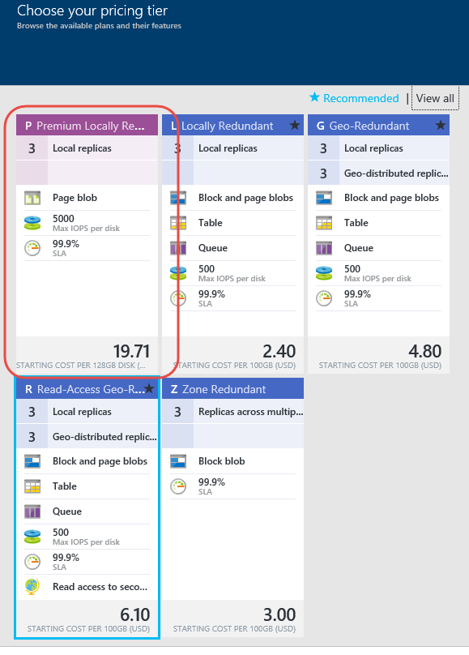
Creating a Premium Storage account
Notes:
In this screenshot, we show a Premium storage account being created through the portal https://portal.azure.com.

Slide 52
Module 2: IaaS VMs
Disks and Images
Notes:
This is not a demo slide, just how to get started.
[EDITOR] Biju.K
Seems to be a trainer’s note. Can this be removed.

Slide 53
Introduction to Disks and Images
OS Images
Microsoft
Partner
User
Base OS image for new VMs
Sysprepped/Generalized/Read-only
Created by uploading or by capture
Disks
OS Disks
Data Disks
Writable disks for VMs
Created during VM creation or during upload of existing Virtual Hard Disks (VHDs)
Notes:
Slide Objective
Explain the workflow for creating a custom image in the cloud.
Notes
This use case is about using the Capture feature of IaaS to create OS images. You start with a base Virtual Hard Disk (VHD) and then customize it with software binaries, registry settings etc. Next, you run sysprep.exe and generalize/shutdown the OS. You can then upload it, if the image is being coming from on-premises, or click the capture button if you created the VM in the cloud.
Capture allows you to take a generalized VM and save the underlying VHD as a new image in your Image library.
Disks and Images
The idea of disks and images are key concepts related to VMs
The difference is between OS images provided by Microsoft, users or partners.
The difference is the fact that those images have been sysprepped and generalized
They can be uploaded, or captured
You can create them, add whatever you need, then capture for repeated use
We are seeing customers who want to install SharePoint in one of these images, save it, and use it
For disks, this represents a .vhd machine that you have already booted up somewhere and that is running sysprep on, may ruin something in its environment. Also, it is a little more risky because if you do not already have remote desktop set up on the image, you would not be able to turn it on in the Cloud like Microsoft does for the OS images. Otherwise, the process is the same as how it works in Microsoft Azure, where an ISO is created, an unattended.xml file and storage is used

Slide 54
Image Mobility
On-premises
Cloud
Blob Storage
MyApp.vhd
Notes:
[EDITOR] Gaiyasi:
Thursday, October 03, 2013
Kindly expand AWS. Is it a reference to Amazon Web Services?
[EDITOR] Biju
Thursday, October 03, 2013 Kindly validate the edit. Original: Speak to images as page blobs.
[EDITOR] Biju.K
Kindly validate the comparison claim made. LCA recommends substantiation of claims made against third-party products.
Slide Objective
Explain the benefits of image mobility.
Notes
One of the key benefits of IaaS is flexibility and control. The Microsoft Azure solution provides you the capability of moving VHDs to the cloud, and to copy of the VHD back down and run it locally or on another cloud service as well. It is ideal for testing production issues or any other scenario that requires you to have a copy of the production server.
Communicate to images as page blobs:
AWS offers a storage service in its PaaS model that differs from its IaaS offering, which is stored on Storage Area Networks (SANs). This means that you do not get much mobility.
Microsoft Azure offers storage for PaaS and IaaS in a unified fashion, so blob storage for VHDs is accessible via the same APIs available to any blob storage. This means that we can pull images down, run them in Hyper-V, push them back to Microsoft Azure, and repeat as often as required.

Slide 55
Bring Your Own Server/VHD
On-premises
Cloud
MyApp.vhd
On-premises Virtual Server
Provision VM from an image or a disk using a portal, a script or an API
Use Case
Forklift Migration of VMs
Sysprepped Images
Use Add-AzureVHD to upload
VHD must be fixed disk
* Disk must be converted before upload
Upload VHD
Blob storage
Create disk or
image
Notes:
Slide Objective
Explain the workflow for creating a custom image in the cloud.
Notes
This use case is about using the Capture feature of IaaS to create OS images. You start with a base Virtual Hard Disk (VHD) and then customize it with software binaries, registry settings etc. Next, you run sysprep.exe and generalize/shutdown the OS. You can then upload it, if the image is being coming from on-premises, or click the capture button if you created the VM in the cloud.
Capture allows you to take a generalized VM and save the underlying VHD as a new image in your Image library.
Bring your Own Server/VHD
These are sysprepped images, and they must be fixed disk
Uploading images to Azure http://michaelwasham.com/windows-azure-powershell-reference-guide/uploading-and-downloading-vhds-to-windows-azure/
Use Add-AzureVHD PowerShell cmdlet to upload
[EDITOR] TWB_Trevor:
08 October 2013 The first two paragraphs of the notes content is repeated - same as notes page 25. Kindly verify.

Slide 56
Imaging VMs in the Cloud
Cloud
Blob storage
Identical or similar deployment instances use a common OS image as a starting point
Base.VHD
Boot
VM
Blob storage
Customize
VHD
Generalize
VHD
Capture
VM
Capture VM saves the customized image to your image library
Notes:
Slide Objective
Explain the workflow for creating a custom image in the cloud.
Notes
This use case is about using the Capture feature of IaaS to create OS images. You start with a base Virtual Hard Disk (VHD) and then customize it with software binaries, registry settings etc. Next, you run sysprep.exe and generalize/shutdown the OS. You can then upload it, if the image is being created on-premises, or click the Capture button if you created the VM in the cloud.
Capture allows you to take a generalized VM and save the underlying VHD as a new image in your Image library.
The steps on the slide show that you can not only use a base VHD that you put into storage, but you can also modify the base image in storage, capture it, and then use that as the new base.
How do you generalize?
Sysprep
What happens to the base?
The base becomes a sysprepped image
[EDITOR] TWB_Trevor:
08 October 2013 The first two paragraphs of the notes content is repeated - same as notes page 25. Kindly verify.

Slide 57
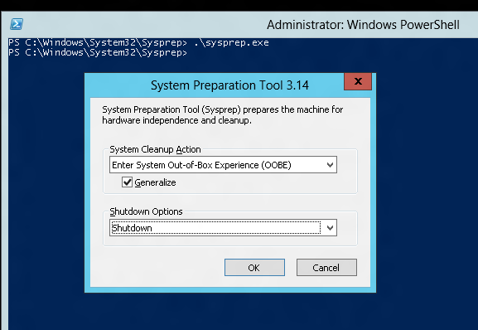
Tips on Bring Your Own (BYO) Generalized Images
Sysprep and Generalize is expected
Do not put unattend.xml on the disk
Do not install the Microsoft Azure Integration Components
No Microsoft Azure agent

Slide 58
Module 2: IaaS VMs
Managing VMs
Notes:
This is not a demo slide, just how to get started.
[EDITOR] Biju.K
Seems to be a trainer’s note. Can this be removed.

Slide 59
Azure VM Agent and Extensions
VM Agent is used to install, configure, manage and run Azure VM Extensions
Installs, configures, and removes VM extensions on instances of Azure VMs
Enable via Portal or PowerShell
Available for Windows and Linux
VM Extensions provide dynamic features that Microsoft and other third parties provide
Modify security and identity features, such as resetting account values and using antimalware
Start, stop, or configure monitoring and diagnostics
Reset or install connectivity features, such as RDP and SSH
Diagnose, monitor, and manage your VMs
Notes:
$vm = Get-AzureVM –serviceName
$svc –Name $name $vm.VM.ProvisionGuestAgent = $TRUE
Update-AzureVM –Name $name –VM $vm.VM –ServiceName $svc
Azure VM Extensions and Features
https://msdn.microsoft.com/en-us/library/dn606311.aspx

Slide 60
Virtual Machine Shutdown (classic portal view)
Shutdown from Windows Azure Portal or Stop-AzureVM
Billing stops for the VM
All resources are released (including network adapters)
Shutdown within the VM or Stop-AzureVM –StayProvisioned:
Billing continues for the VM
Keeps resources reserved (including IP address)

Slide 61
Module 2: IaaS VMs
Preview Features
Notes:
This is not a demo slide, just how to get started.
[EDITOR] Biju.K
Seems to be a trainer’s note. Can this be removed.

Slide 62
Linux/Windows Disk Encryption
Currently only data disks can be encrypted with BitLocker*
New preview service allows Linux/Windows OS and Data disk encryption
Integrated with KeyVault
* Use CloudLink to encrypt OS Drive http://azure.microsoft.com/blog/2014/08/19/azure-virtual-machine-disk-encryption-using-cloudlink/
Notes:
At Ignite this week, we will be demonstrating a new capability that will let you encrypt all of your Virtual Machine disks including the boot and data disks. Disk encryption for VMs will work with Linux and Windows, and is integrated with KeyVault so you can manage encryption keys using the KeyVault service, while ensuring all the data in the VM disks is encrypted at rest safely in your storage accounts. We plan on making it available in the very near future and will have more details to share on the Azure blog at that time – please stay tuned for more!

Slide 63
Module Knowledge Check

Slide 64
Answers – Module Knowledge Check

Slide 65
Module Summary
Support for key server applications
Easy storage manageability
High availability features
Advanced networking
Integration with compute PaaS

Slide 67
IaaS and PaaS: Better Together
Physical
Virtual
IaaS
PaaS
SaaS
Notes:
We are talking now about bridging IaaS and PaaS together
We need to be able to connect VMs through:
VIPs or public endpoints through the load balancer
Direct connectivity through VNETs
Mixed mode, in which we have both web and worker roles accessing VMs
[EDITOR] TWB_Trevor:
08 October 2013 What does “VIPs” stand for? Kindly provide the expansion.

Slide 68
Benefits of PaaS
Rapid deployment for developers
Reason: There is less work for developers to do
Benefit: Applications can go from idea to availability more quickly
Lower cost for administration
Reason: There is less admin and management work to do
Benefit: Organizations spend less supporting applications
Lower risk based on SLA
Reason: The platform does more, leaving fewer opportunities for error
Benefit: Creating and running applications gets more reliable

Slide 69
IaaS and PaaS Side-by-Side
Connect cloud apps via Virtual IP addresses (VIPs)
Easily compose services by connecting public endpoints
Direct connectivity using virtual networking
For advanced connectivity scenarios such as AD or Distributed Component Object Model (DCOM)

