Slide 1
Application Platform

Slide 2
Introducing Containers

Slide 3
Containers A new approach to build, ship, deploy, and instantiate applications
Applications traditionally built and deployed onto physical systems with 1:1 relationship
New applications often required new physical systems for isolation of resources
Package and run apps within
containers
Physical
Physical/virtual
Higher consolidation ratios and better utilization
Faster app deployment than in a traditional, physical environment
Apps deployed into VMs with high compatibility success
Apps benefited from key VM features i.e., live migration, HA
Key benefits
Further accelerate of app deployment
Reduce effort to deploy apps
Streamline development and testing
Lower costs associated with app deployment
Increase server consolidation
Virtual

Slide 4
Why containers? Applications are fueling innovation in today’s cloud-mobile world
Developers
Containers unlock ultimate productivity and freedom
Enable ‘write-once, run-anywhere’ apps
Can be deployed as multi-tier distributed apps in IaaS/PaaS models
Containers offers powerful abstraction for microservices
DevOps
Integrate people, process, and tools for an optimized app development process
Operations focus on standardized infrastructure
Developers focus on building, deploying, and testing apps
Operations
Enhances familiar IT deployment models
Provide standardized environments for development, QA, and production teams
Abstract differences in OS distributions and underlying infrastructure
Higher utilization and compute density
Rapid scale-up and scale-down in response to changing business needs

Slide 5
Containers Isolated runtime environment for hosted applications
Container
Dependencies
Every application has its own dependencies which includes both software (services, libraries) and hardware (CPU, memory, storage)
Virtualization
Container engine is a light weight virtualization mechanism which isolates these dependencies per each application by packaging them into virtual containers
Shared host OS
Container runs as an isolated process in user space on the host OS, sharing the kernel with other containers
Flexible
Differences in underlying OS and infrastructure are abstracted away, streamlining “deploy anywhere” approach
Fast
Containers can be created almost instantly, enabling rapid scale-up and scale-down in response to changes in demand
App A Bins/libraries
App B Bins/libraries
Container management stack
Host OS with container support
Server

Slide 6
Containers How do they differ from virtual machines?
Virtual machine
Dependencies
Each virtualized app includes the app itself, required binaries and libraries and a guest OS, which may consist of multiple GB of data
Independent OS
Each VM can have a different OS from other VMs, along with a different OS to the host itself
Flexible
VMs can be migrated to other hosts to balance resource usage and for host maintenance, without downtime
Secure
High levels of resource and security isolation for key virtualized workloads
App A Bins/Libraries
App B Bins/Libraries
Guest OS
Guest OS
Hypervisor
Server

Slide 7
Container use cases
Workload characteristics
Scale out
Distributed
State separated
Rapid (re)start
Deployment characteristics
Efficient hosting
Multitenancy
Rapid deployment
Highly automatable
Rapid scaling
Distributed compute
Databases
Web
Tasks
Scale out
$$f\left(x\right)$$

Slide 8
Container ecosystem
Container runtime
Container images
Image repository
Application
Linux
Application framework

Slide 9
Microsoft’s Container runtimes
Windows Server container
Hosting
Highly automated
Secure
Scalable and elastic
Efficient
Trusted
multi-tenancy
Hyper-V container
Shared hosting
Regulated workloads
Highly automated
Secure
Scalable and elastic
Efficient
Public
multi-tenancy

Slide 10
Modern app dev, flexible isolation
Container Runtimes
Windows Container Images
Container Management
Hyper-V container
Docker
Application Framework
PowerShell
Others
Windows Server container
Write once, deploy anywhere

Slide 11
Docker integration Joint strategic investments to drive containers forward
Docker
An open source engine that automates the deployment of any application as a portable, self-sufficient container that can run almost anywhere
Partnership
Enable the Docker client to manage multi-container applications using both Linux and Windows containers, regardless of the hosting environment or cloud provider
Customer
Datacenter
Dockerized app
Windows Server
Container
Linux Container
Container
Run anywhere
Docker
Microsoft
Azure
Service
Provider
Strategic investments
Investments in Windows Server 2016
Open source development of the Docker Engine for Windows Server
Azure support for the Docker open orchestration APIs
Federation of Docker Hub images into the Azure Gallery and Portal

Slide 12
Docker integration Joint strategic investments to drive containers forward
Docker Hub
Huge collection of open and curated applications available for download. https://hub.docker.com
Collaboration
Bring Windows Server containers to the Docker ecosystem to expand the reach of both developer communities
Docker Engine
Docker Engine for Windows Server containers will be developed under the Docker open source project
Docker client
Windows customers will be able to use the same standard Docker client and interface on multiple development environments
Docker Client
Docker.exe
Examples:
docker run
docker images
Linux
Docker Remote API
Examples:
GET images/json
POST containers/create
Docker Engine
(Daemon)
Docker Engine
(Daemon)
Windows Server
Container Support
Linux Container
Support (LXC)

Slide 13
DevOps process with containers
Developers update, iterate, and deploy updated containers
2
3
Operations collaborates with developers to provide app metrics and insights
Developers build and test apps in containers, using development environment; i.e., Visual Studio
1
2
Operations automates deployment and monitors deployed apps from central repository
Central Repository
Containers pushed to central repository

Slide 14
Container OS environments
Nano Server
Server Core
Highly optimized
Highly compatible
“Born in the cloud” applications
Traditional applications

Slide 15
Container runtime
Windows Server
container(s)
Host Operating System

Slide 16
Container runtime
Windows Server container(s)
Hyper-V container(s)
Host Operating System
Virtual machine(s)
Hyper-V Hypervisor

Slide 17
Container runtime
Windows Server container(s)
Hyper-V container(s)
Hyper-V Hypervisor
Host Operating System
Virtual machine(s)
Hyper-V Hypervisor

Slide 18
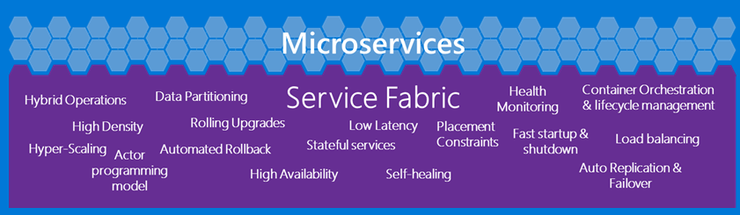
The right tools for you
Container management
Service Fabric
PowerShell
Docker
Others
Container technologies
Development environments
Development frameworks and languages
Linux
PHP
Python
Win32
Ruby
Go
.NET
Node
Java
Javascript
C++
Perl
Microsoft Cloud
Eclipse
Others…
Azure
On- premises
Service provider

Slide 19
Demo
Work with containers in PowerShell

Slide 20
Introducing Nano Server

Slide 21
Customer voice
Reboots impact my business
Why do I have to reboot because of a patch to a component I never use?
When a reboot is required, the systems need to be back in service A.S.A.P.
Server images are too big
Large images take a long time to install and configure
Transferring images consumes too much network bandwidth
Storing images requires too much disk space
Infrastructure requires too many resources
If the OS consumes fewer resources, I can increase my VM density
Higher VM density lowers my costs and increases my efficiency and margins

Slide 22
“ I want just the components
I need, and nothing more.”

Slide 23
“We need server configuration
optimized for the cloud.”

Slide 24
The next step in the journey…
Nano Server: A new headless, 64-bit only, deployment option for Windows Server
Server with a desktop experience
Deep refactoring with cloud emphasis
Cloud fabric & infrastructure (clustering, storage, networking)
Born-in-the-cloud applications (PaaS v2, ASP.NET v5)
VMs & Containers (Hyper-V & Docker)
Server Core
Extend the Server Core pattern
Roles & features live outside of Nano Server
No binaries or metadata in OS image
Standalone packages install like apps
Full driver support
Antimalware
Nano Server

Slide 25
Nano Server
Nano Server is an Installation Option
Located on the Windows Server media
Must be customized to determine it’s functionality
Zero-footprint model
Server roles and optional features live outside of Nano Server
Standalone packages that install like applications, from local/cloud repositories
Key roles and features
Hyper-V, Storage (SoFS), Networking (DNS), Clustering
Core CLR, ASP.NET 5 and PaaS
Full Windows Server driver support
Antimalware available as optional feature

Slide 26
Nano Server Quick Start
Scripts included in Nano Server folder to make it easy to build a customized Nano Server image
NanoServerImageGenerator.psm1
Convert-WindowsImage.ps1
Use scripts to generate a Nano Server image for
PHYSICAL MACHINE
VIRTUAL MACHINE
New-NanoServerImage -MediaPath F:\ -BasePath .\Base -TargetPath .\NanoVM\SRV-Nano.vhd -ComputerName SRV-Nano -GuestDrivers –Storage -Clustering

Slide 27
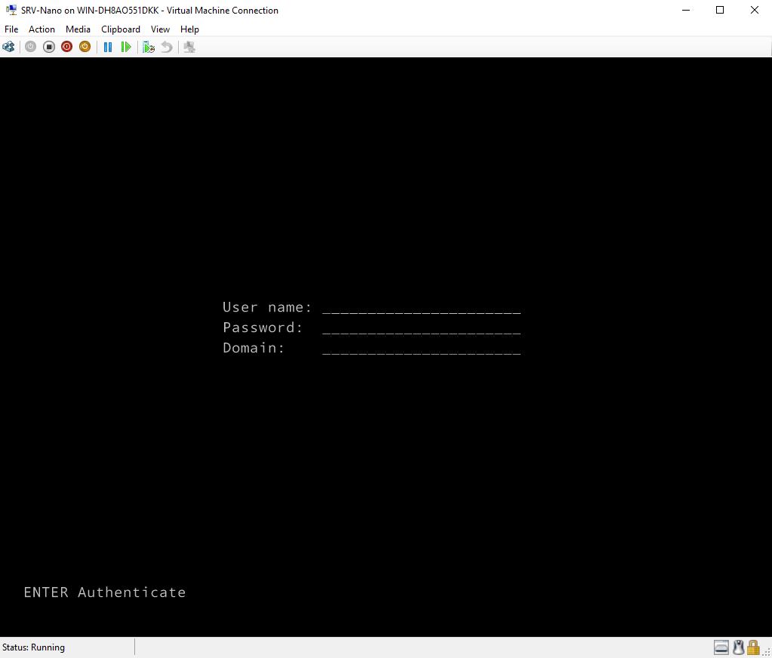
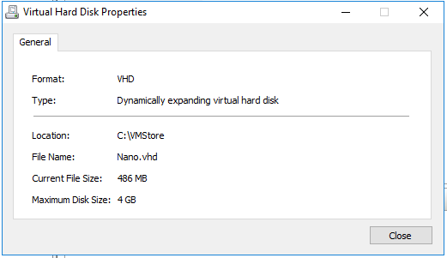
The end result…

Slide 28
Nano Server roles and features
Table shows roles and features that are available in this release of Nano Server, along with the Windows PowerShell options that will install the packages for them
Role or feature | Option
Hyper-V role | -Compute
Failover clustering | -Clustering
File server role and other storage components | -Storage
Windows Defender antimalware, including a default signature file | -Defender
OEM drivers—select drivers that ship in-box with Server Core | -OEMDrivers
Reverse forwarders for application compatibility, for example common application frameworks such as Ruby, Node.js, etc. | -ReverseForwarders
Hyper-V guest drivers for hosting Nano Server as a VM | -GuestDrivers
Host Support for Windows Containers | -Containers

Slide 29
Nano Server roles and features
Table shows roles and features that are available in this release of Nano Server, along with the Windows PowerShell options that will install the packages for them
Role or feature | Option
DNS Server Role | -Packages Microsoft-NanoServer-DNS-Package
Desired State Configuration (DSC) | -Packages Microsoft-NanoServer-DSC-Package
IIS Web Server | -Packages Microsoft-NanoServer-IIS-Package
System Center VMM Agent | -Packages Microsoft-Windows-Server-SCVMM-Package -Packages Microsoft-Windows-Server-SCVMM-Compute-Package
Network Perf Diagnostics Service (NPDS) | -Packages Microsoft-NanoServer-NPDS-Package
Data Center Bridging | -Packages Microsoft-NanoServer-DCB-Package

Slide 30
Demo
Build and Deploy Nano Servers

Slide 31
Remotely managing Nano Server
Remote graphical & Web tools
PowerShell remoting
VM & container management
Deployment & monitoring
Partners & frameworks
Server manager
Azure Portal tools
Task manager
Registry editor
File explorer
Server configuration
Event viewer
Disk manager
Device & driver management
Performance
Users & groups
Core PowerShell engine, language, and cmdlets
Windows Server cmdlets (network, storage, etc.)
PowerShell DSC
Remote file transfer
Remote script authoring & debugging
PowerShell Web access
Hyper-V manager
Hyper-V cmdlets
PowerShell Direct over PSRP
CimSession support
Docker
SCVMM agent & console
3rd-party agents & consoles
DISM online & VHD support
Unattended setup
Visual Studio integration
DSC Local Config Manager
Setup & boot eventing
SCOM agent
VSO App Insights
Azure Op Insights
Chef integration
.NET Core and CoreCLR
ASP.NET 5
Python, PHP, Ruby, Node.js
PowerShell Classes
PS Script Analyzer
PowerShell Gallery
PowerShellGet

Slide 32
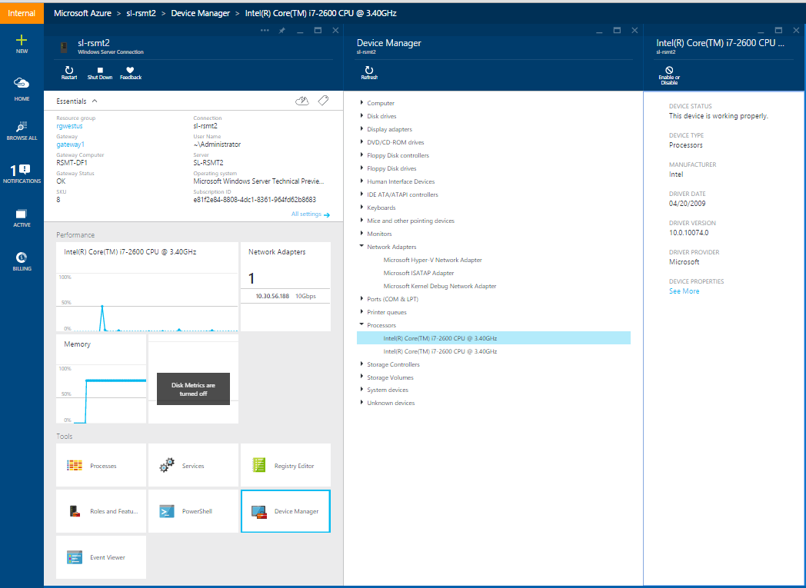
Remote Server Management Tool
Eliminating the need to ever sit in front of a server
Azure-based
Includes replacements for local-only tools
Task manager, registry editor
Event viewer, device manager
Sconfig
Control panel, file explorer
Performance monitor, disk management
Users/Groups manager
Supports Server Core and server with desktop experience

Slide 33
Demo
Deploy Server Management Tools

Slide 34
Nano Server resources and feedback
Shift your org and tools to full remote management of Server Core
Inventory tools and agents that only run locally
Check with your ISV for a remotable version
Send list of those with no remote equivalent and ISV to nanoserver@microsoft.com
Deploy Nano Server, your apps, and your tools
Deployment guide at: https://msdn.microsoft.com/en-us/library/mt126167.aspx
Give use feedback and let us know where you encounter difficulties: http://windowsserver.uservoice.com/forums/295068-nano-server
Remote Management feedback
http://windowsserver.uservoice.com/forums/295071-remote-management-tools

Slide 35
Nano resources and feedback
Blogs
Nano Server: http://blogs.technet.com/b/nanoserver/
Server Core: http://blogs.technet.com/b/server_core/
Deeper training
Microsoft Virtual Academy: https://www.microsoftvirtualacademy.com/ en-US/training-courses/a-deep-dive-into-nano-server-13785
Documentation
TechNet: http://aka.ms/nanoserver
Technical preview
Windows Server: https://www.microsoft.com/en us/evalcenter/evaluate-windows-server-technical-preview

Slide 36
Lab Getting started with Nano Server
Notes:
For this lab, you should be using the Modern Datacenter TP4 lab series, and specifically launching the “Windows Server 2016: Managing Nano Server” lab – it is recommended that you just perform the first 2 exercises based on available time.

