Slide 1
The Software Defined Datacenter – Part 1

Slide 2
What is a “Software Defined Datacenter”
Software defined compute.
Software defined networking.
Software defined storage.
Remove the limits of physical configurations.
Abstraction and agility.
Platform agnostic, centrally configured, policy managed.

Slide 3
In this module….
Software defined compute (Hyper-V)
Software defined networking (Network Virtualization)

Slide 4
Compute (Hyper-V)

Slide 5
The story so far…
SCALE
64 vCPU per VM
1TB RAM per VM
4TB RAM per host
320 LP per host
64 TB VHDX
1024 VMs per host
vNUMA
AGILITY
Dynamic memory
Live migration
LM with compression
LM over SMB direct
Storage LM
Shared nothing LM
Cross-version LM
Hot add/resize VHDX
Storage QoS
Live VM export
AVAILABILITY
Host clustering
64 node clusters
Guest clustering
Shared VHDX
Hyper-V replica
Built in.
NETWORKING
Integrated network virtual
Network virtual gateway
Extended port ACLs
vRSS
Dynamic teaming
AND MORE…
Gen 2 VMs
Enhanced session
Auto VM activation
HETEROGENEOUS
Linux
FreeBSD

Slide 6
A leader in Gartner magic quadrants
x86 server virtualization¹
Microsoft only leader in all four magic quadrants
Public cloud storage services²
Cloud infrastructure as a service³
Enterprise application platform as a service⁴
[1] Gartner “x86 Server Virtualization Infrastructure,” by Thomas J. Bittman, Michael Warrilow, July 14 2015; [2] Gartner “Public Cloud Storage Services,” by Arun Chandrasekaran, Raj Bala June 25, 2015; [3] Gartner “Magic Quadrant for Cloud Infrastructure as a Service,” by Lydia Leong, Douglas Toombs, Bob Gill, May 18, 2015; [4] Gartner “Enterprise Application Platform as a Service,” by Yefim V. Natis, Massimo Pezzini, Kimihiko Iijima, Anne Thomas, Rob Dunie , March 24, 2015.
Gartner does not endorse any vendor, product or service depicted in its research publications, and does not advise technology users to select only those vendors with the highest ratings or other designation. Gartner research publications consist of the opinions of Gartner's research organization and should not be construed as statements of fact. Gartner disclaims all warranties, expressed or implied, with respect to this research, including any warranties of merchantability or fitness for a particular purpose.

Slide 7
So what’s new?
AVAILABILITY
VM Compute Resiliency
VM Storage Resiliency
Node Quarantine
Shared VHDX – Resize, Backup, Replica Support
Memory – Runtime Resize for Static/Dynamic
vNIC – Hot-Add and vNIC Naming
OPERATIONAL EFFICIENCIES
Production Checkpoints
PowerShell Direct
Hyper-V Manager Improvements
ReFS Accelerated VHDX Operations
ROLLING UPGRADES
Upgrade WS2012R2 -> WS2016 with no downtime for workloads (VMs / SOFS) or additional H/W
VM Integration Services from Windows Update

Slide 8
Availability

Slide 9
Failover Clustering Integrated solution, enhanced in Windows Server Technical Preview
VM compute resiliency
Provides resiliency to transient failures such as a temporary network outage, or a non-responding node
In the event of node isolation, VMs will continue to run, even if a node falls out of cluster membership
This is configurable based on your requirements—default set to 4 minutes
VM storage resiliency
Preserves tenant virtual machine session state in the event of transient storage disruption
VM stack is quickly and intelligently notified on failure of the underlying block or file-based storage infrastructure
VM is quickly moved to a PausedCritical state
VM waits for storage to recover and session state retained on recovery
Hyper-V cluster
Shared storage
Notes:
Can I have a running VM but kill a node and show the VM running?

Slide 10

Failover clustering Integrated solution, enhanced in Windows Server Technical Preview
Node quarantine
Unhealthy nodes are quarantined and are no longer allowed to join the cluster
This capability prevents unhealthy nodes from negatively affecting other nodes and the overall cluster
Node is quarantined if it unexpectedly leaves the cluster three times within an hour
Once a node is placed in quarantine, VMs are live migrated from the cluster node, without downtime to the VM
Hyper-V cluster
Shared storage

Slide 11
Guest clustering with Shared VHDX Not bound to underlying storage topology
Flexible and secure
Shared VHDX removes need to present the physical underlying storage to a guest OS
*NEW* Shared VHDX supports online resize
Streamlined VM shared storage
Shared VHDX files can be presented to multiple VMs simultaneously, as shared storage
The VM sees shared virtual SAS disk that it can use for clustering at the guest OS and application level
Utilizes SCSI-persistent reservations
Shared VHDX can reside on a Cluster Shared Volume (CSV) on block storage, or on SMB file-based storage
*NEW* protected
Shared VHDX supports Hyper-V Replica and host-level backup
Guest cluster
Guest cluster
Hyper-V host clusters
Shared VHDX files
Shared VHDX files
CSV on block storage
SMB Share file-based storage

Slide 12
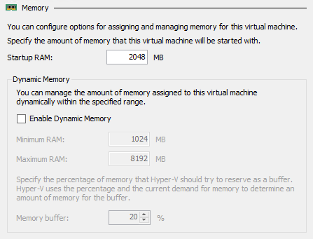
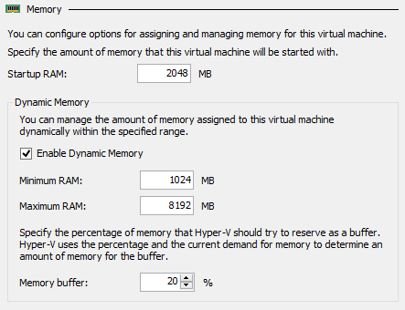
Memory management Complete flexibility for optimal host utilization
Static memory
Startup RAM represents memory that will be allocated regardless of VM memory demand
*NEW* Runtime resize
Administrators can now increase or decrease VM memory without VM downtime
Cannot be decreased lower than current demand, or increased higher than physical system memory
Dynamic memory
Enables automatic reallocation of memory between running VMs
Results in increased utilization of resources, improved consolidation ratios and reliability for restart operations
Runtime resize
With Dynamic Memory enabled, administrators can increase the maximum or decrease the minimum memory without VM downtime

Slide 13
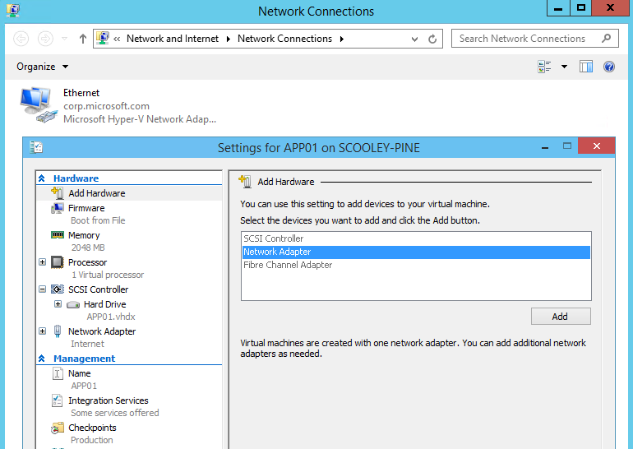
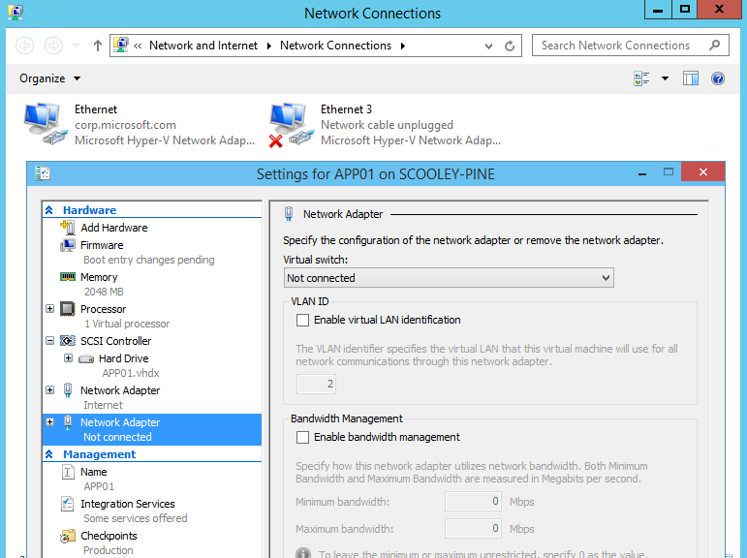
Virtualization and networking Virtual network adaptor enhancements
Flexibility
Administrators now have the ability to add or remove virtual NICs (vNICs) from a VM without downtime
Enabled by default, with Gen 2 VMs only
vNICs can be added using Hyper-V Manager GUI or PowerShell
Full support
Any supported Windows or Linux guest operating system can use the hot add/remove vNIC functionality
vNIC identification
New capability to name vNIC in VM settings and see name inside guest operating system
Add-VMNetworkAdapter -VMName “TestVM” – SwitchName “Virtual Switch” -Name “TestNIC” -Passthru | Set-VMNetworkAdapter -DeviceNaming on

Slide 14
Demo
High Availability
Notes:
Node Quarintine
Shared VHDX
Memory Management , Hot add RAM
Networking, Hot add NIC

Slide 15
Rolling Upgrades

Slide 16
Cluster OS rolling upgrades Upgrade cluster nodes without downtime to key workloads
Streamlined upgrades
Upgrade the OS of the cluster nodes from Windows Server 2012 R2 to Windows Server Technical Preview without stopping the Hyper-V or the SOFS workloads
Infrastructure can keep pace with innovation, without impacting running workloads
Phased upgrade approach
A cluster node is paused and drained of workloads by using available migration capabilities
The node is evicted, and the operating system OS is replaced with clean install of Windows Server Technical Preview
The new node is added back into active cluster. The cluster is now in mixed-mode. This process is repeated for other nodes
The cluster functional level stays at Windows Server 2012 R2 until all nodes have been upgraded. Upon completion, the administrator executes: Update-ClusterFunctionalLevel
Hyper-V cluster
Shared storage
Windows Server 2012 R2 Cluster Nodes | Updated Windows Server Cluster Nodes
0
1
2
3
2
3
1
0

Slide 17
Virtual machine upgrades New virtual machine upgrade and servicing processes
Compatibility mode
When a VM is migrated to a Windows Server Technical Preview host, it will remain in Windows Server 2012 R2 compatibility mode
Upgrading a VM is separate from upgrading host
VMs can be moved back to earlier versions until they have been manually upgraded
Update-VMVersion vmname
Once upgraded, VMs can take advantage of new features of the underlying Hyper-V host
Servicing model
VM drivers (integration services) updated as necessary
Updated VM drivers will be pushed directly to guest operating system via Windows Update
By running Update-VMVersion, VM will be upgraded to newest hardware version and can use the new Hyper-V features
Windows Server Technical Preview supports previous version VMs in compatibility mode
v6
v6
v6
v6
Windows Server 2012 R2 Hyper-V
Windows Server Technical Preview Hyper-V

Slide 18
Demo
Mixed Mode Clustering and Rolling Upgrade
Notes:
Do the Hyper-V Lab, this has this feature in it already.

Slide 19
Operational Efficiencies

Slide 20
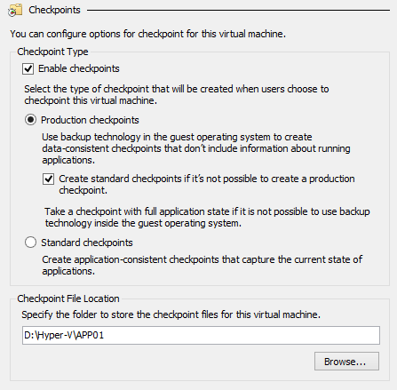
Production Checkpoints Fully supported for production environments
Full support for key workloads
Easily create “point in time” images of a virtual machine, which can be restored later on in a way that is completely supported for all production workloads
VSS
Volume Snapshot Service (VSS) is used inside Windows virtual machines to create the production checkpoint instead of using saved state technology
Familiar
No change to user experience for taking/restoring a checkpoint
Restoring a checkpoint is like restoring a clean backup of the server
Linux
Linux virtual machines flush their file system buffers to create a file system consistent checkpoint
Production as default
New virtual machines will use production checkpoints with a fallback to standard checkpoints

Slide 21
PowerShell Direct
Bridge the boundary between Hyper-V host and guest VM in a secure way to issue PS cmdlets and run scripts easily
Currently supports Windows 10/Windows Server 2016 guest on Windows 1 10/Windows Server 2016 host
No need to configure PS remoting or network connectivity
Just need the guest credentials
Can only connect to particular guest from that host
Enter-PSSession -VMName VMName
Invoke-Command -VMName VMName -ScriptBlock { Fancy Script }

Slide 22
Hyper-V Manager improvements
Multiple improvements to make it easier to remotely manage and troubleshoot Hyper-V servers:
Support for alternate credentials
Connecting via IP address
Connecting via Windows Remote Management
IP

Slide 23
ReFS accelerated VHDX operations
Resilient File System:
Maximizes data availability, despite errors that would historically cause data loss or downtime
Rapid recovery from file system corruption without affecting availability
Resilient against power outage corruption
Periodic checksum validation of file system metadata
Improved data integrity protection
ReFS remains online during subdirectory reconstruction and nows where orphaned subdirectories exist and automatically reconstructs them
Taking advantage of an intelligent file system for…
Instant fixed disk creation
Instant disk merge operations

Slide 24
Demo
Operational Efficiencies
Notes:
Production vs Standard Checkpoints
PowerShell Direct
VHDX on REFS

Slide 25
Summary
AVAILABILITY
VM Compute Resiliency
VM Storage Resiliency
Node Quarantine
Shared VHDX – Resize, Backup, Replica Support
Memory – Runtime Resize for Static/Dynamic
vNIC – Hot-Add and vNIC Naming
OPERATIONAL EFFICIENCIES
Production Checkpoints
PowerShell Direct
Hyper-V Manager Improvements
ReFS Accelerated VHDX Operations
ROLLING UPGRADES
Upgrade WS2012R2 -> WS2016 with no downtime for workloads (VMs / SOFS) or additional H/W
VM Integration Services from Windows Update

Slide 26
Software-defined Networking

Slide 27
The story so far…
Hyper-V Extensible Switch
Inbox NIC teaming
SMB 3.0 protocol
Hardware offloads
Converged networking
4
1
Windows Server Gateway
3
Virtual networks
2
Network Switch Management with OMI
3
Virtualized networks with NVGRE
Hyper-V hosts
4
Windows Server Gateway
1
Physical switches
2

Slide 28
The story so far…host networking
Extensible Switch
L2 network switch for VM connectivity. Extensible by partners, including Cisco, 5nine, NEC, and InMon
Inbox NIC teaming
Built-in, multiple configuration options and load-distribution algorithms including new Dynamic mode
SMB Multichannel
Increase network performance and resilience by using multiple network connections simultaneously
SMB Direct
Highest performance through use of NICs that support Remote Device Memory Access (RDMA) – high speed, with low latency
Hardware offloads
Dynamic VMQ load-balances traffic processing across multiple CPUs. vRSS allows VMs to use multiple vCPUs to achieve highest networking speed
Windows Server Gateway
4
3
Virtual networks
Hyper-V hosts
1
Physical switches
2

Slide 29
The story so far…switch management
OMI
Open Management Infrastructure – open source, highly portable, small footprint, high performance CIM Object Manager
Open source implementation of standards-based management – CIM and WSMAN
API symmetry with WMI V2
Supported by Arista and Cisco, among others
Datacenter abstraction layer
Any device or server that implements standard protocol and schema can be managed from standard compliant tools like PowerShell
Standardized
Common management interface across multiple network vendors
Automation
Streamline enterprise management across the infrastructure
Windows Server Gateway
4
3
Virtual networks
Hyper-V hosts
1
Physical switches
2

Slide 30
The story so far…virtual networks
Network Virtualization
Overlays multiple virtual networks on shared physical network
Uses industry standard Generic Routing Encapsulation (NVGRE) protocol
VLANs
Removes constraints around scale, mis-configuration, and subnet inflexibility
Mobility
Complete VM mobility across the datacenter, for new and existing workloads
Overlapping IP addresses from different tenants can exist on same infrastructure
VMs can be live migrated across physical subnets
Automation
Streamline enterprise management across the infrastructure
Compatible
Works with today’s existing datacenter technologies
Windows Server Gateway
4
3
Virtual networks
Hyper-V hosts
1
Physical switches
2

Slide 31
The story so far…gateways
Gateways
Bridge network-virtualized and non-network-virtualized environments
Come in many forms – switches, dedicated appliances or built into Windows Server
System Center
Windows Server gateway can be deployed and configured through SCVMM
Service Template available on TechNet for streamlined deployment
Deployment options
Supports forwarding for private clouds, NAT for VM internet access and S2S VPN for hybrid
Windows Server Gateway
4
3
Virtual networks
Hyper-V hosts
1
Physical switches
2

Slide 32
Demo
Understanding Network Virtualization
Notes:
Use the existing lab as the demo.

Slide 33
Switch-Embedded Teaming (SET)
New way of deploying converged networking
Teaming integrated into the Hyper-V vSwitch
Teaming modes: Switch independent (no static or LACP in this release)
Load balancing: Hyper-V port or dynamic only in this release
Management: SCVMM or PowerShell, not NIC Teaming GUI in this release
Up to 8 uplinks per SET: Same manufacturer, same driver, same capabilities (e.g., dual port NIC)
No longer required to create a NIC Team
Switch must be created in SET-mode (SET can’t be added to existing switch)
New-VMSwitch -name SETswitch –NetAdapterName “NIC1”,“NIC2” ‑EnableEmbeddedTeaming $true

Slide 34
Network Function Virtualization
Firewall & antivirus
DDoS & IPS/IDS
App/WAN Optimizers
S2S Gateway
L2/L3 Gateways
Routers & switches
NAT & HTTP Proxy
Load balancers
Network functions that are being performed by hardware appliances are increasingly being virtualized as virtual appliances
Virtual appliances are quickly emerging and creating a brand new market
Dynamic and easy to change because they are a pre-built, customized virtual machine
It can be one or more virtual machines packaged, updated, and maintained as a unit
Can easily be moved or scaled up/down
Minimizes operational complexity
Microsoft included a standalone gateway as a virtual appliance starting with Windows Server 2012 R2

Slide 35
Network Controller
Internet
Internet
Datacenter
A centralized, programmable point of automation to manage, configure, monitor, and troubleshoot virtual and physical network infrastructure in your datacenter
Management Tool
Router
Can be deployed as single VM (lab) or as a cluster of 3 physical servers (no Hyper-V) or 3 VMs on separate hosts
Physical Top of Rack Switch
Physical Top of Rack Switch
Hyper-V Host
Hyper-V Host
Network Controller
Hyper-V Host
Hyper-V Host
Hyper-V vSwitch
Hyper-V vSwitch
Hyper-V vSwitch
Hyper-V vSwitch
VM
VM
VM
VM
VM
VM
VM
VM

Slide 36
Network Controller overview
Highly available and scalable server role
Southbound API for NC to communicate with the network
Northbound API allows you to communicate with the NC
Southbound API
Network Controller can discover network devices, detect service configurations, and gather all of the information you need about the network
Provides pathway to send information to the network infrastructure, such as configuration changes that you have made
Northbound API (REST interface)
Provides you with the ability to gather network information from Network Controller and use it to monitor and configure the network
Configure, monitor, troubleshoot, and deploy new devices on the network by using Windows PowerShell, REST, SCVMM, SCOM etc.
Can manage
Hyper-V VMs & vSwitches, physical network switches, physical network routers, firewall software, VPN gateways including RRAS, load balancers…
Management applications
Network aware applications
Network Controller
Virtual network infrastructure
Physical network infrastructure
NIC

Slide 37
Network Controller features
Fabric Network Management
IP subnets
VLANS
L2 and L3 switches
Host NICs
Firewall Management
Allow/deny rules
East/West & North/South
Firewall rules plumbed into vSwitch port of VMs
Rules for incoming/outgoing traffic
Log traffic allowed/denied
Network Topology
Automatic discovery of network elements and relationships
Service Chaining
Rules for redirecting traffic to one or more virtual appliances
Software Load Balancer
Centralized configuration of SLB policies
Network Monitoring
Physical and virtual
Active network data: Network loss, latency, baselines, deviations
Fault localization
Element data: SNMP polling and traps
Limited set of critical data via public Management Info Bases (MIB) i.e., link state, system restarts, BGP peer status
Device (switch, router) and Device Group (racks, subnets etc.) health
Gathers network loss, latency, device CPU/memory usages, link utilization, and packet drops
Impact analysis: Overlay networks affected by underlying faulty physical networks using topology information to determine vNext footprint and health
System Center Operations Manager integration for health and statistics
Virtual Network Management
Deploy Hyper-V Network Virtualization
Deploy Hyper-V Virtual Switch
Deploy Virtual Network Adaptors to VMs
Store and distribute virtual network policies
Supports NVGRE and VXLAN
Windows Server Gateway Management
Deploy, configure & manage WSGs -> host & VMs
S2S VPN with IPsec, S2S VPN with GRE
P2S VPN, L3 forwarding, BGP routing
Load balancing of S2S and P2S connections across gateway VMs + logging config/state changes

Slide 38
Powerful platform for virtual appliances
Network Controllers
3
2
Deploy, configure, & manage virtual appliances with the Network Controller
Standardized REST API & PowerShell
Northbound interface
Deploy virtual appliances from vendors of your choice
Service Managers
Software Load Balancer
Virtual network Firewall
HNV L2/L3 GW
S2S GW
VPN GW
SC for third-party VNF
Southbound interface
4
Hyper-V can host the top guest OS’s that you need
Hyper-V Host
S2S GW
SLB
HNV L2/L3 GW
VPN GW
Host agent
SC
FW
SLB agent
1
Microsoft provides key virtualized network functions with Windows Server

Slide 39
Software Load Balancer (SLB)
Scalable and available
Proven with Azure—scale out to many Multiplexer (MUX) instances, balancing billions of flows
High-throughput between MUX and virtual networks
Highly available
Supports North/South and East/West load balancing
Utilizes Direct Server Return for high performance
Flexible and integrated
Reduced capex through multi-tenancy
Access to physical network resources from tenant virtual network
Layer 3 and layer 4 load balancing
Supports NAT
Easy management
Centralized control and management through Network Controller
Easy fabric deployment through SCVMM
Integration with existing tenant portals via Network Controller— REST APIs or PowerShell
Purple virtual network
Blue virtual network
Green virtual network
SLB MUX
SLB MUX
Edge routing infrastructure
Network
Controller

Slide 40
Datacenter Firewall
Included within Windows Server
It is a network layer, 5-tuple, stateful, multitenant firewall
Protocol
Source and destination port numbers
Source and destination IP addresses
Tenant administrators can install and configure firewall policies to help protect their virtual networks
Managed via Network Controller and northbound APIs
Protects East/West and North/South traffic flows
PowerShell
Network Controller
Northbound Interface (REST APIs)
Distributed Firewall Manager
Southbound Interface
Policies
Policies
Host 1
Host 2
VM1
VM2
VM1
VM3
VM2
VM3
vNICs
vNICs
vSwitch
vSwitch
NIC
NIC
NIC
NIC
Gateway

Slide 41
Datacenter Firewall
Highly scalable, manageable, and diagnosable software-based firewall
Freedom to move tenant virtual machines to different compute hosts without breaking tenant firewall policies
Deployed as a vSwitch port host agent firewall
Tenant virtual machines get the policies assigned to their vSwitch host agent firewall
Firewall rules are configured in each vSwitch port, independent of the actual host running the virtual machine
Guest OS agnostic
Protect traffic between VMs on same/different L2 subnets
PowerShell
Network Controller
Northbound Interface (REST APIs)
Distributed Firewall Manager
Southbound Interface
Policies
Policies
Host 1
Host 2
VM1
VM2
VM1
VM3
VM2
VM3
vNICs
vNICs
vSwitch
vSwitch
NIC
NIC
NIC
NIC
Gateway

Slide 42
Converged networking
N
Physical NIC
Management OS
VM(s)
Tx
Team
VM vNIC
Each host needs separate networks for:
T1: Management Traffic (Agents, RDP)
T2: Cluster (CSV, health)
T3: Live Migration
Storage (2 Subnets with SMB/SAN)
T4: Virtual Machine Traffic
End result:
Lots of cables. Lots of ports. Many switches. Reasonable bandwidth.
Hyper-V vSwitch
T1
T2
T3
T4
N
N
N
N
N
N
N
N
N
N
N
N
Traditional Hyper-V Host (non converged) Example 12 x 1GbE NICs

Slide 43
Converged networking with 10GbE
Host vNIC1
Management Traffic
Host vNIC4
Storage Subnet 1
Management OS
VM(s)
Host vNIC2
Cluster
Host vNIC5
Storage Subnet 2
Host vNIC1
Host vNIC4
VM vNIC
Live Migration
Host vNIC3
Host vNIC2
Host vNIC5
Host vNIC3
Use QoS to divide bandwidth across the different networks
Set-VMNetworkAdapter –ManagementOS –Name “Management” –MinimumBandwidthWeight 5
Host vNICs can exist on different VLANs if required
Hyper-V vSwitch
20GbE Team 1
10GbE N1
10GbE N2
WS2012 R2 Hyper-V Host (with converged) Example 2 x 10GbE NICs

Slide 44
Converged networking with 10GbE + RDMA
Host has 2 subnets for it’s own use, via the RDMA capable NICs
VMs have dedicated 10GbE NICs
RDMA not compatible with teaming and when a vSwitch attached
Separate ‘networks’ are created using Datacenter Bridging and QoS policies
New-NetQosTrafficClass “Live Migration” –Priority 5 –Algorithm ETS –Bandwidth 30
If using RoCE, configure PFC from end to end of the network
Management OS
VM(s)
DCB policies configured for management, storage, migration, & clustering traffic
Utilizes SMB Multichannel & SMB Direct
VM vNIC
Hyper-V vSwitch
20GbE Team 1
RDMA N1
RDMA N2
10GbE N1
10GbE N1
WS2012 R2 Hyper-V Host (with converged) Example 2 x 10GbE + 2 x 10GbE RDMA NICs

Slide 45
Converged networking with 2016
Management OS
VM(s)
Management OS
VM(s)
Host vNIC3
DCB policies configured for management, storage, migration, & clustering traffic
Utilizes SMB Multichannel & SMB Direct
VM vNIC
VM vNIC
Host vRNIC1
Host vNIC4
Host vRNIC2
Host vNIC5
Hyper-V vSwitch
Hyper-V vSwitch
(SDN) with SET
20GbE Team 1
RDMA N1
RDMA N2
10GbE N1
10GbE N1
10GbE RN1
10GbE RN2
WS2012 R2 Hyper-V Host (with converged) Example 2 x 10GbE + 2 x 10GbE RDMA NICs
WS2016 Hyper-V Host (with converged) Example 2 x 10GbE RDMA NICs

Slide 46
Switch creation
In WS2016, you can enable RDMA on NICs bound to a Hyper-V vSwitch with or without SET
Example 1 – create a Hyper-V Virtual Switch with an RDMA vNIC
New-VMSwitch -name RDMAswitch -NetAdapterName "SLOT 2"
Add-VMNetworkAdapter -SwitchName RDMAswitch -Name SMB_1 -managementOS
Enable-NetAdapterRDMA "vEthernet (SMB_1)"
Example 2 – create a Hyper-V Virtual Switch with SET and RDMA vNICs
New-VMSwitch -name SETswitch -NetAdapterName "SLOT 2","SLOT 3"
Add-VMNetworkAdapter -SwitchName SETswitch -Name SMB_1 -managementOS
Add-VMNetworkAdapter -SwitchName SETswitch -Name SMB_2 -managementOS
Enable-NetAdapterRDMA "vEthernet (SMB_1)","vEthernet (SMB_2)"

Slide 47
Converged networking – RDMA
Allows host vNICs to expose RDMA capabilities to kernel processes (e.g., SMB Direct)
With SET, allows multiple RDMA NICs to expose RDMA to multiple vNICs (SMB Multichannel over SMB Direct)
With SET, allows RDMA fail-over for SMB Direct when two RDMA-capable vNICs are exposed
Operates at full speed with same performance as native RDMA

Slide 48
PacketDirect (PD)
Today’s NDIS for Windows
General purpose platform – TCP/IP stack is a very generic stack
Support for client and datacenter alike
NDIS in its current form, is not enough for 100G
What can we do better?
General purpose I/O
Memory
Application is not in full control of its packet management
Look at applications that are very network intensive – DDoS, SLB, vSwitch etc – these typically look at packets and forward them on
Similar to Data Path Data Kit Technology from Intel
Becoming a de facto standard for data path acceleration
Heavily utilized in NFV appliances

Slide 49
PacketDirect (PD)
Lightning fast lock-free IO model
Coexists with traditional NDIS data path
Gives apps direct access to CPU, memory, and NIC capabilities
App now decides when it wants to send/receive using polling
App owns buffer management
App driven I/O for NFV
Will work with most 10G NICs
Host
PD Buffers managed by PD client
CPUs managed by PD client
CPU
CPU
CPU
CPU
PacketDirect Client
(vmSwitch, SLB)
PacketDirect Platform
Q1
Q2
Queues managed by PD client
NetAdapter – PacketDirect Provider
Internet

Slide 50
New and improved
Flexible encapsulation
These technologies operate at the data plane, and support both Virtual Extensible LAN (VxLAN) and Network Virtualization Generic Routing Encapsulation (NVGRE)
VXLAN supported in MAC distribution mode (Floodless)
Hyper-V vSwitch
High-performance distributed switching and routing, and a policy enforcement layer that is aligned and compatible with Microsoft Azure
Flow engine inside the Hyper-V vSwitch is the same as Microsoft Azure’s – proven at hyper-scale
Standardized protocols
REST, JSON, OVSDB, WSMAN/OMI, SNMP, NVGRE/VXLAN,

Slide 51
Summary
Software defined compute.
Software defined networking.
Software defined storage.
Remove the limits of physical configurations.
Abstraction and agility.
Platform agnostic, centrally configured, policy managed.

Slide 52
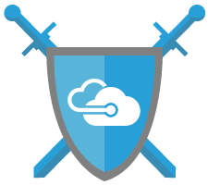
Next steps
Try Windows Server 2016 Technical Preview: https://www.microsoft.com/en-us/evalcenter/evaluate-windows-server-technical-preview
Check out Windows Server 2016 page: http://www.microsoft.com/windowsserver2016
Windows Server Blog: http://blogs.technet.microsoft.com/windowsserver

