Slide 1
Exam Prep 70-398:
Section 1: Design for Cloud/Hybrid Identity
Joe Lurie
MCS Northeast
Alfred Ojukwu
MCS Northeast

Slide 2



Joe Lurie
Senior Consultant - Microsoft
jolurie@microsoft.com
TechReady Speaker, exam prep sessions for Windows 8 and 10, Azure, and EMS. All of this is related to 70-398
Active in Devices and Mobility community
Fun fact (you decide): Never watched Star Trek of any flavor – no episodes of any variety, no movies

Slide 3








Alfred Ojukwu
Senior Consultant - Microsoft
alojukwu@microsoft.com
Mobility Consultant with Microsoft Consulting Services (MCS)
Certified Trainer – MCT - Mobility
20+ Years in IT Administration
WW Community Lead, Devices and Mobility
Extensive involvement with Internal and External Readiness
Blog: http://thedevicepros.com
Interesting Fact: Grew up in Hawaii
alojukwu@

Slide 4
Agenda - list all main modules
1
Design for Cloud/Hybrid Identity (15-20%)
2
Design for device access and protection (15-20%)
3
Design for data access and protection (15-20%)
4
Design for Remote Access (15-20%)
5
Plan for apps (15-20%)
6
Plan updates and recovery (15-20%)

Slide 5
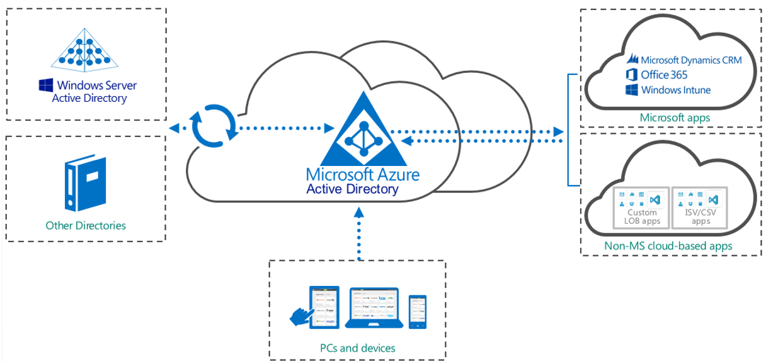

Design for Cloud / Hybrid Identity

Slide 6



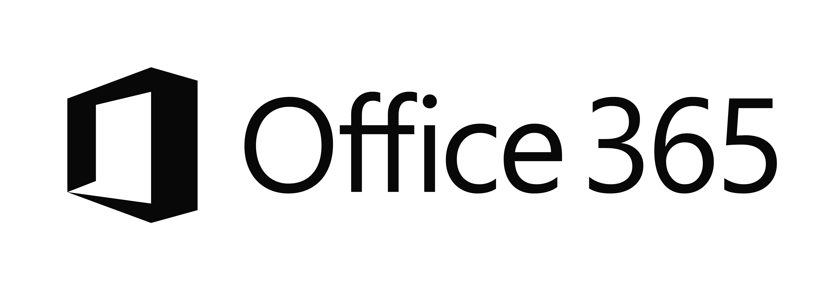

The Current Reality…
EC2
On-Premises
Managed devices
Private Cloud

Slide 7
Identity as the control plane
Simple connection
Self-service
Single
sign on
Windows Server
Active Directory
Username
•••••••••••
Other
Directories
SaaS
Azure
Public
cloud
Office 365
On-premises
Cloud
Microsoft Azure Active Directory

Slide 8


Delivering a seamless user authentication experience
Active Directory
Microsoft Azure
Identity Synchronization with password (hash) sync
User attributes are synchronized using Identity Synchronization services including a password hash, Authentication is completed against Azure Active Directory
Identity Synchronization
Microsoft Azure
User attributes are synchronized using Identity Synchronization tools, Authentication is passed back through federation and completed against Windows Server Active Directory
AD FS

Slide 9

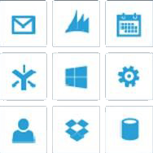

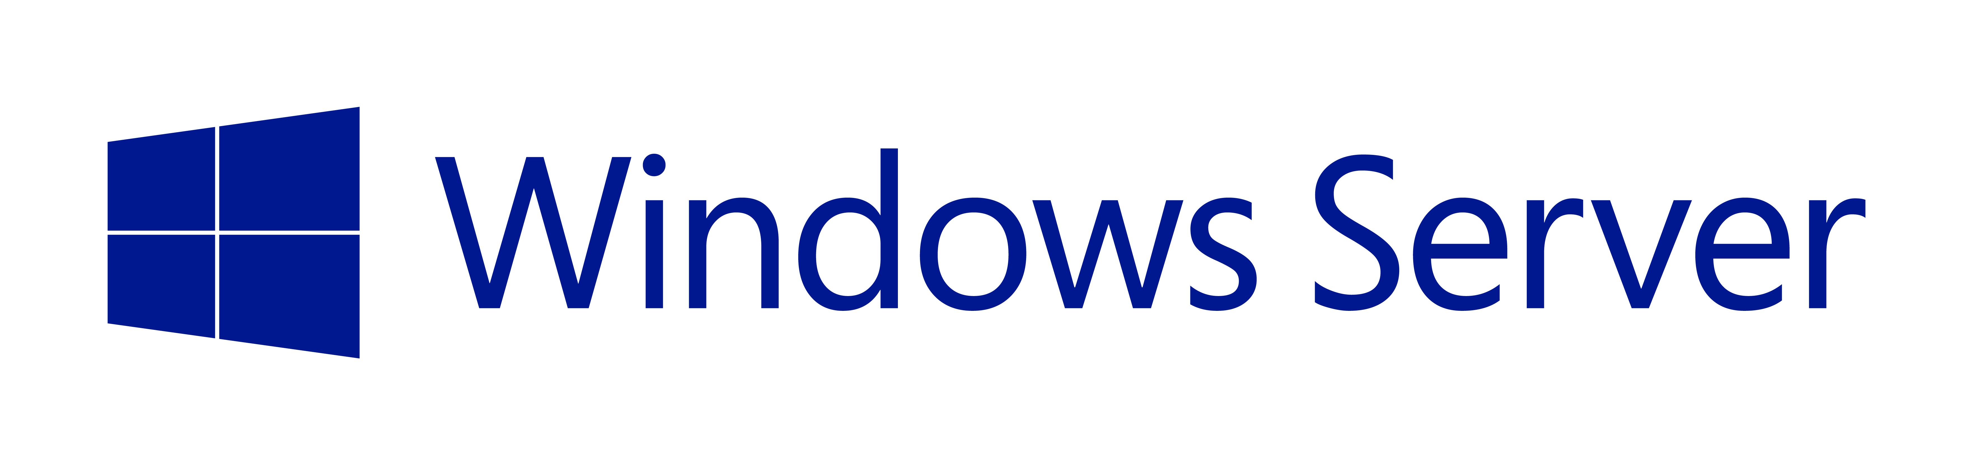


Identity Federation
Organizations can connect to SaaS applications running in Azure, Office 365 and 3rd party providers
Enhancements to AD FS include simplified deployment and management
SaaS Apps
Active Directory
Active Directory
Published applications
Web Application Proxy
(includes AD FS Proxy)
Active Directory Federation Services
Organizations can federate with partners and other organizations for seamless access to shared resources
Conditional access with multi-factor authentication is provided on a per-application basis, leveraging user identity, device registration & network location
Claims & Kerberos web apps
Office Forms Based Access
Resources in other businesses or identity realms
Active Directory Federation Services
Restful OAuth apps

Slide 10
Federation Benefits
Single Sign-On
Reduced Credentials
Fewer Accounts to manage
Authentication Flexibility
Authorization Control
Claims extensibility
Unified Programming Model
Reduced development efforts
Decouple AuthN & AuthZ Policies from code
Interoperability
Stronger authentication methods (MFA)
Enforce AuthN and AuthZ policies
Granular control over resources trough Conditional Access Control assets
User Perspective
IT Perspective
Developer Perspective
Security Perspective
10

Slide 11
Identity Choices
Identity Type | AAD Subscription Required | AAD Connect Required | AD DS Required | AD FS Required | Microsoft Federation Gateway Required
Cloud Identity | YES | NO | NO | NO | NO
Synced Identity | YES | YES | YES | NO | NO
Federated Identity | YES | YES | YES | YES | YES

Slide 12
Azure Active Directory
Alfred Ojukwu

Slide 13
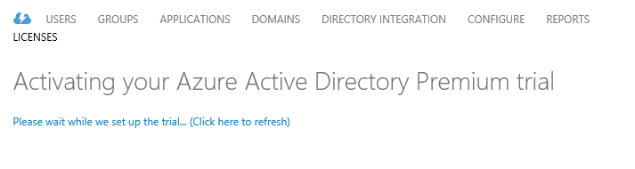
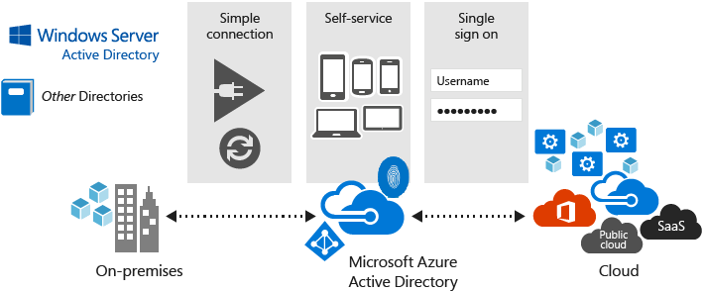
Planning for Azure Active Directory (AD)
Custom LOB applications that integrate with Azure Active Directory
Sign in to Active Directory-integrated applications with cloud identities
Active Directory-integrated applications can access Office 365 and other web APIs
Applications can extend Azure Active Directory schema
Cross-platform support (iOS, Android, and Windows)
Open Standards
(SAML, OAuth 2.0, OpenID Connect, Odata 3.0)

Slide 14
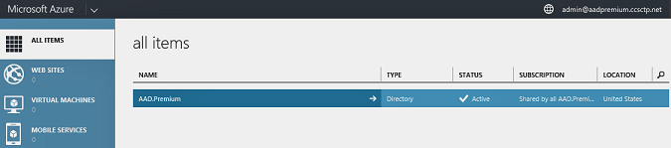
Planning for Azure Active Directory (AD)
Design Azure AD premium features
  Cloud app discovery
  Group-based application access
  Self-service group management
  Advanced security reporting
  Password reset with write-back

Slide 15
Azure Active Directory features and editions
 |  |  | Azure AD Basic | Azure AD Premium | Office 365 apps only
Common Features | Directory as a Service | 500,000 Object Limit | No Object Limit | No Object Limit | No Object limit for Office 365 accounts
 | User/group management (add/update/delete) | Yes | Yes | Yes | Yes
 | SSO to pre-integrated SAAS applications / custom apps | 10 apps per user | 10 apps per user | No Limit | 10 apps per user
 | User-based access management/provisioning | Yes | Yes | Yes | Yes
 | Self-service password change for cloud users | Yes | Yes | Yes | Yes
 | Azure AD Connect | Yes | Yes | Yes | Yes
 | Security reports/audit | 3 Basic Reports | 3 Basic Reports | Advanced Security Report | 3 Basic Reports
Premium+ Basic Features | Group-based application access management |  | Yes | Yes
 | Self-Service Password Reset for cloud users |  | Yes | Yes | Yes
 | Company branding (logon pages/access panel customization) |  | Yes | Yes | Yes
 | Application Proxy |  | Yes | Yes
 | Service Level Agreement (99.9%) |  | Yes | Yes | Yes
Premium Features | Self-Service Group Management |  |  | Yes
 | Self-Service Password Reset/Change with on-premises write-back |  |  | Yes
 | Advanced usage reporting, security reports and alerts |  |  | Yes
 | Multi-Factor Authentication (cloud and on-premises (MFA server)) |  |  | Yes | Limited cloud only for Office 365 Apps
 | MIM CAL + MIM Server |  |  | Yes
 | Administrative Units (in Preview) |  |  | Yes
 | Cloud App Discovery |  |  | Yes
 | Conditional access : MFA per application (in Preview) |  |  | Yes
 | Automated password roll-over (in Preview) |  |  | Yes

Slide 16
Azure Active Directory features and editions
 |  | Azure AD Free | Azure AD Basic | Azure AD Premium | Office 365 apps only
Premium Features | Connect Health |  |  | Yes
 | Connect Write Back of users and groups (in Preview) |  |  | Yes
 | HR Integration with Workday (in Preview) |  |  | Yes
 | Dedicated Group (in Preview)
 | Dynamic Group (in Preview) |  |  | Yes
 | Azure AD Domain Services (in Private Preview)
 | Add your own SaaS applications
 | Privileged Access Management |  |  | Yes
 | Self-service application requests
 | Azure reporting API |  |  | Yes

Slide 17
Practice Question
Your network contains an Active Directory domain named bcdtrain.com. You create an Azure Active Directory (Azure AD) domain named bcdtrain.onmicrosoft.com. You need to provide a single sign-on experience for on-premises users to bcdtrain.onmicrosoft.com.
What should you do first?
Install Active Directory Federation Services (AD FS)
Add a domain in Azure AD
Deploy a Windows Server 2012 R2 virtual machine in Azure and install Active Directory Domain Services (AD DS).
Enroll in Azure Active Directory Premium
Download Azure AD Connect

Slide 18

What is Azure Multi-Factor Authentication?
A stand-alone Azure Identity and Access management service also included in Azure Active Directory Premium
Prevents unauthorized access to both on-premises and cloud applications by providing an additional level of authentication
Trusted by thousands of enterprises to authenticate employee, customer, and partner access.

Slide 19

Azure MFA
Connectivity and Mobility Options
Types of MFA Supported: Phone Call, Text Message, Smart Phone app, Oauth Token
Azure MFA requires AAD Premium or EMS (which includes AAD Premium)
Two usage models: Per authentication, per user (break even point is 10 auths/month)
Azure MFA is free for Azure Administrators

Slide 20
How it works
Mobile apps
Phone calls
Text messages
1 4 5 6 7 6
ALERT

Slide 21

1
Users sign in from any device using their existing username/password.
2
Users must also authenticate using their phone or mobile device before access is granted.
User
On-Premises Apps
RADIUS
LDAP
IIS
RDS/VDI
SAML
.NET, Java, PHP…
Cloud Apps
Multi-Factor
Authentication
Server
Multi-Factor
Authentication
Server
Microsoft Azure
Active Directory
Windows Server
Active Directory or Other LDAP

Slide 22
Azure MFA vs MFA for Office 365
 | MFA for Office 365/Azure Administrators | Azure Multi-Factor Authentication
Administrators can Enable/Enforce MFA to end-users | Yes | Yes
Use Mobile app (online and OTP) as second authentication factor | Yes | Yes
Use Phone call as second authentication factor | Yes | Yes
Use SMS as second authentication factor | Yes | Yes
Application passwords for non-browser clients (e.g. Outlook, Lync) | Yes | Yes
Default Microsoft greetings during authentication phone calls | Yes | Yes
Suspend MFA from known devices | Yes | Yes
Custom greetings during authentication phone calls |  | Yes
Fraud alert |  | Yes
MFA SDK |  | Yes
Security Reports |  | Yes
MFA for on-premises applications/ MFA Server. |  | Yes
One-Time Bypass |  | Yes
Block/Unblock Users |  | Yes
Customizable caller ID for authentication phone calls |  | Yes
Event Confirmation |  | Yes
Trusted IPs |  | Yes

Slide 23
Azure MFA
What is it
Initiated after the user has supplied a user name and password
Initiated only if the user has been configured for MFA
Users can select which form of MFA they prefer – phone, text or authenticator app.
NOTE: Some versions of Outlook and Lync do not support MFA. Some other non-browser based applications may also not support MFA. For these apps you would need to manage authentication via an application password.

Slide 24
Practice Question (Hard)
Your network contains an Active Directory domain named domain1.com. Domain1.com is synchronized with Domain1.onmicrosoft.com for Azure Active Directory (Azure AD). You plan to require Azure Multi-Factor Authentication for Domain1.com users by using a Remote Desktop Gateway. You need to configure Azure Multi-Factor Authentication for Domain1.com users.
What should you do? Select the three actions you should perform and arrange them in the order in which you should perform them.
Download and install the Multi-Factor Authentication Server.
Add a Multi-Factor Authentication Provider
Enable multi-factor authentication for users in on-premises Active Directory.
Enable multi-factor authentication for users in Azure AD.
Download and install the Multi-Factor Authentication Server.
Configure multi-factor authentication settings for Azure AD
Add the application to Azure AD
Enable multi-factor authentication for users in on-premises Active Directory.
Add a Multi-Factor Authentication Provider

Slide 25
User Self-Service
Configured after setting up MFA
Allows users to update their contact information (phone number) without involving IT
  Accessible via http://myapps.microsoft.com
Allows self-service password reset
TIP: Exam questions that refer to reducing IT overhead or reducing administrative effort with regards to user management, look for answers around user self-service

Slide 26
Group Management
Allows users to create/manage/delete groups
NOTE: SECURITY GROUPS CANNOT BE CREATED USING SELF-SERVICE GROUP MANAGEMENT
Allow group owners to add new members, edit the group name, leave the group, delete the group, set group ownership
Can delegate self-service of groups to a restricted set of users (do not need to open to all users)
Pro Tip: In a hybrid identity scenario, you could have both AD DS sourced groups and cloud groups. Be careful about complexity if you enable group management in both locations.

Slide 27
Practice Question (Easy)
You plan to deploy Azure Active Directory self-service password reset on your network. You need to configure the user password reset policy to meet the following requirements:
Users must answer security questions if they forget their password.
Users must be presented with three questions if they forget their password.
Users must answer five questions to enroll for password reset.
Users should not have to update their security questions once they have enrolled.
How should you configure the user password reset policy? (All options range from 0 to 5)
Number of authentication methods required
1
Number of questions required to register
5
Number of questions required to reset
3
Number of days before users are asked to reconfirm their authentication information?
0

Slide 28
Directory Synchronization

Slide 29
AD Sync and Active Directory Connect
AD Connect connects on-prem AD with Azure AD allowing for SSO
Design single sign-on
  Password Sync: hashes of user passwords sync’d from on-prem AD to Azure AD (default option)
  AD Federation Services (AD FS): user logs onto SaaS applications with on-prem password – use if security policy prohibits syncing password hashes to the cloud
Active Directory integration scenarios
  On-prem to Cloud
  Cloud to on-prem

Slide 30
Upgrade Options
DirSync (<50k objects)
  In-place migration of all supported custom configurations
  Will not migrate unsupported configurations (such as removed attribute flows)
DirSync (>50k objects)
  Side-by-side deployment. Export DirSync configuration and import in Azure AD Connect
    On Dirsync box, wizard prompts you to export config file
    On new box, @ cmd prompt run AzureADConnect.exe /migrate, specify config file
    Once full import and full sync complete, uninstall dirsync on old box, on new box run wizard second time to turn off staging mode
Azure AD Sync
  In-place upgrade

Slide 31
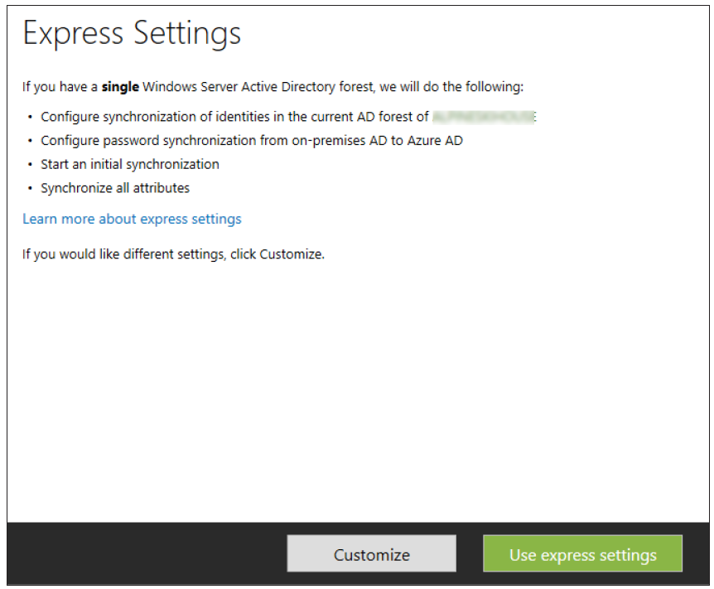
Prepare for AAD Connect
For all scenarios (Express Settings or Custom)
  Office 365 or Azure AD subscription – free trial is OK
  For custom Azure AD domains, configure your public DNS records
    Wizard will tell you if DNS is not complete
  AD users have UPNs (IDFix)
Just for AD FS
  SSL certificate is trusted on all FS+WAP host
    Generally a non issue if publicly trusted cert
  Enable WinRM on all remote targets
  Federation service name resolves
    Wizard ‘verify’ helps with this
For write-back scenarios
  AAD Premium, prepare Active Directory

Slide 32
Demo:
Azure Active Directory Connect

Slide 33
Azure Active Directory Connect – Required Servers
Server Type | Operating System/Version | Role | Comments
Existing Domain Controllers | Windows Server 2008 or later | Active Directory domain controller | Forest functional level must be 2003 or higher
Synchronization | Windows Server 2008 R2 or later | Azure Active Directory Connect Synchronization Services | Windows Server 2012 R2 recommended
Federation | Windows Server 2012 R2 | AD FS | Two or more recommended
Federation Proxy | Windows Server 2012 R2 | Windows Server WAP | Two or more recommended
Database | SQL Server 2008 or later | Data store for synchronization and AD FS | Required only when scaling beyond approximately 50,000 - 100,000 users

Slide 34
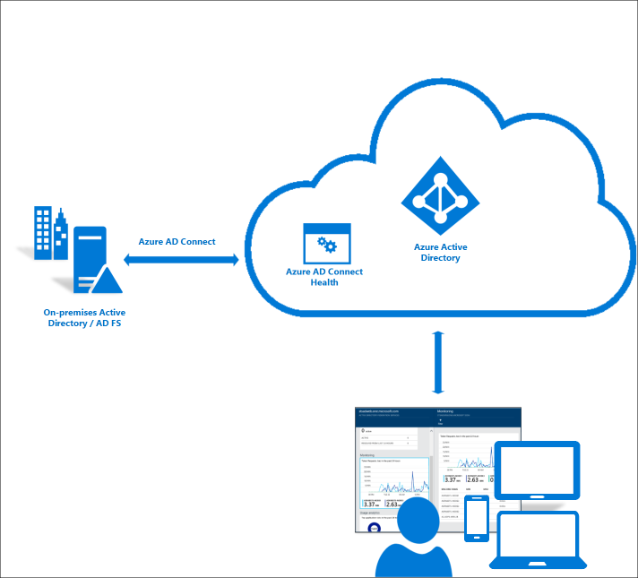
Active Directory Connect Health
What is it
  Offers ability to view alerts, performance patterns, and configuration settings
  Agent found in Marketplace under Security + Identity
Requirements
  Requires Azure AD Premium subscription
  Must be Global Administrator to enable
  If using AD FS, AD FS auditing must be enabled to use Usage Analytics
  Agent must be installed on all targeted servers
  Azure AD Connect Health Agent for Sync must be installed (installed by default)
  Firewall ports 80, 443, 5671
  Must have connectivity to Azure Service endpoints

Slide 35
Reporting

Slide 36

Security reports
Rule based (free)
  Sign ins from unknown sources
  Sign ins after multiple failures
  Sign ins from multiple geographies
Specialized information
  Sign ins from possibly infected devices
  Sign ins from IP addresses with suspicious activity
Machine learning
  Irregular sign in activity
Combined
  Users with anomalous sign in activity
Actions
  Reset password
  Manage Multi-factor auth
  Ignore event
Download reports

Slide 37
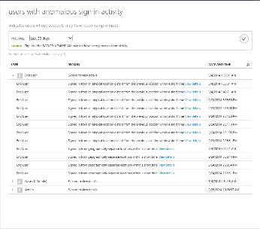
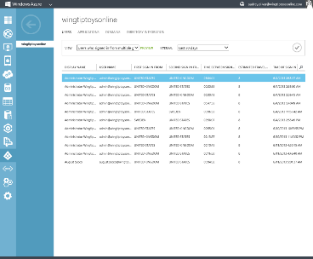

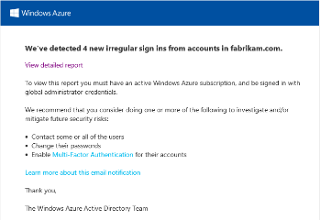
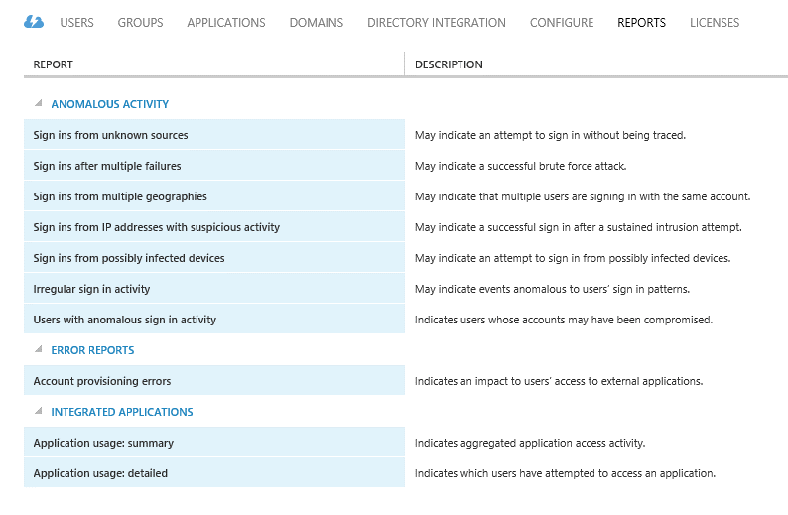
Operational reports
Activity
  Audit (free)
  Password reset activity
  Password reset registration activity
Application Management
  Application usage
  Account provisioning activity (free)
  Account provisioning errors (free)

Slide 38
Practice Question (Easy)
Your network contains an on-premises Active Directory Domain Services (AD DS) domain named bcdtrain.com and an Azure Active Directory (Azure AD) domain named bcdtrain.onmicrosoft.com
Azure AD Connect is installed and Active Directory Federation Services (AD FS) is configured. Password write-back is enabled.
You need to monitor the synchronization events generated by Azure AD Connect.
What should you do first?
Install Azure AD Connect Health
Create a new Operational Insights workspace
Install Azure AD Privileged Identity Management
Enable Azure AD Premium Features

Slide 39
Practice Question (Medium)
You are the Enterprise Mobility Administrator for Contoso.com. You have been asked to ensure that all cloud access to mobile device can be monitored. After configuring the cloud settings for Azure AD Connect health using default settings, you install the client agent and notice that you are unable to retrieve reports from the Azure AD.
You need to ensure you can retrieve reports to review health status. What should you do to retrieve reports?
You need to open TCP Port 80, and 443 to resolve IIS traffic in your firewalls
You need to uninstall and re-install the client agent
You need to open TCP Ports 80, 443, and 5671 in your firewalls.
You need to enable Microsoft to access your health information
You need to enable automatic of your Azure AD Connect Health agent in the portal
You need to open TCP Port 80, and 3389 to resolve IIS traffic in your firewalls

Slide 40
Design for Cloud/Hybrid Identity– EXAM TIPS
Tip #1
Know the Azure editions and the features available in each
Azure AD Free
Azure AD Basic
Azure AD Premium
O365 apps only
Azure AD Connect Health
Tip #2
MFA – Multifactor Authentication supports phone, text, app, or Oauth. User can select which he prefers
Tip #3
Azure AD Connect Health can be used to monitor the synchronization events generated by Azure AD Connect
Connectivity and Mobility Options

