Slide 1
Microsoft Azure: Infrastructure as a Service (IaaS)

Slide 2
How to View This Presentation
All slides have two styles of PDF documents:
  Full View – full page view per slide
  Notes View – 3 slides per page with ruled lines used to take notes
Use Adobe Reader or other PDF viewing tools to review the PDF slides
All PDF slides are located in your AzureIaaSWS.zip file

Slide 3
Introduction and Logistics
Your trainer
You
  Your role
  Your company
  Your experience in this technology area
  Your goals for this workshop
Start and end times
Facilities (bathrooms, smoking)
Meals
Computers, phones, tablets, etc.
Please set to vibrate
What’s on your desk?

Slide 4
Module 2 - Azure Resource Manager (ARM)
Overview

Slide 5
Benefits of Azure Resource Manager (ARM)
Desired-state deployment
Faster deployments
Role-based access control (RBAC)
Resource-provider model
Common interface for Azure and Azure Stack
Notes:
Purpose of Slide
Discuss basic benefits of ARM
Notes
ARM does desired-state deployment of resources. It does not do desired-state configuration inside these resources (e.g., VMs), although it can initiate the process of desired-state configuration.
Faster Deployments – ARM can deploy in true parallel as compared to semi-sequential in ASM
RBAC is fully integrated with AAD – and is a long-requested feature.
Resource-provider model is intended to be fully extensible.
Common interface for Azure and Azure Stack – When Azure Stack is released, same API model for on-premises and Cloud

Slide 6
ARM Definitions
Resource - Atomic unit of deployment
Resource group - Collection of resources
Resource provider - Manages specific kinds of resources
Resource type - Specifies the type of resource
Notes:
Basic ARM Definitions before you start going in to detail

Slide 7
Resource Groups
A Resource Group is a Unit of Management
Application Lifecycle Containment – Deployment, update, delete and status
Declarative solution for Deployment – “Config as Code”
Grouping – Metering, billing, quote: applied and rolled up to the group
Consistent Management Layer
Access Control – Scope for RBAC permissions
Notes:
Slide Objectives
To discuss the concept of a resource group
Notes
Application Lifecycle Containment – You can deploy everything included in a resource group together, thereby maintaining versions of an application along with it’s resources.
Declarative Solution – RG’s are .json, declarative/configuration code
Grouping – Resource groups provide a logical grouping of resources
Consistent Management Layer – In the V2 portal, everything is controlled in a RG. RGs can be accessed via REST APIs and resource providers
Access Control – You can only use RBAC in the new portal and the highest level generally used for RBAC is the resource group level. There is a Subscription Admin role, but that is typically not the type of things customers are interested in assigning to IT Pros or Developers
[EDITOR] TWB_Trevor:
09 October 2013
It seems odd to use “finally” here, given that this is not a long process – or, at least, has not been described in great detail. Kindly consider removing it, or replacing it with something that clarifies context.

Slide 8
Azure Resource Groups
Tightly coupled containers of multiple resources of similar or different types
Resource groups can span regions
Every resource *must* exist in one and only one resource group
RESOU
R
CE G
R
OUP
Notes:
Resource Groups
When resources are in the container, they have a common lifecyle. You can deploy these things together, put RBAC on them together with one request and they can know about each other
Every resource must be in ONE resource group, important for RBAC
Don’t have to live in same location, can deploy to multiple regions
Resources can be heterogenous or homogenous

Slide 9
Resource Group Lifecycle
Question:
Should these resources be in the same group or a different one?
Hint:
Do they have common lifecycle and management?
Answer:
It’s up to you.
Notes:
Most significant question is of lifecycle and what to place in a resource group
Can apply RBAC, but is this right for a particular resource group?
Sometimes resources are shared across multiple applications, in other words a VM could be stored in a storage account in a different resource group
Lifecycle is distinct and managed by different people
No hard and fast rule

Slide 10
Organizational Concepts
Resource groups
Tightly coupled to a container of resources
Follows RBAC rules
1 resource group at a time
Tags
  Loosely coupled user or system defined categorization
  Arbitrary boundaries
  15 tags to use as needed
Resource groups and tags are the building blocks from which users define applications.
Notes:
Resource Groups
Tightly coupled to a container of resources – a resource can only be in one resource group
Follows RBAC rules – you can specify RBAC roles for specific permissions per resource or per resource group
1 resource group at a time – in the portal, you can only view one resource group at a time
Tags
Loosely coupled user or system defined categorization – A tag can be associated with resources from multiple resource groups
Arbitrary boundaries – Tags can be associated to anything within a subscription
15 tags to use as needed - 15 unique tag names are the limits

Slide 11
Deployment Templates
SQL-A
Instantiation of repeatable config.
Configuration → Resource Group
What?
Source file, can be checked-in
Specifies resources, dependencies and connections
Parameterized input/output
Why?
Ensure Idempotency
Simplify orchestration
Provide cross-resource configuration and update support
Website
[SQL CONFIG] VM (2x)
DEPENDS ON SQL
DEPENDS ON SQL
SQL - A
Website
Virtual
Machines
SQL
C
ONFIG
Notes:
Written in JSON, describes entities
Template execution engine can interpret dependencies and relationships and orchestrate the deployment of the resources for you
Resources at the bottom of the stack are deployed first
Idempotent, can redeploy and get the same goal state
Parameterized input and output – reuse template in different environments
Templates are represented in the gallery

Slide 12
Demo: Resource Groups and Templates
Notes:
Look at current portal first – this is a singleton
Show the different pieces of the current portal, show how hard it is to find things
Log in to new portal
Need website + SQL database that already exists in a resource group
Browse, show blades, resource groups
Click on resource/application
Show overall containerization of resource group (note bugs may be present)
Show monitoring, billing
Show alert rules (don’t create one, just show one that exists)
Go to Home screen and show how to customize tiles
Discuss Templates
Show the gallery in the new portal. The gallery is just where you click on either the New button or Everything to show the list of things that can be created.
New portal is run entirely with ARM and some things are not available
Deploy a new web app
Chose new ASP.Net starter site
Create
Name it
Set hosting plan
Put the hosting inside a new resource group
Also show Virtual Machine gallery images – VM templates – including Linux
Show the deployed website and explain the deployment

Slide 13
Module 2 - Azure Resource Manager (ARM)
Resource Providers

Slide 14
Resource Providers
Used to deploy specific types of resources
Identified by provider namespace
    e.g., Microsoft.Compute, Microsoft.Storage, Microsoft.Web (~25 Microsoft or Customer namespaces)
Resource types
    Each provider namespace manages one or more resource types: e.g., virtualMachines
    Different regional availability and apiVersions
PowerShell
    Get-AzureLocation
    Get-AzureRMResourceProvider
Notes:
We will show examples of what types of resource providers are currently available, but the slides following this are always changing rapidly in that the product team is constantly adding new resource providers to the list
A Resource Provider is used by the Azure Resource Manager to manage distinct types of resources – in your JSON template, you will have code that shows what the resource provider expects to see in order for the resource provider (sitting out in Azure) to build the resource that you want…for example a SQL Server or SQL DB or VM
Resource providers are an extensibility point allowing new resource providers to be added in a consistent manner as new services are added to Azure – anyone can write their own provider
Get-AzureLocation indicates which resourceTypes are available in each region
Get-AzureRMResourceProvider indicates which resource providers and apiVersions are available in each region.
(Get-AzureRMResourceProvider -ProviderNamespace Microsoft.Storage).ResourceTypes | Where { $_.ResourceTypeName -eq 'storageAccounts' } | Select –ExpandProperty ApiVersions
(Get-AzureProvider -ProviderNamespace Microsoft.Storage).ResourceTypes | Where { $_.ResourceTypeName -eq 'storageAccounts' } | Select -ExpandProperty Locations

Slide 15
Resource Provider Types (examples)
Resource Type | Usage
Microsoft.Compute/virtualMachines | Virtual Machines (VMs) ~ (V2)
Microsoft.Storage/storageAccounts | Storage accounts (V2)
Microsoft.Compute/availabilitySets
Microsoft.Network/networkInterfaces | Virtual network interface card (NIC)
Microsoft.Network/loadBalancers | Azure Load Balancer or Internal Load Balancer
Microsoft.Network/virtualNetworks | Virtual networks (V2)
Microsoft.ClassicStorage | V1 storage – not managed by ARM
Microsoft.ClassicCompute | V1 VMs – not managed by ARM
Many more!
Notes:
Purpose of slide
To show a small example of the types of resource providers currently available
NOTES
Special note to show the ‘classic’ resource providers that are not controlled by ARM

Slide 16
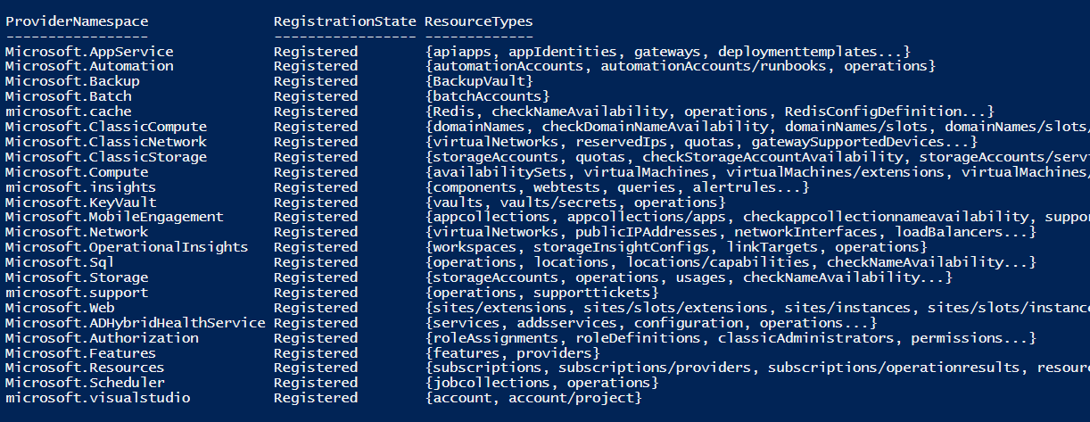
How do I know what resources providers are available?
Using PowerShell, log in to your Azure account and then run
Get-AzureRmResourceProvider
Notes:
Running this PS cmdlet, you can tell which providers are available in which regions. Note that you need to first log in with Login-AzureRmAccount

Slide 17
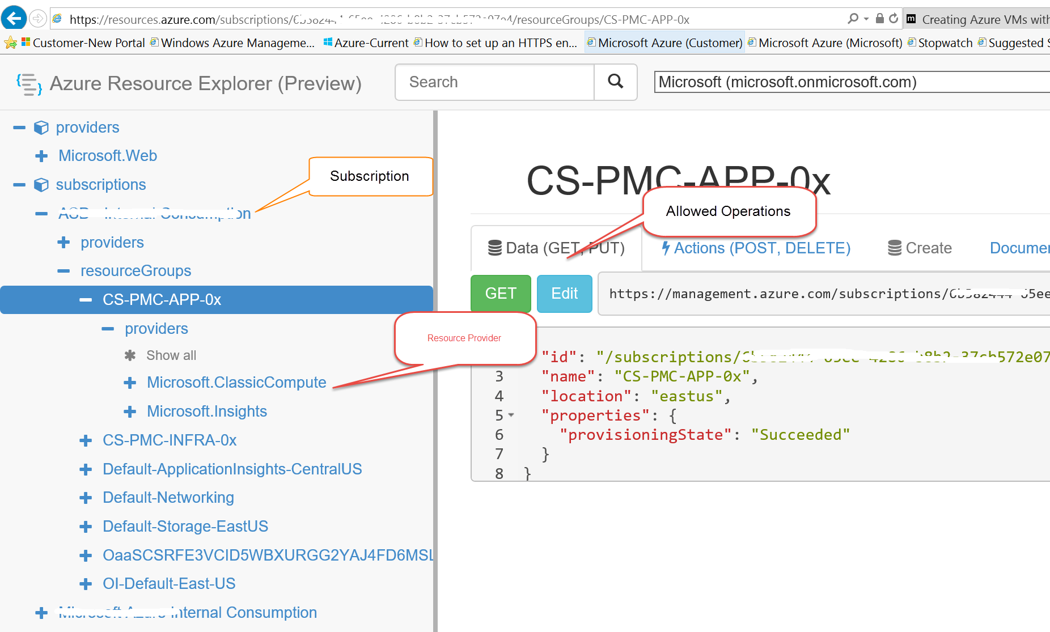
How can I see what Resource Providers are in use in my subscription?
Go to https://resources.azure.com and log in using your Azure Credentials
Notes:
Using the Azure resource explorer, you can see what is currently in use and also what type of operations you are allowed to perform on the resources from the explorer view. In the recent release of the V2 portal there is also an icon that takes you to its view of the resource explorer but the UI does not appear to be quite as functional as this one.

Slide 18
Resource Definition
Name
    Unique for resource group and resource type (e.g., Microsoft.Compute/virtualMachines)
Id
    Unique across Azure
    /subscriptions/GUID/resourceGroups/myRG/providers/Microsoft.Compute/virtualMachines/vmName
Location
ResourceType
ResourceGroup
Properties
    Additional properties specific to the resource provider
Notes:
Focusing more on what a resource definition consists of, if you look in a JSON file you will see these types of parameters listed

Slide 19
Other Azure Resource Manager links
Link to all templates: https://azure.microsoft.com/en-us/documentation/templates/
GitHub: https://github.com/Azure/azure-quickstart-templates
Visualize your Templates: http://armviz.io
Capture a Resource Group* : http://capturegroup.azurewebsites.net
Visual Studio Code: https://code.visualstudio.com/
    Visual Studio Code Extensions: https://marketplace.visualstudio.com/VSCode
*Capture group requires OrgId sign in and is very sensitive
Notes:
Various tools for templates

Slide 20
Module 2 - Azure Resource Manager (ARM)
Tools

Slide 21
Tools typically used by IT with ARM
PowerShell
Troubleshooting in the portal
Visual Studio
Notes:
The focus here is to discuss what tools IT Pros may use with ARM.
PowerShell – PowerShell is used to deploy the ARM templates and can be used to download log files from the Resource Group to analyze issues
Troubleshooting in the Portal – we will discuss how to troubleshoot in the portal vs. PowerShell
Visual Studio – less likely but also available to IT Pros
There of course are other tools like
Cross Platform command line tool
Postman for REST Apis
But those are not typically used by IT to build and deploy

Slide 22
Visual Studio
Provides a new template from the gallery
Allows the deployment of a resource group
Generates scripts to deploy application
Notes:
Visual Studio, although not required, will more than likely be the tool of choice for creating the ARM templates.
Out of the Box, VS has an Azure Resource Group template, and then provides a list of ready-made templates that can be used as a starting position.
Inside the template you will view the JSON and the PowerShell script for deployment.

Slide 23
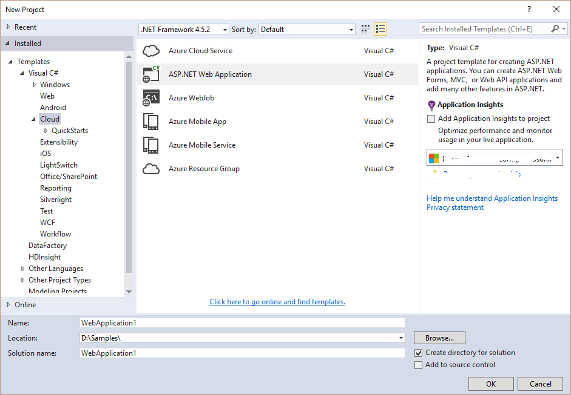
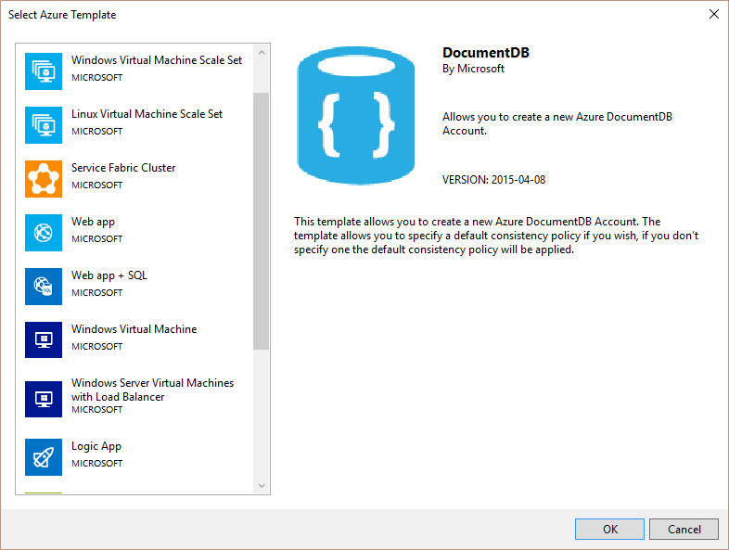
Template options
Notes:
When opening Visual Studio, you first select the template for ‘Azure Resource Group’, then you will be asked what type of template you want to choose from

Slide 24
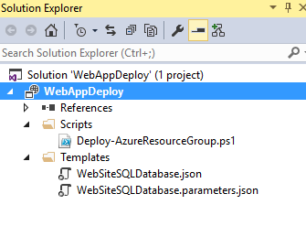
Files Generated by Template
PowerShell script for deployment
JSON Template
JSON Parameter file
Notes:
PowerShell script – VS does not deploy the RG or App, the PowerShell script does
JSON Template – this is the template that has the resources, variables, configuration as code to decide what to put into the RG
JSON Parameter file – can be used in multiple environments
You can right click on the deployment project and select to deploy it to a resource group
Fill in the dialog box parameters

Slide 25
Demo: Visual Studio Deployment

Slide 26
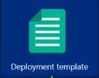


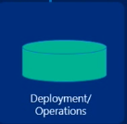
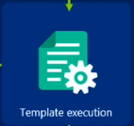
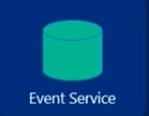



Troubleshooting Deployments
Azure Portal
Azure Resource
Manager
Notes:
As resources are being deployed, the resource providers will interact with the Event Service
Gathers event information about what is happening behind the scenes
<click> The slide opens with just a screenshot of how the portal is separated from the ARM in that the ARM is responsible for the entities involved with the execution of the template and performing the deployment operations.
<click> A deployment template is sent to ARM
<click> Simultaneously, as the template execution is taking place, information is being requested from the resource providers, which in turn, are reporting all actions they are taking to the Event service
<click> The Event service then notifies the event viewer of operations. This includes ANY activity that gets performed

Slide 27
Demo: Troubleshooting
Event Viewer in the Azure Portal
Deployment operations in the Azure Portal
Notes:
Event Viewer
In the V2 portal, you need to have a working, deployed, pre-existing web application
Go to Monitoring and see Events in the past week
Drill in to items, look at actions and talk about how this effects RBAC
Deployment operations
Find Deployment history and click on it. Click through it looking at the details of the history. In the Resource Group blade, at the top you will see a ‘Last Deployment’ Click on this to see the deployment history.
Deployment logs in PowerShell
In PowerShell ISE, type in Get-AzureRmLog -ResourceGroup 'WebPlusSQL-1' -Verbose - note that to get this to work, although I had already logged in with Login-AzureRmAccount, it kept giving me errors saying ‘larrywa@Microsoft.com’ is not authorized to perform this operation. I ran Clear-AzureProfile, did another Login-AzureRmAccount

Slide 28


