Slide 1
Extensible Platform
Microsoft Dynamics 365
Eric Boocock
Director Product Marketing

Slide 2

Session objectives
This session will cover…
What’s new in application extensibility
Introduce new extensibility scenario with PowerApps and the Common Data Model “CDM”
Leaving today, you should
be able to…
Understand the new application extensibility investments in Dynamics 365
Understand the new opportunity to build composite LOB apps PowerApps and the CDM

Slide 3
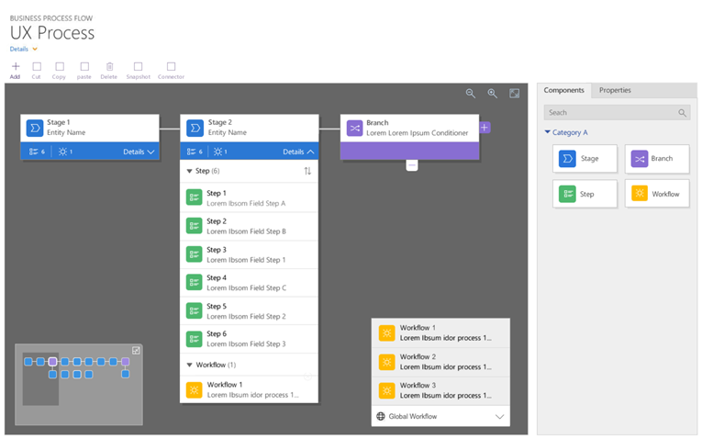
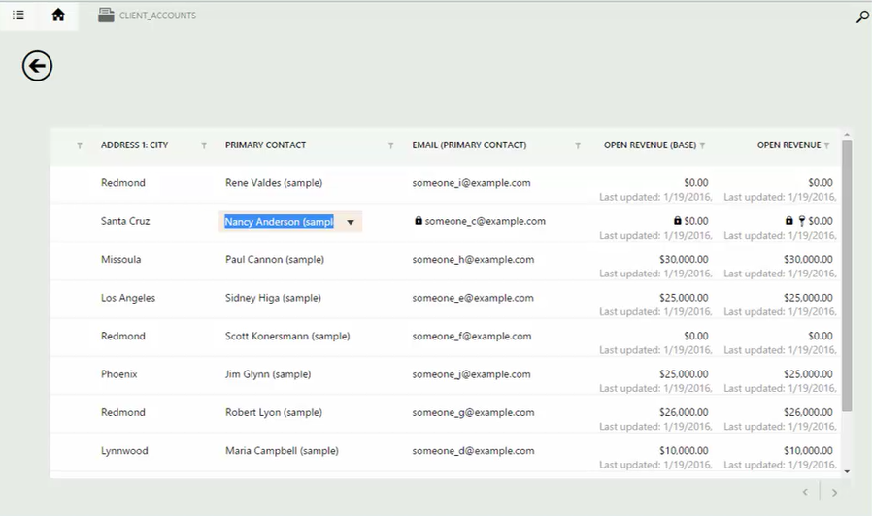
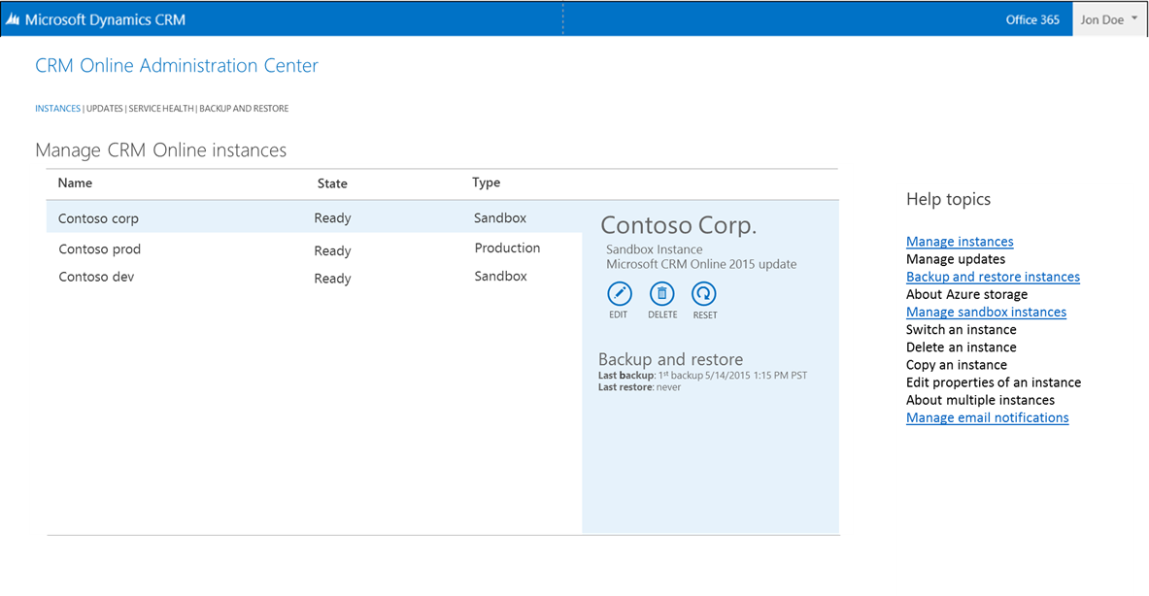
What’s new in App Extensibility
Sales, Customer Service, Field Service, Project Services Automation
Visual process designer
Easy to use designer for automation and composition that provides intelligence and insights.
Editable grids
Complete in-grid and sub-grid editing in both the Web and Mobile with portable business logic.
Scheduling Unification
Schedule Sales and Service to leverage scarce resources and skillsets across multiple modes of service in an Everything-as-a-service world.
Data Warehouse & Backup and restore
Data replication to Azure SQL for enterprise reporting requirements & perform your own CRM backup’s and restores to meet business data recovery plans.
Notes:
1. Visual Process designer; With visual process designer we are delivering a drag-and-drop visual designer that will be an easy to use designer for automation and composition that provides intelligence and insights. For Business Process Flows, the Process Designer enables composition scenarios with Workflows that can be configured to be automatically executed on certain events to manipulate data or other processes. For Task Flows, it allows the visual modelling of the flow structure and integration with Portable Business Logic. This will increase collaboration as organization can run multiple business process against the same record. Processes include full security support meaning processes are only available to approved roles, enabling information security scenarios. Process record also become externally available through the SDK for custom applications such as PowerApps and PowerBI. Business recommendations are rule-based, action driven insights that can be defined by Key users or Business Analysts through the us of portable business logic and it helps guide users using the process to take the correct next step.
2. Editable Grids; One of our highly requested features is being launched in this release of CRM. We are now offering editable grids in both the Web Client and Mobile App. In this release we will support a complete in-grid editing experience at the entity or sub-grid level. Editable grids will support column groupings, filtering, sorting, pagination, hierarchical views and calculated fields. Users will be able to navigate with either the mouse or keyboard and let’s not forget the number of “clicks” this is going to reduce for our community! Last but not least we are also creating a configuration experience so any customer, ISV or partner can leverage for their extensions.
3. Scheduling Unification: One continuous set of experiences in order to bring together the scheduling experiences. This allows organizations to leverage scarce resources and skillsets across multiple modes of service in an Everything-as-a-service world. For example you can assign resources to various representations of work including cases, work orders, and project.
4. Data Warehouse: Dynamics CRM Online now supports data replication to Azure SQL Servers which opens a huge window of opportunity for advanced data warehouse requirements. Enterprise reporting requirements are now easily met.
5. Backup and Restore: As we continue to invest in the trusted cloud we are now offering our CRM online customers the ability to perform their own CRM backup’s and restores to meet their business data recovery plans. This scenario provides customers the ability to backup the CRM database to Azure storage using Hypernet (not the public internet) which means we offer a secure transfer of the data. Another unique feature this brings to the table is the ability to download and connect your backup to an On-Premise environment. We see several potential scenario’s our customers will utilize this scenario for, one of them being a local developer experience.

Slide 4
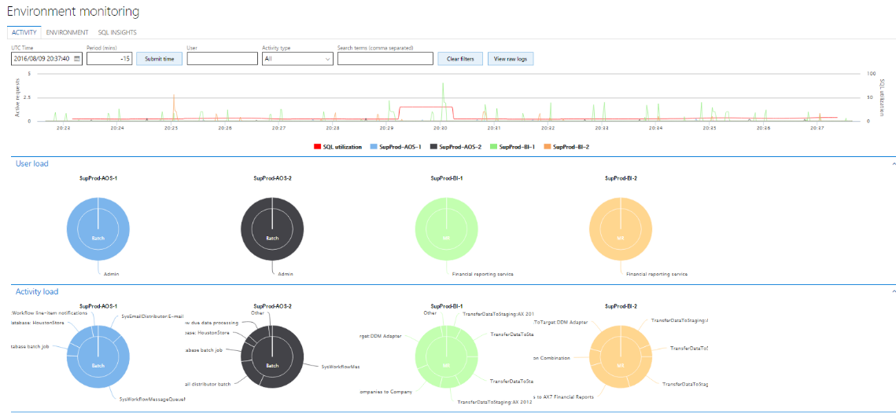
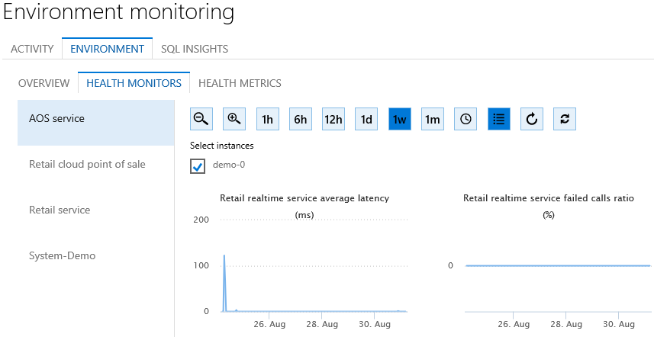
What’s new in App Extensibility
Operations
Key Vault
Customer stores and manages keys to business application data and provide these to anyone that would like to access.
Automated Disaster Recovery
Automate disaster recovery and increase in service level with Azure Site Recovery (ASR).
Monitoring
Onboarding service health and entity store monitoring.
Data migration for Dynamics AX 2009
Data migration tool set to migrate data from Dynamics AX 2009 implementations to Dynamics 365 for Operations. (Migration tools for AX2012 to Dynamics 365 for Operations planned for Q1 2017)
Notes:
Security improvements using Key Vault
ASR – business continuity

Slide 5



Adaptability of business processes
DYNAMICS 365 BUSINESS APPS
PURPOSE BUILT APP FOR MY TEAM
3rd PARTY APPS
Sales
Customer
Service
Custom Apps
by PowerApps
Operations
Operations
Field
Service
Microsoft AppSource
Compose Workflow by Microsoft Flow
PRODUCTIVITY APPS & DASHBOARDS
Project Service
Automation
Business Processes
Business Processes
Business Processes
Business Processes
Business Processes
Business Processes
Data
Other data
sources
Data
Data
Data
Common
Data Model
Common Navigation

Slide 6
PowerApp demo
Meeting prep app

Slide 7

Key resources
Additional blitz sessions
  Microsoft Dynamics 365
  Sales
  Customer Service
  Field Service
  Project Service Automation
  Monetization
Post-blitz learning series
Infopedia and PartnerSource
Help and training
Dynamics YouTube channel

Slide 8

Go-dos
Continue configuring and extending Dynamics 365 apps to meet customer requirements
Learn more about PowerApps, the CDM and Microsoft Flow
Consider PowerApps to enable unique customer scenarios and business processes that are not native to Dynamics 365
Leverage TDM BOM assets on Infopedia
Tell the One Microsoft story
Be a Microsoft Dynamics 365 evangelist

Slide 9
Thank you

