Slide 1
Module 2
Maintaining Active Directory® Domain Services
Notes:
20411C
2: Maintaining Active Directory® Domain Services

Slide 2
Module Overview
Implementing Virtualized Domain Controllers
Implementing RODCs
Administering AD DS
Managing the AD DS Database
Notes:
20411C
2: Maintaining Active Directory® Domain Services

Slide 3
Implementing Virtualized Domain Controllers

Slide 4
Lesson 1: Implementing Virtualized Domain Controllers
Considerations for Virtual Domain Controller Deployment
How Checkpoints Affect Domain Controllers
Domain Controller Virtualization in Windows Server 2012
Domain Controller Cloning
Demonstration: Cloning Domain Controllers
Domain Controller Virtualization Best Practices
Notes:
20411C
2: Maintaining Active Directory® Domain Services

Slide 5
Considerations for Virtual Domain Controller Deployment
Virtualization benefits of domain controllers:
  Scalability
  Independence from hardware
  Quicker recovery
Windows Server 2012 is cloud-ready and virtualization aware
Considerations for virtualization include:
  Time synchronization
  Domain membership of the virtualization host
  Single point of failure
  Moving AD DS to the cloud
Notes:
20411C
2: Maintaining Active Directory® Domain Services

Slide 6
How Checkpoints Affect Domain Controllers
Checkpoints are useful for testing and developing environments, but can corrupt an AD DS database
Replication between domain controllers is a complex, multistep process
Changes are made at attribute, not object level
Each domain controller tracks attribute changes from all other domain controllers, and assigns USNs to all changes
Restoring a checkpoint could wipe out USNs
Change replication could be stopped or incomplete between domain controllers that had checkpoints restored and those that did not
Notes:
20411C
2: Maintaining Active Directory® Domain Services

Slide 7
Domain Controller Virtualization in Windows Server 2012
To support safe virtualization of domain controllers:
  Hypervisor needs to support a Virtual Machine Generation Identifier, such as Hyper-V on Windows Server 2012
  Virtual guest domain controller needs to be on Windows Server 2012 or newer
Safeguards are triggered when:
  A snapshot is restored during guest shutdown
  A snapshot is restored while machine is running
Guest employs virtualization safeguards by
  Invalidating the local RID pool
  Setting a new invocation ID for the domain controller database, effectively presenting itself as new domain controller and verifying all objects and attributes
Notes:
20411C
2: Maintaining Active Directory® Domain Services

Slide 8
Domain Controller Cloning
Domain controllers can be cloned for:
  Rapid deployment
  Private clouds
  Recovery strategies
To clone a source domain controller:
  Add the domain controller to the Cloneable Domain Controllers group
  Verify application and service compatibility
  Create a DCCloneConfig.xml file
  Export once and create as many clones as needed
  Start the clones
Notes:
20411C
2: Maintaining Active Directory® Domain Services

Slide 9
Demonstration: Cloning Domain Controllers
In this demonstration, you will see how to:
  Prepare a source domain controller that is to be cloned
  Export the source virtual machine
  Create and start the cloned domain controller
Notes:
20411C
2: Maintaining Active Directory® Domain Services
(More notes on the next slide)

Slide 10
Domain Controller Virtualization Best Practices
Avoid single points of failure
Ensure that all computers participate in the same time services infrastructure
Use virtualization technology with the Virtual Machine Generation Identifier feature
Use Windows Server 2012 or Windows Server 2012 R2 as virtualization guests
Avoid or disable snapshots
Ensure that the virtualization administrators are as trusted as your Domain Admins
Consider taking advantage of cloning in your deployment or recovery strategy
Start a maximum of 10 new clones at the same time
Consider using virtualization technologies that allow virtual machine guests to move between sites
Adjust your naming strategy to allow domain controller clones
Notes:
20411C
2: Maintaining Active Directory® Domain Services

Slide 11
Implementing RODCs

Slide 12
Lesson 2: Implementing RODCs
Considerations for Implementing RODCs
Managing Credential Caching on an RODC
Managing Local Administration for RODCs
Demonstration: Configuring RODC Credential Caching
Notes:
20411C
2: Maintaining Active Directory® Domain Services

Slide 13
Considerations for Implementing RODCs
RODCs provide several important functions:
  Credential caching
  Administrative role separation
  Read-only DNS
To deploy an RODC:
  Ensure there is no computer account in AD DS for the new RODC
  Precreate the RODC account in AD DS in the Domain Controllers container
  Run the AD DS installation wizard on the new RODC
Notes:
20411C
2: Maintaining Active Directory® Domain Services

Slide 14
Managing Credential Caching on an RODC
Credential caching is managed through Password Replication Policies
Password Replication Policies:
  Determine which credentials to cache on an RODC
    User accounts
    Computer accounts
  Contain an allowed and denied list
    Allowed RODC Password Replication Group
    Denied RODC Password Replication Group
Do not cache domain administrative accounts
Notes:
20411C
2: Maintaining Active Directory® Domain Services

Slide 15
Managing Local Administration for RODCs
Delegate RODC administration to local administrators
Set a single security principal as an administrator
  User
  Group
Enable by using the following methods:
  Managed By tab of RODC
  dsmgmt
  ntsdutil
Cache the credentials of delegated administrators
Notes:
20411C
2: Maintaining Active Directory® Domain Services

Slide 16
Demonstration: Configuring RODC Credential Caching
In this demonstration, you will see how to:
  Configure password replication groups
  Create a group to manage password replication to the remote office RODC
  Configure a password replication policy for the remote office
  Evaluate the resulting password replication policy
  Monitor credential caching
Notes:
20411C
2: Maintaining Active Directory® Domain Services
(More notes on the next slide)

Slide 17
Administering AD DS

Slide 18
Lesson 3: Administering AD DS
Overview of Active Directory Administration Snap-ins
Overview of the Active Directory Administrative Center
What Is Ntdsutil?
Overview of the Active Directory Module for Windows PowerShell
Demonstration: Managing AD DS by Using Management Tools
Managing Operations Master Roles
Managing AD DS Backup and Recovery
Notes:
20411C
2: Maintaining Active Directory® Domain Services

Slide 19
Overview of Active Directory Administration Snap-ins
Active Directory administration snap-ins consist of four different MMC consoles:
  Active Directory Users and Computers
  Active Directory Sites and Services
  Active Directory Domains and Trusts
  Active Directory Schema
Use RSAT Windows Update to install Snap-ins on non-domain controller computers
Notes:
20411C
2: Maintaining Active Directory® Domain Services

Slide 20
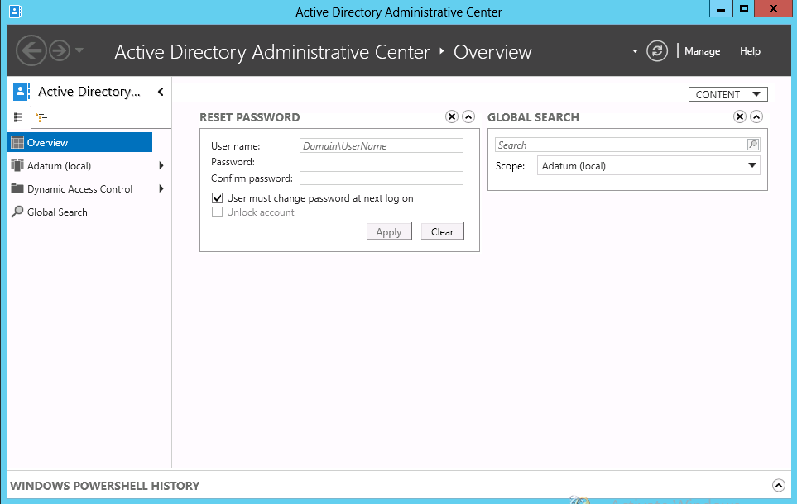
Overview of the Active Directory Administrative Center
Active Directory Administrative Center is a task-oriented tool based on Windows PowerShell
New features in Windows Server 2012
  Active Directory
  Recycle Bin
  Fine Grained
  Password Policy
  Windows PowerShell
  History Viewer
Notes:
20411C
2: Maintaining Active Directory® Domain Services

Slide 21
What Is Ntdsutil?
By using NTDSUtil you can:
Manage and control single master operations
Perform AD DS database maintenance
  Perform offline defragmentation
  Create and mount snapshots
  Move database files
Maintain domain controller metadata
Reset Directory Services Restore Mode password
Notes:
20411C
2: Maintaining Active Directory® Domain Services

Slide 22
Overview of the Active Directory Module for Windows PowerShell
The Active Directory module for Windows PowerShell provides full administrative functionality for:
  User management
  Computer management
  Group management
  OU management
  Password policy management
  Searching and modifying objects
  Forest and domain management
  Domain controller and operations-masters management
  Managed service account management
  Site-replication management
  Central access and claims management
Notes:
20411C
2: Maintaining Active Directory® Domain Services

Slide 23
Demonstration: Managing AD DS by Using Management Tools
In this demonstration, you will see how to:
  Create objects in Active Directory Users and Computers
  View object attributes in Active Directory Users and Computers
  Navigate within Active Directory Administrative Center
  Perform an administrative task in Active Directory Administrative Center
  Use the Windows PowerShell Viewer in Active Directory Administrative Center
  Manage AD DS objects with Windows PowerShell
Notes:
20411C
2: Maintaining Active Directory® Domain Services
(More notes on the next slide)

Slide 24
Managing Operations Master Roles
Operations Master Roles are assigned to the domain controller that is responsible for performing a specific task on the forest or domain
Forest-wide Operations Master Roles
  Domain Naming Master Role
  Schema Master Role
Domain-wide Operations Master Roles
  RID Master Role
  Infrastructure Master Role
  PDC Emulator Role
Notes:
20411C
2: Maintaining Active Directory® Domain Services

Slide 25
Managing AD DS Backup and Recovery
System State or Full backups of the Domain controllers allow the following type of restores:
  Non-authoritative or normal restore
  Authoritative restore
    Allows deleted objects to be returned on all domain controllers
  Full server restore
    Typically performed in Windows RE
Some tasks require you to stop AD DS service
Use NTDSUtil commands to optimize AD DS and clean up metadata
  Offline AD DS database defragmentation
  Remove records on deleted domain controllers
Notes:
20411C
2: Maintaining Active Directory® Domain Services

Slide 26
Managing the AD DS Database

Slide 27
Lesson 4: Managing the AD DS Database
Understanding the AD DS Database
Understanding Restartable AD DS
Demonstration: Performing AD DS Database Maintenance
Creating AD DS Snapshots
Understanding How to Restore Deleted Objects
Configuring the Active Directory Recycle Bin
Demonstration: Using the Active Directory Recycle Bin
Notes:
20411C
2: Maintaining Active Directory® Domain Services

Slide 28

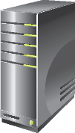
Understanding the AD DS Database
The AD DS database holds all domain-based information in four partitions
Domain Partition
Configuration
Partition
AD DS
Database
Schema Partition
DC
Application
Partitions (optional)
Notes:
20411C
2: Maintaining Active Directory® Domain Services

Slide 29
Understanding Restartable AD DS
AD DS can be started or stopped by using the Services console
AD DS can be in one of three states :
  AD DS Started
  AD DS Stopped
  DSRM
It is not possible to perform a system state restore while AD DS is in Stopped state
Notes:
20411C
2: Maintaining Active Directory® Domain Services

Slide 30
Demonstration: Performing AD DS Database Maintenance
In this demonstration, you will see how to:
Stop AD DS
Perform offline defragmentation of the AD DS database
Check the integrity of the AD DS database
Start AD DS
Notes:
20411C
2: Maintaining Active Directory® Domain Services
(More notes on the next slide)

Slide 31
Creating AD DS Snapshots
Create a snapshot of the AD DS
  Use NTDSUtil
Mount the snapshot to a unique port
  Use NTDSUtil
Expose the snapshot
  Right-click the root node of Active Directory Users and Computers, and choose Connect to Domain Controller
  Enter serverFQDN:port
View (read-only) snapshot
  Cannot directly restore data from the snapshot
Recover data
  Connect to the mounted snapshot, and export/reimport objects with LDIFDE
  Restore a backup from the same date as the snapshot
  Manually reenter data
Notes:
20411C
2: Maintaining Active Directory® Domain Services

Slide 32


Understanding How to Restore Deleted Objects
Deleted objects are recovered through tombstone reanimation
When an object is deleted, most of attributes are cleared
Authoritative restore requires AD DS downtime
Delete
Garbage collect
Live
Tombstoned
Physically deleted
Reanimate tombstone/
autoritative restore
Notes:
20411C
2: Maintaining Active Directory® Domain Services

Slide 33
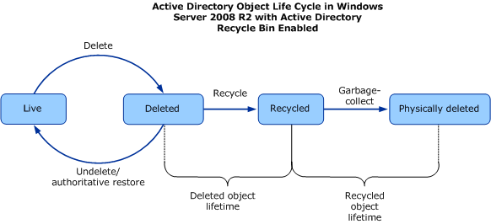
Configuring the Active Directory Recycle Bin
Active Directory Recycle Bin
  Provides a way to restore deleted objects without AD DS downtime
  Uses Windows PowerShell with Active Directory Module or the Active Directory Administrative Center to restore objects
Notes:
20411C
2: Maintaining Active Directory® Domain Services

Slide 34
Demonstration: Using the Active Directory Recycle Bin
In this demonstration, you will see how to:
  Enable the Active Directory Recycle Bin
  Create and then delete test accounts
  Restore deleted accounts
Notes:
20411C
2: Maintaining Active Directory® Domain Services
(More notes on the next slide)

Slide 35
Additional Resources & Next Steps
Instructor-Led Courses
  20411C: Administering Windows Server 2012
Books
Exam Ref 70-411: Administering Windows Server 2012
Exams & Certifications
  Exam 70-411: Administering Windows Server 2012

