Slide 1
Module 5: Microsoft Azure pricing
Notes:
Thank you for taking the time to view this training session. In this session, we will provide an overview of Microsoft Azure pricing and configurations..

Slide 2
Azure benefits for MSDN subscribers (U.S. $)
Subscription level | Visual Studio Professional with MSDN | Visual Studio Test Professional with MSDN | MSDN platforms | Visual Studio Premium with MSDN | Visual Studio Ultimate with MSDN
Azure credits included per month | $50 | $50 | $100 | $100 | $150
Annual savings first year | $600+ | $600+ | $1,200+ | $1,200+ | $1,800+
Estimated saving only includes the monthly credits provided and does not include any savings from the discounts and the use of MSDN software. Actual savings can be much higher. All prices indicated are for the United States as of the publish date. Check local prices.
Enjoy lower rates – 33 percent discount on Windows virtual machines and 25 percent discount on Cloud Services, HDInsight, and reserved websites
No additional charge for MSDN software in virtual hard disks customers upload
Support for organizational accounts - flexibility to transfer Azure account services and benefits between different employees of the same organization
Enable team development - allow team members to share the same subscription, enabling collaboration while also providing isolation between teams and environment
http://azure.microsoft.com/en-us/pricing/member-offers/msdn-benefits-details/
Notes:
MSDN customers get free Azure credits. Additionally, customers can enjoy lower rates with a 33 percent discount on Windows virtual machines and 25 percent discount on Cloud Services, HDInsight, and reserved websites. There is no additional charge for MSDN software in virtual hard disks that customers upload themselves. Customers also get the flexibility to transfer Azure account services and benefits between different employees of the same organization. And your customers can enable team development by allowing team members to share the same subscription, enabling collaboration while also providing isolation between teams and environment.

Slide 3
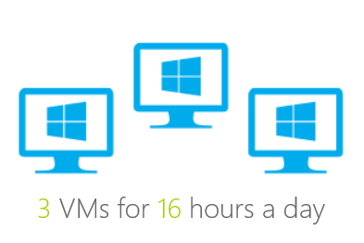
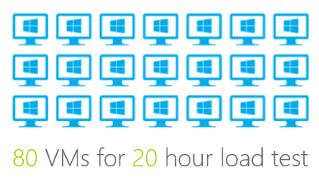
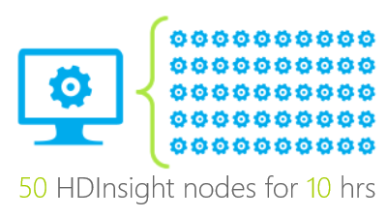
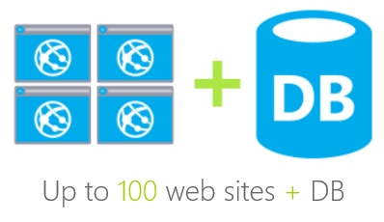
What can customers do with $100/month benefit?
Notes:
Here are just a few examples of what the $100 per month credit could enable your customers to do. They could run 3 virtual machines for 16 hours each day, or use 80 virtual machines for a 20 hour load test. Obviously, your customers can do whatever they like with the credit.

Slide 4
Ways to buy Azure
We sell Microsoft Azure in the following ways:
 | MicrosoftAzure.com | Enterprise Agreement | Open
Pay as you go | ✓
Monetary commitment
Azure plans
✓
✓
✓
✓
✓
✓
✓
Notes:
How do customers buy Azure? They can buy it with a credit card and pay as they use services. Or they can sign an Enterprise Agreement. When they add it to an Enterprise Agreement, they pay upfront but they get a reduced price. Or they can buy it through Open licensing where they get a discount. They buy $100 tokens on Azure and they just continue to buy tokens as they need more services.
At a high level, Azure is an ever-growing bundle of distinct cloud services that customers can use across our network of global datacenters. Each one of those services has it’s own costs associated. Each service has it’s own set of usage meters and prices. The typical way a cloud customer pays for these services on MicrosoftAzure.com is with a credit card once a month, but customers can also take advantage of licensing agreements like the Enterprise Agreement or Open license to save money and align licensing with their other Microsoft services.
I will go into more detail on the Monetary Commitment option on the next slide.

Slide 5
Ways to buy: monetary commitment
Monetary commitment
Monetary commitment
Prepay option for your usage
Pay as you go
Virtual machines
Websites
Cloud services
Mobile services
Deposit for use on eligible Azure pay-as-you-go services
Provides short-term billing in Enterprise Agreements (EA)
Take advantage of potential offers
Good until EA anniversary (maximum 12 months)
Have a use plan based on available pay-as-you-go services at time of commitment
Can’t be used on Azure plans, support, store, or other EA products and services
Site Recovery
Backup
HDInsight
SQL database
Media
RemoteApp
HPC
Scheduler
Automation
CDN
RemoteApp
Multi-Factor
ExpressRoute
Virtual Network
Data Transfer
Traffic Manager
Notes:
Furthermore, any solution your customers deploy on Azure is going to consume a variety of these services, and each is charged via its own price and meter (for example, per gigabyte per month, per compute size per minute, etc.).

Slide 6
Ways to buy: Azure plans
Similar to Office 365, some Azure services will have yearly subscription options
Pay as you go
Azure plans
Annual rights to a specific service or suite of services; payment through annual entitlement only
Virtual machines
Websites
Cloud services
Mobile services
Site Recovery
Backup
HDInsight
SQL database
Service
(e.g., Site Recovery)
Site Recovery
Media
RemoteApp
HPC
Scheduler
Suite of services
(e.g., Backup+Site Recovery)
Automation
CDN
RemoteApp
Multi-Factor
Backup
Site Recovery
ExpressRoute
Virtual Network
Data Transfer
Traffic Manager
Notes:
Furthermore, any solution you deploy on Azure is going to consume a variety of these services, that are each charged via their own price and meter (ex. per GB/per month, per compute size per minute, etc.). It’s complex, sort of like a cell phone bill with a number of different charges accruing to your total monthly price.

Slide 7
In the news: cloud pricing today
Extreme pressure on portal list prices
Azure…Promises to Match Any AWS Price Drop
- April 2013 (TechCrunch)
Microsoft Azure Drops Storage Prices To Match Amazon’s Latest Price Reduction
- January 2014 (TechCrunch)
Microsoft chops Azure prices to match Amazon’s latest reductions
- March 2014 (ZDNet)
Sources: http://techcrunch.com/2013/04/16/windows-azure-announces-general-availability-and-promises-to-match-any-aws-price-drop/; http://techcrunch.com/2014/01/24/microsoft-azure-drops-storage-prices-to-match-amazons-latest-price-reduction/; http://www.zdnet.com/microsoft-chops-azure-prices-to-match-amazons-latest-reductions-7000027898/
Notes:
Microsoft has announced publicly multiple times that we will not lose on price. I think you’ve all witnessed the price wars that are going on. One month after Amazon drops its price, we match them. We drop the price, Amazon matches us. The reality is, though, that Microsoft is committed to remaining competitive on price.

Slide 8
Azure EAs: what’s changed
No EA price increases result from these changes
EA PRICES MAINTAINED BY PUBLIC PRICE DROP
New and existing Azure services
Already in market
AS ANNOUNCED
Storage
Already in market
NO CHANGE
Legacy Compute
27-36%
from existing list price
Series A of compute, HDInsight, and Azure websites
3-12%
on most Azure services
Lowest listed
tier pricing on MicrosoftAzure.com
Notes:
A lot of customers purchase through their EA. They can bundle Azure into their existing EA or they can do an Azure-only EA, if they wish to. What that means is, depending on the level that they purchase, they get discounts or savings between 3 percent and 12 percent (based on October 2014 pricing). The old discount for Azure starting at 27 percent is only valid for the series A virtual machines, HDInsight, and Azure websites. Everything else in Azure falls into this category.

Slide 9
Sell Managed Services
Enable Service Providers and System Integrators to host and manage services and applications for their end customers.
Partner must have full admin access to any virtual machines or “OSE’s” (Operating System Entities) its customers use
Partner’s customers must only have admin access within their applications or virtual OSE’s (not to Azure services directly).
Partner is responsible for its customers’ use of Azure
Examples
Infosys manages Coca-Cola’s payroll application on Azure
Accenture hosts and manages Exchange Server on Azure for BMW
Notes:
Are you providing managed services on Azure?
This is one area where Microsoft is hearing of a lot of partner interest. You have the ability to purchase Azure for yourself. You can use it internally for your operations, demonstrations, Dev & Test, and for hosting your customer solutions and become a hoster, only that your data center is Azure.
There are no additional agreements for you to sign. There are no additional contracts for you to sign. You could buy an Azure EA for yourself or your company. Partners that own an Azure EA can host solutions for their customers. It accelerates the sales process and it puts a lot more money in your pocket.

Slide 10
Azure Use Rights
Permitted under MOSP, Open, and EA
Not Permitted
Internal use
Self-hosted ISV
Managed Services
Managed IT
Resale
Microsoft Azure services are deployed for and consumed by a single entity’s employees and affiliates
The Microsoft Azure platform is used to support the deployment of an ISV application or service that is made available to external entities, customers, partners etc.
Managed Service Providers (MSP) leverage Azure services to support an application or service that runs on top of the Microsoft Azure platform and provides primary and significant value above and beyond Azure itself
Managed Service Providers (MSP) provide a managed IT service to a third party that consists of the administration of and support for Microsoft Azure Services.
The “white labeling” or pure reselling of Azure services to end customers, where a customer that does not contract with Microsoft but directly accesses and/or manages Microsoft Azure services themselves.
Notes:
What rights do you get? Basically, you can use it internally. You can host some special intellectual property that you’ve developed. Or you can provide managed services or managed IT. However, you cannot “white label” Azure services and just resell Azure services. You have to have some management component or some intellectual property on top of Azure in order for you to resell that Azure consumption.

Slide 11
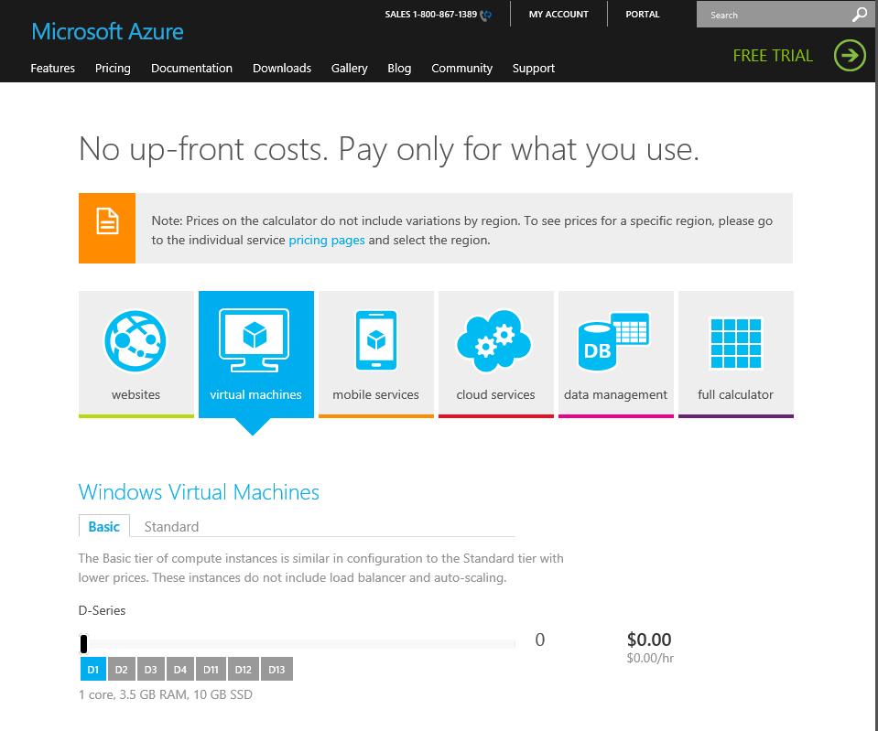
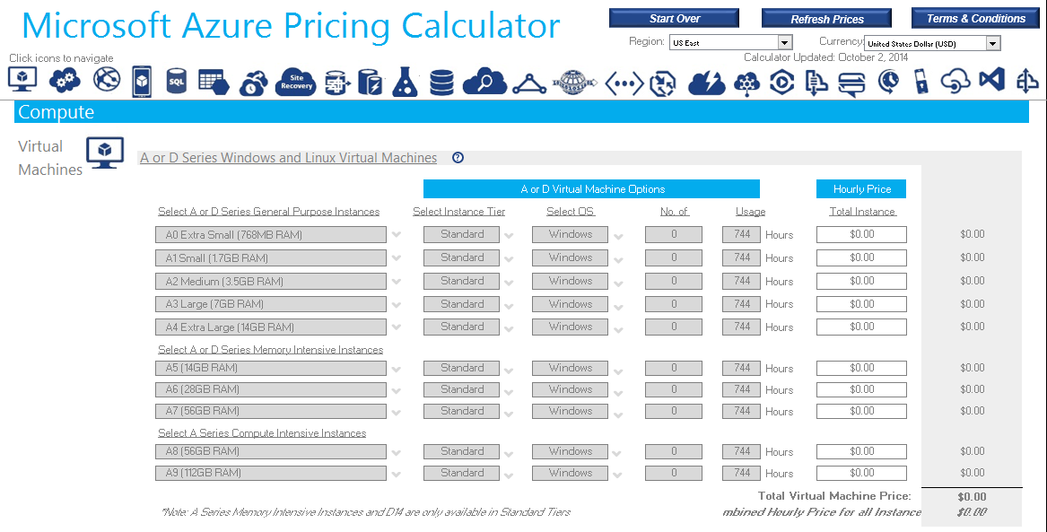
Azure calculators
Notes:
Got to MicrosoftAzure.com to access Azure calculators. Click on “pricing,” then select the pricing calculator. The full calculator gives you everything. This is how you would price a standard virtual machine. For example, you can select the number of cores for processing power, how much RAM, and then you get a price. Linux machines, SQL machines, Oracle machines, all of the services are on here. You can use the calculator to do a back-of-the-napkin type of cost estimation for the solutions that you are designing.

Slide 12
Sample Microsoft Azure quote (U.S. $) Extending a Datacenter
Opportunity: Web application server (Active Directory dependent) running on aging hardware. Customer desires reliable, highly available platform for the application server.
Proposed Microsoft Azure solution***
Microsoft Azure services | Monthly cost
Microsoft Azure S\services | Monthly Cost
2* x Application Server Virtual Machine – Standard Medium | $267.84
2* x Domain Controller Virtual Machine – Standard Small | $133.92
Virtual Network for Site to Site VPN ($.84/Day) | $26.78
Disk Storage – 400 GB (Geo Redundant Page Blob) | $38.00
Backup – 200 GB | $39.00
Estimated egress traffic** | $20.00
*Since these are critical production servers, 2 VMs are quoted. They will be part of an availability set, qualifying for the Azure SLA.
**Egress traffic will fluctuate based on usage but generally a low cost. *** Example only scenario, costs vary by deal.
Notes:
Here’s a solution for a customer that wanted to replace its web app servers that are running on aging hardware. The customer wants the app to be highly available and reliable.
If you know anything about Azure, you’ve got to deploy something what we call an “affinity group,” so it’s minimum of 2. That’s how a customer gets an SLA of 99.95%. So in this scenario, we have two app servers. For the domain controller, 2 standard smalls, some networking, some disk storage, some backup, and some estimated egress traffic. That’s basically walking through that pricing calculator when you fill those things out.

Slide 13
Sample Microsoft Azure quote (U.S. $) Identity Management (App Portal)
Opportunity: Customer uses several cloud SaaS providers including Office 365 and is having challenges with managing users and passwords for all services.
Proposed Microsoft Azure solution
Microsoft Azure services | Monthly cost
Add Office 365 Azure Active Directory to existing Azure tenant | Free
2* x Domain Controller Virtual Machine (One running Dirsync) – Standard Small | $133.92
Virtual Network for Site to Site VPN ($.84/Day) | $26.78
10 SaaS identity integrations in Azure Active Directory | Free
Estimated egress traffic** (172GB/Month) | $20.00
Total Monthly Estimated Cost | $180.70
Azure Services | Monthly Cost
*Since these are critical production servers, 2 VMs are quoted. They will be part of an availability set, qualifying for the Azure SLA.
**Egress traffic will fluctuate based on usage but generally a low cost.
Notes:
Here’s another example. This customer wants to provide Active Directory authentication for its Office 365 users and the rest of the company. So the customer gets two standard small VMs to run the domain controller and some networking. Notice that the Active Directory components are basically free if you’re an Office 365 customer.
As mentioned before, prices indicated are in U.S. dollars base don pricing at the time this course was developed. Local prices may vary.

Slide 14
Sample Microsoft Azure quote (U.S. $) Websites on Azure
Opportunity:
Pizza franchise runs internal and external websites with a commerce platform included and wants to get rid of on-premises solution.
Proposed Microsoft Azure solution
Azure services | Monthly cost
2 x Azure basic websites | $111.60
200 GB storage (Geo Redundant Page Blob Storage) | $19.00
500 GB egress traffic** | $43.07
1 small basic SQL Server machine | $352.66
Total Monthly Estimated Cost | $526.32
Yearly Costs | $6,315.85
*Egress traffic will fluctuate based on usage but generally a low cost.
Notes:
Here’s one more example. This customer wants to run scalable websites. Again, we configure 2 basic Azure website machines with some storage, geo-redundancy, some egress traffic, and a basic SQL Serve machine to run its ASP.NET app. This is different. Azure Websites is more of a “platform as a service” offering, so the redundancy is built-in. When you deploy a virtual machine, it is highly recommended that you create an affinity group.
One last time, prices indicated are in U.S. dollars base don pricing at the time this course was developed. Local prices may vary.

Slide 15
Thank you!
Notes:
Thank you for taking the time to view this module. We encourage you to review the other Microsoft Azure sales training modules.

