Slide 1
Exam Prep: Microsoft Technology Associate 98-366: Networking Fundamentals

Slide 2
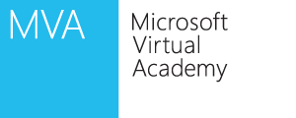
Meet the Presenters
Christopher Chapman, MCT
Content Project Manager, Microsoft Learning
Background
IT manager and implementer focused on deploying, maintaining and optimizing networks of all sizes
IT Consulting projects include Custom SharePoint for Microsoft IT, Netware/Notes migration to AD/Exchange, Transition to centralized management (250 clients)
Instructor and Director of Instruction
Multiple Microsoft and other industry certifications (MCP, MCTS, MCSA, MCSE, MCT)
Contact
christophermva@microsoft.com
@ChristopherMSL
Notes:
1 minute

Slide 3
Meet the Presenters
Thomas Willingham
Content Developer, Cloud and Enterprise
Background
Taught the Microsoft MCSE and the Novell CNE certifications, and worked as a network consultant for almost 10 years
Courseware Author for MS Learning
Content developer for Remote Desktop Virtualization at Microsoft for the last 5 years
Contact
gotthomas@microsoft.com
Notes:
1 minute

Slide 4
Course Topics
Network Fundamentals
01 | Understanding Local Area Networking
02 | Defining Networks with the OSI Model
03 | Understanding Wired and Wireless Networks
04 | Understanding Internet Protocol (IP)
05 | TCP/IP Tools
06 | Network Services
07 | Understanding Wide Area Networks
08 | Defining Network Infrastructure and Security
Notes:
1 minute

Slide 5
Setting Expectations
Target Audience
IT Help Desk staff interested in moving into Network/Systems Administration
Anyone interested in learning more about networking
Suggested Prerequisites/Supporting Material
Exam 98-349: Windows Operating System Fundamentals
Notes:
1 minute

Slide 6
Understanding Local Area Networking
Module 1

Slide 7
Objectives
Skills/Concepts | Objective Domain Description | Objective Domain Number
Examining Local Area Networks, Devices and Data Transfers | Understand local area networks (LANS) | 1.2
Identifying Network Topologies and Standards | Understand network topologies and access methods | 1.5
Notes:
This should also be a review for the 70-642.

Slide 8
Network components and Terminology
Data
Node
Client
Server
Peer
Network adapter
Hub
Switch
Router
Media
Transport Protocol
Bandwidth

Slide 9
Local Area Network
A Local Area Network (LAN) is group of computers confined to a small geographic area, such as a single building
A LAN is a group of computers or devices that share a common communication medium, such as cabled or wireless connections

Slide 10
Networks
Networks are used to exchange data
Reasons for networks include
Sharing information
Communication
Organizing data

Slide 11
Network Documentation
Network documentation helps describe, define, and explain the physical and logical method for connecting devices
The documentation phase occurs before a network is built, or when changes are made to the network
Microsoft Visio is a tool that can be used to document networks

Slide 12
Hub
A Hub is the most basic central connecting device
Hubs enable computers on a network to communicate
A host sends data to the hub. The hub sends the data to all devices connected to the hub
•
•

Slide 13
Switch
Switches work the same was as a hub, but they can identify the intended recipient of the data
Switches can send and receive data at the same time
•
•

Slide 14
Router
Internet
Routers enable computers to communicate and allow communication between two networks – such as your home network and the Internet
This communications link between the one network and the other is where the LAN ends
24.136.72.110
192.168.1.1

Slide 15
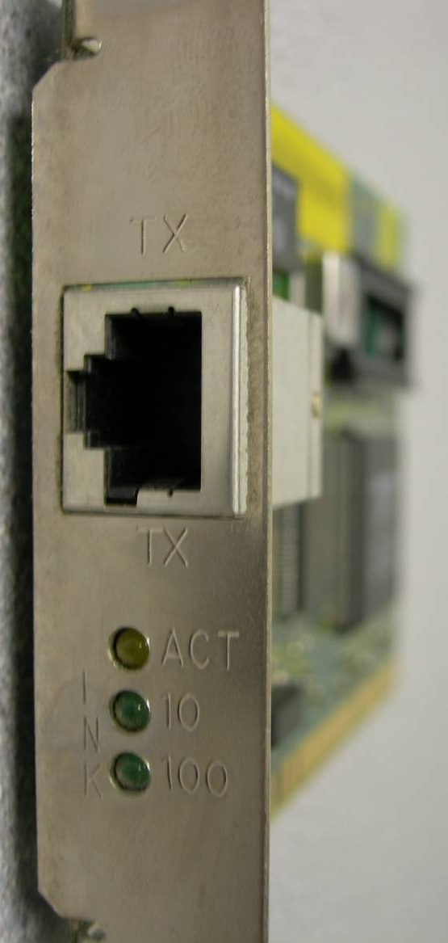
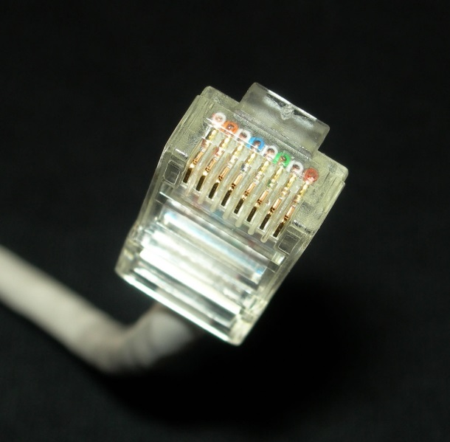
Network Adapter and RJ45 Patch Cable
A network adapter, also known as a network interface card (NIC), is the hardware device that enables you to send and receive from your computer
RJ45 is the most common type of network adapter connection
A network adapter can connect to the network by using cable (wired) or by air (wireless)
Notes:
This adapter might be integrated into the motherboard or act as a separate device that connects to a PCI slot or perhaps a PC card slot or USB port.

Slide 16
Wireless Access Point
The wireless access point (WAP) acts as the central connecting device for the network
Wireless networks can consist of many types of devices other than traditional PCs:
Smart phones
PDAs
Tablet computers
Micro computers
PCs and laptops equipped with wireless network adapters can connect to these networks as well

Slide 17
Demo
Device Manager Showing Network Adapters
Network Adapter Properties
IP Address

Slide 18
Serial Data Transfer
Serial data transfer is the transfer of one bit at a time—in other words, transfer in a single-bit stream, like a one lane highway
On the network cable, data travels in a single bit stream

Slide 19
Data Transfer Rate
Data transfer rate defines the maximum bits per second (bps) that can be transmitted over a network
Rated in bits, and signified with a lowercase b (for example, 10 Mbps)
The lowercase b differentiates this unit from data that is stored on a hard drive, which uses an upper case B that stands for bytes (for example 10 MB)
Types of Transfers
Broadcast sends data to every other host on the network
Unicast sends data to a specific host

Slide 20
IP Address
Most every computer and many other devices have an Internet Protocol (IP) address
An IP address uniquely identifies your device and the associated network and allows each device to send and receive information
A typical example of an IPv4 address would be 192.168.1.1
Every IP address is broken down into two parts by a subnet address
Network ID 192.168.1
Host ID 1

Slide 21
Subnet Mask
The subnet mask is a group of four numbers that define what IP network the computer is a member of.
All of the 255s in a subnet mask collectively refer to the network portion, whereas the 0s refer to the host portion.
Type of Address | First Octet | Second Octet | Third Octet | Fourth Octet
IP Address | 192 | 168 | 1 | 1
Subnet Mask | 255 | 255 | 255 | 0

Slide 22
Host
IP addresses are usually applied to your network adapter, but they can also be applied to other devices like switches, routers, and so on
The fact that a device or computer has an IP address is what makes it a host

Slide 23
LAN
Computers and other devices are connected using copper-based twisted-pair cables or wireless equipment

Slide 24
Virtual LAN
A virtual LAN (VLAN) is a group of hosts with a common set of requirements that communicate as if they were connected together in a normal fashion on one switch, regardless of their physical location.
Port 1: VLAN1
Port 2: VLAN1
Port 3: VLAN2
Port 4:
Port 5: VLAN1
Port 6: VLAN1
Port 7: VLAN2
Port 8: VLAN1
Port 9:
Port 10:

Slide 25
Network Topology
A network topology defines the physical connections of hosts in a computer network.
There are several types of physical topologies including:
Bus
Ring
Star
Mesh
Tree

Slide 26
Star Topology
Most Common topology
Each computer is individually wired to a central connecting device (hub, switch or SOHO router) with twisted-pair cabling

Slide 27
Mesh Topology
Every computer connects to every other computer; no central connecting device is needed.

Slide 28
Ring Topology
In a LAN environment, each computer is connected to the network using a closed loop
Used by Token Ring and Fiber Distributed Data Interface (FDDI)

Slide 29
Token Ring
A Token Ring network sends data logically in a ring fashion, meaning that a token goes to each computer, one at a time, and continues on in cycles
Physically Token Ring computers are connected in a star fashion
Namely, all computers in a Token Ring network are connected to a central connecting device known as a Multistation Access Unit (MAU or MSAU)

Slide 30
Ethernet
Institute of Electrical and Electronics Engineers (IEEE) standard (802.3) that defines how information is sent and received between network adapters, hubs, switches, and other devices
Ethernet is the de facto standard and is the most widely-installed local area network technology
Common types of Ethernet include:
802.3u or Fast Ethernet that runs at 100 Mbps
802.3ab or Gigabit Ethernet

Slide 31
Frames
Computers on Ethernet networks communicate via frames
A frame is a sequence of bits containing a detectable beginning and end of a packet in the stream of bits
A frame is a data packet residing on Layer 2 of the OSI model
frame
data
preamble
(8 bytes)
crc
(4 bytes)

Slide 32
Centralized Computing
Computing is done at a central location using terminals that are attached to this main system
Mainframes are a powerful computer and the rest of the devices connected to the computer are known as terminals (or dumb terminals)
Each terminal consisted solely of a keyboard and display with no processing power

Slide 33
Client/Server Model
The client/server model is an architecture that distributes applications between servers and client computers
Server: System that provides services such as Windows Server 2008 R2
Client: Device that requests services such as Windows 7

Slide 34
Peer-to-Peer Networking
Peer-to-peer networking distributes applications or workloads between computers
Peers are both service providers and service requestors

Slide 35
Distributed Computing
Distributive computing includes both client-server and peer-to-peer networks
Every device or workstation has its own processing power

Slide 36
Remote Desktop Services and Remote Sessions
Centralized computing has made a comeback of sorts. Remote Desktop Services and remote sessions to computers are based off of the centralized computing model
Thin-client computers do not have a hard drive and store an operating system in RAM, to be loaded up every time the device is turned on
All other applications and data are stored centrally, this system is a blend of centralized and distributive computing

Slide 37
Servers
More powerful computers that provide centralized services:
File
Print
Database
Network controller
Messaging/Email
Web

Slide 38
Client and Server Operating Systems
Client Operating Systems | Server Operating Systems
Windows 8 | Windows Server 2012
Windows 7 | Windows Server 2008 R2 Windows Server 2008
Windows Vista Windows XP | Windows Server 2003
Windows 2000 Professional | Windows 2000 Server
Windows NT 4.0 Workstation Windows ME/98/95 | Windows NT 4.0 Server

Slide 39
P2P
Peer-to-peer or P2P has recently taking on an additional meaning
P2P can also refer to file sharing networks
Examples of file sharing networks
Napster
Gnutella
G2
Other technologies also take advantage of P2P file sharing:
Skype
VoIP
Cloud computing

Slide 40
Summary
Understand local area networks (LANs), including but not limited to LAN elements, design, perimeter networks, IP addressing, and LAN types
Understand network topologies and access methods, including topologies such as star, mesh, and ring; Ethernet architecture; and the client-server and peer-to-peer networking models

Slide 41
Additional Resources & Next Steps
Instructor-Led Courses
40033A: Windows Operating System and Windows Server Fundamentals: Training 2-Pack for MTA Exams 98-349 and 98-365 (5 Days)
40349A: Windows Operating System Fundamentals: MTA Exam 98-349 (3 Days)
40032A: Networking and Security Fundamentals: Training 2-Pack for MTA Exams 98-366 and 98-367 (5 Days)
40366A: Networking Fundamentals: MTA Exam 98-366
Books
Exam 98-366: MTA Networking Fundamentals (Microsoft Official Academic Course)
Exams & Certifications
Exam 98-366: Networking Fundamentals

Slide 42
© 2012 Microsoft Corporation. All rights reserved. Microsoft, Windows, Windows Vista and other product names are or may be registered trademarks and/or trademarks in the U.S. and/or other countries.
The information herein is for informational purposes only and represents the current view of Microsoft Corporation as of the date of this presentation. Because Microsoft must respond to changing market conditions, it should not be interpreted to be a commitment on the part of Microsoft, and Microsoft cannot guarantee the accuracy of any information provided after the date of this presentation. MICROSOFT MAKES NO WARRANTIES, EXPRESS, IMPLIED OR STATUTORY, AS TO THE INFORMATION IN THIS PRESENTATION.

