Slide 1

Understanding Wired and Wireless Networks
Lesson 3

Slide 2
Objectives
Skills Concepts | Objective Domain Description | Objective Domain Number
Recognizing Wired Networks and Media Types | Understand Media Types | 2.3
Comprehending Wireless Networks | Understand Wireless Networking | 1.4
Notes:
This should also be a review for the 70-642.

Slide 3
Twisted-Pair Cable
the most commonly used cable type in local area networks
relatively easy to work with, flexible, efficient, and fast
contains eight wires grouped into four twisted pairs, typically blue, orange, green, and brown
The twisted wires reduce crosstalk and interference

Slide 4

568B, 568A, and BOGB standards

Slide 5
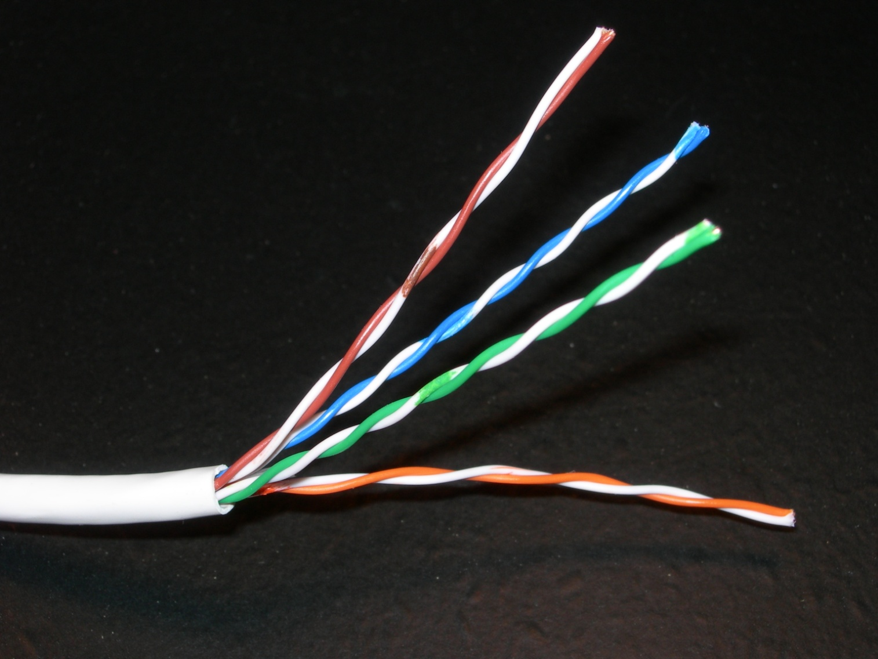
Twisted-Pair Cable with the Wires Exposed

Slide 6
Twisted Pair Categories
Twisted-pair cables are categorized according to the frequency at which they transmit signals and their data transfer rate
Cable Type | Speed
Category 3 (Cat-3) | 10 Mbps
Category 5 (Cat-5) | 100 Mbps
Category 5e (Cat-5e) | 100 Mbps and 1000 Mbps+
Category 6 (Cat-6) | 1000 Mbps+

Slide 7
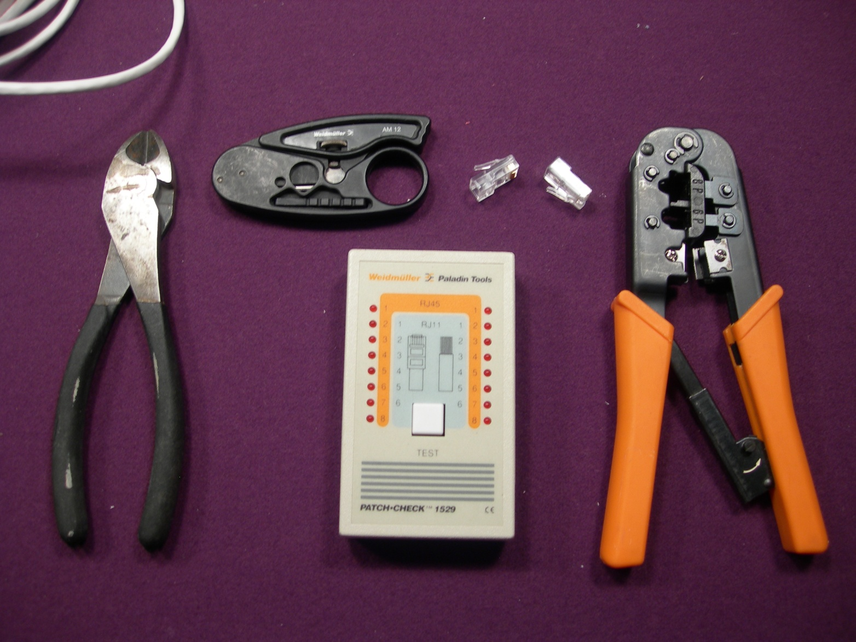
Tools For Twisted Pair Cables

Slide 8
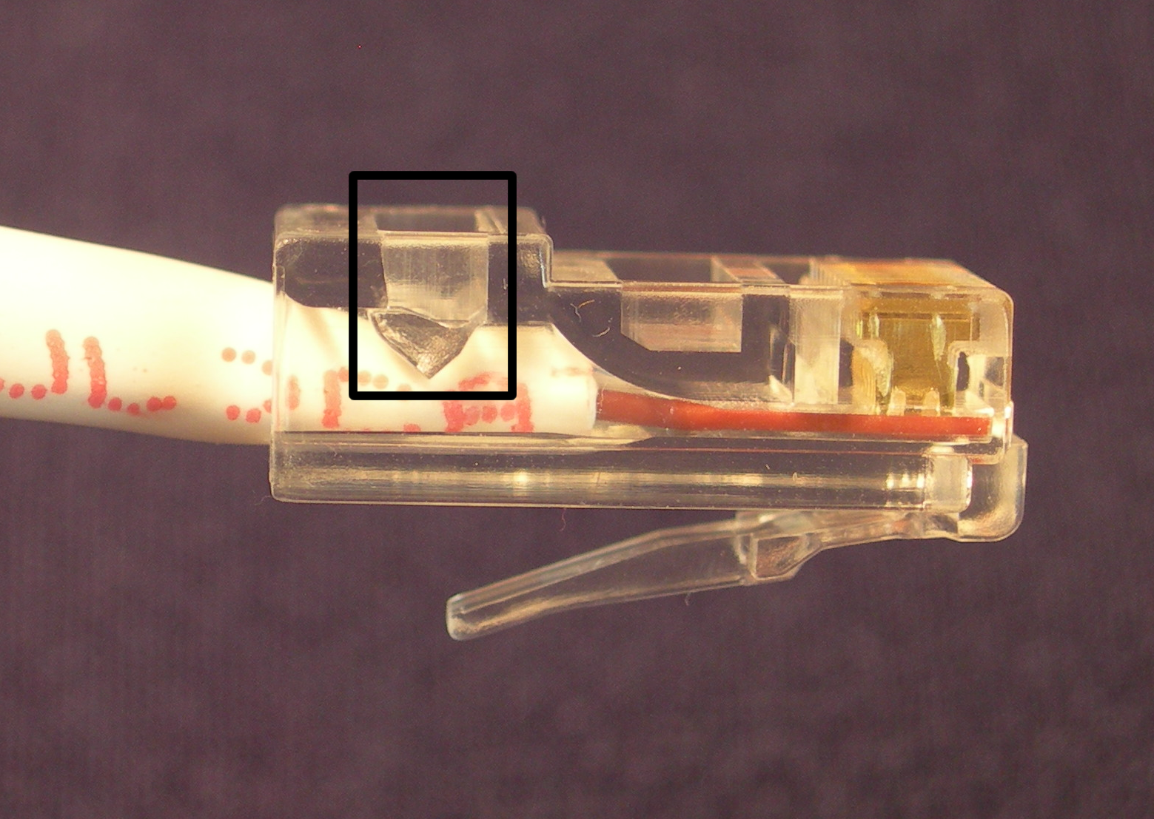
Twisted-Pair Patch Cable

Slide 9
Types of Patch Cables
Straight through cable
  Most common type of patch cable
  Used to connect a computer to a central connecting device like a switch
Crossover cable
  Used to direct connect similar devices without the use of a hub

Slide 10
MDI and MDI-X Ports
Medium dependent interface (MDI) is a type of Ethernet port connection using twisted pair cabling
For computers to communicate with other devices, the wires have to cross somewhere
Instead of using crossover cables to connect computers to central connecting devices such as switches, these central connecting devices are equipped with MDI-X ports (medium dependent interface crossover), which take care of the cross

Slide 11
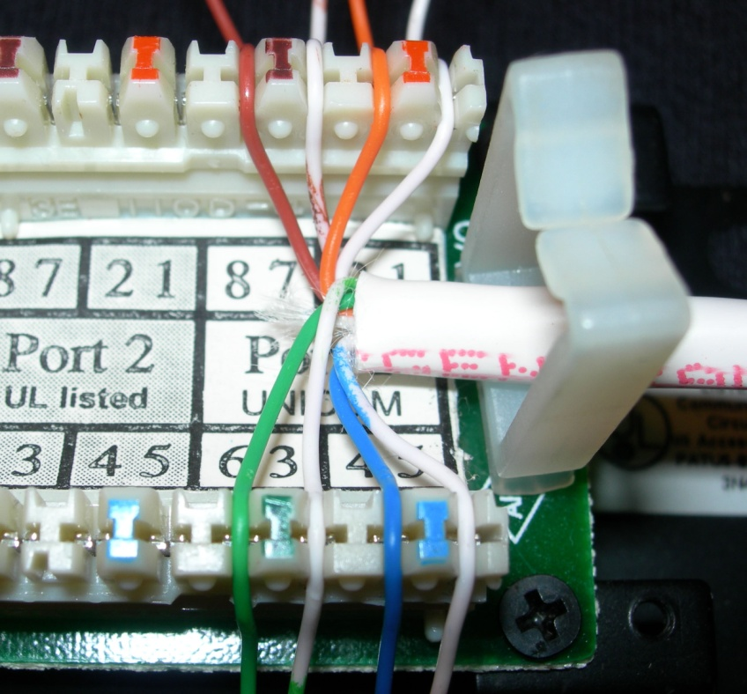
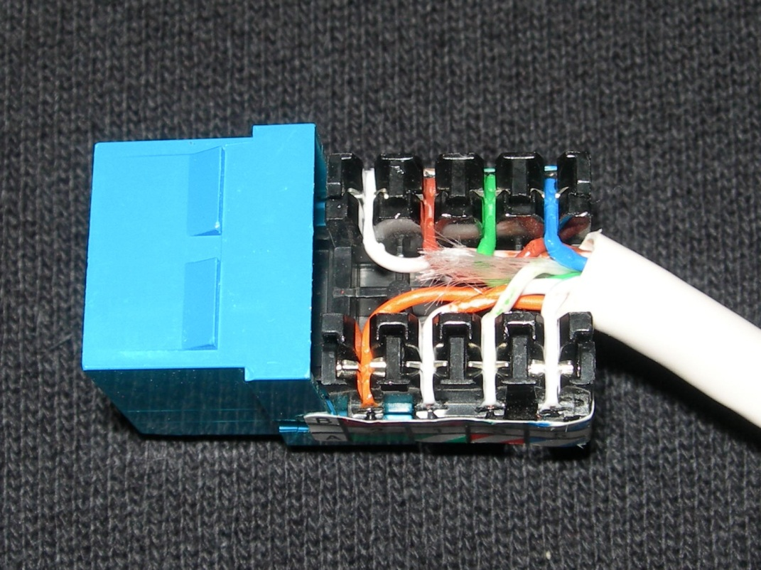
Patch Panel and RJ45 Wall Jack

Slide 12
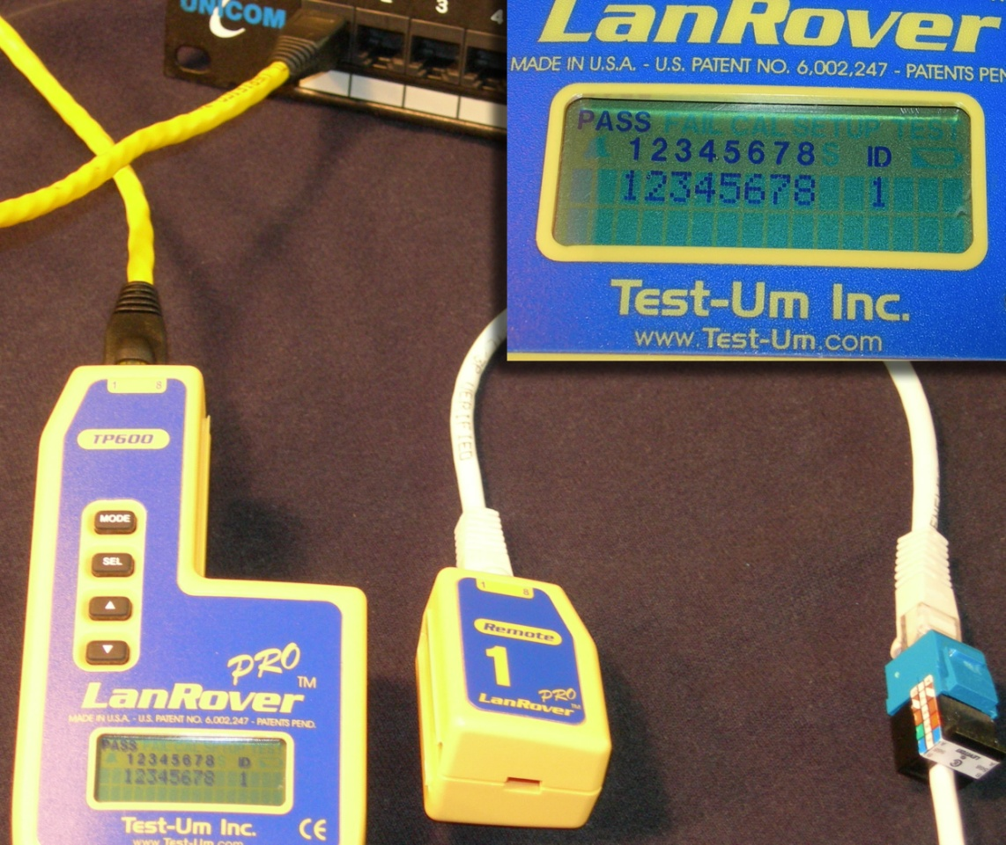
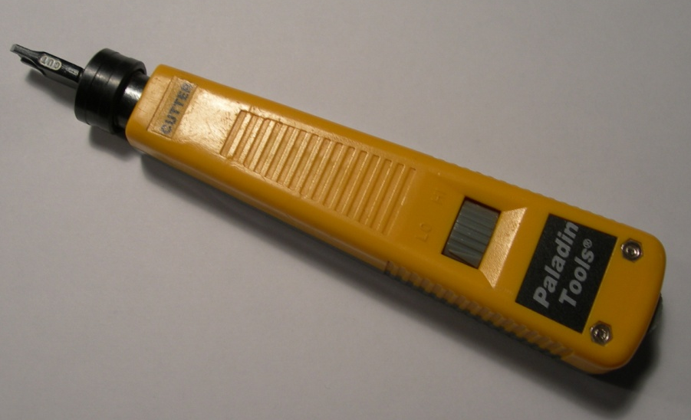
Tools
The tools necessary to make the connections between patch panels and RJ45 jacks include a cutting tool, a wire stripper, a punch down tool, and a testing device known as a continuity tester, which tests all of the pins of a connection one by one.

Slide 13
Attenuation:
The quantity of information reaching the receiver as compared to the transmitted quantity of information
Measured in decibels (dB)
According to the IEEE 802.3 standard, twisted-pair cables can be run 100 meters. Beyond this the signal degrades to such a point that it cannot be interpreted by the destination host.
A signal repeater, a hub, or switch can be used If a cable needs to be run farther

Slide 14
Interference:
anything that disrupts or modifies a signal that is traveling along a wire
Electrical Sources
  Lights
  Electrical Outlets
  Motors
  Appliances
Copper-based cables and network devices should be kept away from these electrical devices and cables if at all possible

Slide 15
Electromagnetic Interference (EMI)
Electromagnetic Interference (EMI) disturbance can affect electrical circuits, devices, and cables due to electromagnetic conduction and possibly radiation
Any type of electrical device causes EMI: TVs, air conditioning units, motors, unshielded electrical cables (Romex)
Copper-based cables and network devices should be kept away from these electrical devices and cables to prevent network communication issues

Slide 16
Radio Frequency Interference (RFI)
This is interference that can come from AM/FM transmissions and cell phone towers
It is often considered part of the EMI family and is sometimes even referred to as EMI
Filters can be installed on the network to eliminate the signal frequency being broadcast by a radio tower, although this will usually not affect standard wired Ethernet networks

Slide 17
Crosstalk
When the signal that is transmitted on one copper wire or pair of wires creates an undesired effect on another wire or pair of wires
When it comes to twisted-pair cabling, crosstalk is broken down into two categories:
  Near end crosstalk (NEXT) occurs when there is measured interference between two pairs in a single cable, measured on the cable end nearest the transmitter.
  Far end crosstalk (FEXT) occurs when there is similar interference, measured at the cable end farthest from the transmitter.

Slide 18
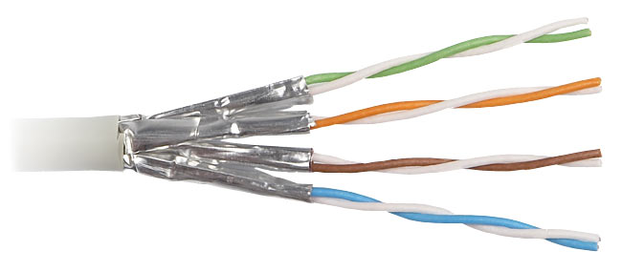
Shielded Twisted-Pair (STP) Cables
STP cables have an aluminum shield inside the plastic jacket that surrounds the pairs of wires

Slide 19
Plenum-Rated
Cables installed inside walls or above drop ceilings where they cannot be accessed by sprinkler systems in the case of a fire should be plenum-rated or low-smoke rated
Plenum-rated cables have a Teflon coating that makes them more impervious to fire
They are used in these situations because standard twisted-pair cables have a PVC jacket, which can emit deadly gas into the air

Slide 20
Fiber Optic Cable
transmits light (photons) instead of electricity over glass or plastic “fibers”
Very good for high-speed, high-capacity data transmission due to lack of attenuation
Single-mode
  meant to carry a single ray of light—one ray of light, one mode
  This type of cable is normally used for higher-bandwidth, longer-distance runs, generally 10-80 km
  More expensive equipment
Multi-mode
  Cable with a larger fiber core, capable of carrying multiple rays of light.
  This type of cable is used for shorter distance runs, up to 600 meters.
  Though much shorter than single mode fiber runs, this is still six times the distance of twisted-pair cable runs.
  Less expensive equipment

Slide 21
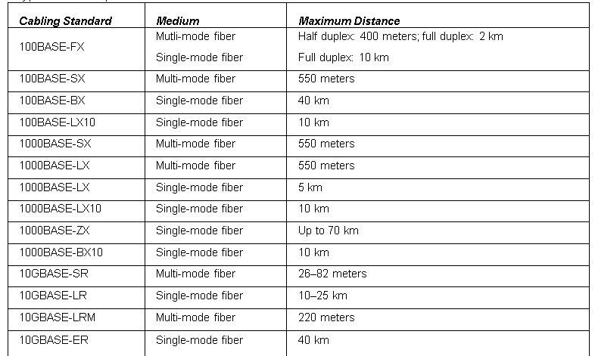
Fiber Optic Cables

Slide 22
Wireless Networks
Enables connection to the network without using a wired connection
Provide a degree of portability
Extend connectivity to a pre-existing wireless network and could be used to connect entire local area networks to the Internet
Some wireless devices can be connected directly to each other in a point-to-point fashion

Slide 23
Wireless Network Adapters
Wireless network adapters enable connectivity between a desktop computer or laptop and the wireless access point
These network adapters come in a variety of shapes and sizes, including USB, PC Card, and as an internal PCI or PCI Express adapter card

Slide 24
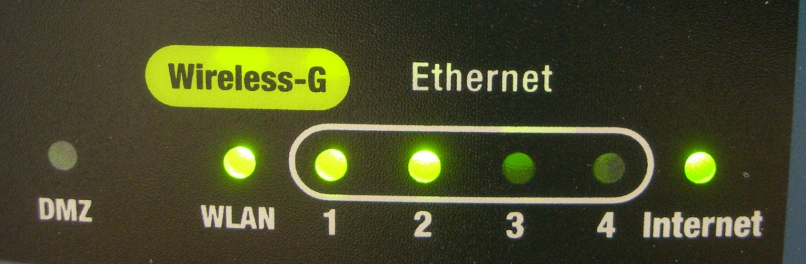
Wireless Access Point
A wireless access point (WAP) enables wireless devices to connect to a wired network
A wireless router can also acts as a router, firewall, and IP proxy

Slide 25
Wireless Modes
There several different methods to connect to a wireless network
  Infrastructure – the mode used when wireless clients connect to and are authenticated by a wireless access point
  Ad-hoc – used when all of the clients communicate directly with each other

Slide 26
Wireless LAN (WLAN)
Wireless LAN or WLAN is a network composed of at least one WAP and a computer or handheld device that connect to the WAP
Usually these networks are Ethernet based, but they can be built on other networking architectures
In order to ensure compatibility, the WAP and other wireless devices must all use the same IEEE 802.11 WLAN standard
Wireless Fidelity (WiFi ) is a trademark to brand products that belong to the category of WLAN devices

Slide 27
Other wireless devices
Wireless Repeater
  used to extend the coverage of a wireless network
Wireless Bridge
  A wireless bridge is similar to a wireless repeater, but the bridge can connect different 802.11 standards together; this is known as bridge mode.

Slide 28
WLAN Standards
IEEE 802.11 Standard | Data Transfer Rate (Max.) | Frequency
802.11a | 54 Mbps | 5Ghz
802.11b | 11 Mbps | 2.4Ghz
802.11g | 54 Mbps | 2.4Ghz
802.11n | 600 Mbps | 2.4Ghz and 5Ghz
802.11ac | 866.7 Mbps | 5Ghz

Slide 29
Wireless Encryption Options
Wireless Encryption Protocol | Description | Encryption Level (Key Size)
WEP | Wired Equivalent Privacy | 64-bit
WPA & WPA2 | Wi-Fi Protected Access | 256-bit
TKIP | Temporal Key Integrity Protocol | 128-bit
AES | Advanced Encryption Standard | 128-, 192- and 256-bit

Slide 30
Service Set Identifier (SSI)
When utilizing infrastructure mode, the base unit (normally a WAP) will be configured with a service set identifier (SSID)
The SSID is the name of the wireless network, and it is broadcast over the airwaves
When clients want to connect to the WAP, they can identify it by the SSID
For security, the SSID can be hidden from public discovery

Slide 31
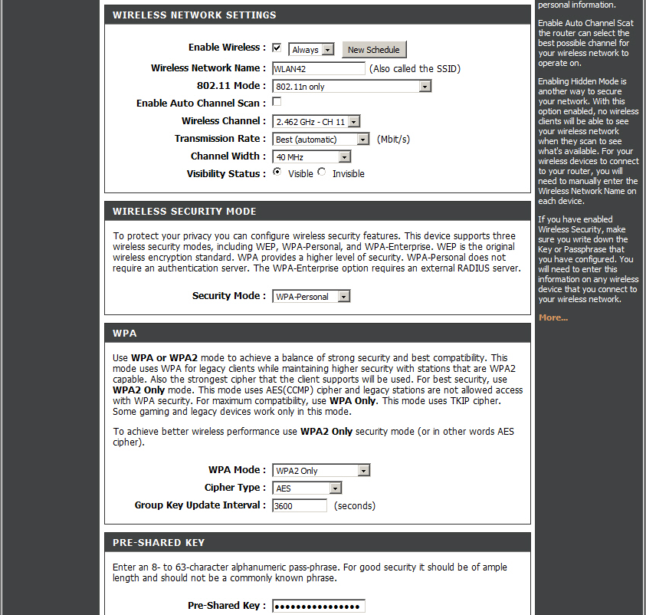
Wireless Settings

Slide 32
Summary
To recognize wired networks and media types. This includes identifying twisted-pair cable, cabling tools, and testers. You also learned what can interfere with twisted-pair cabling and how to avoid it, and about a slew of wiring standards you should know for the real world. You also learned some of the basics about fiber optic cabling and some of the standards attached to these extremely quick cables.
To comprehend wireless networks. This included wireless devices, wireless settings and configurations, wireless standards, and encryption protocols.

Slide 33
Additional Resources & Next Steps
Instructor-Led Courses
  40033A: Windows Operating System and Windows Server Fundamentals: Training 2-Pack for MTA Exams 98-349 and 98-365 (5 Days)
  40349A: Windows Operating System Fundamentals: MTA Exam 98-349 (3 Days)
  40032A: Networking and Security Fundamentals: Training 2-Pack for MTA Exams 98-366 and 98-367 (5 Days)
  40366A: Networking Fundamentals: MTA Exam 98-366
Books
Exam 98-366: MTA Networking Fundamentals (Microsoft Official Academic Course)
Exams & Certifications
  Exam 98-366: Networking Fundamentals

Slide 34

© 2012 Microsoft Corporation. All rights reserved. Microsoft, Windows, Windows Vista and other product names are or may be registered trademarks and/or trademarks in the U.S. and/or other countries.
The information herein is for informational purposes only and represents the current view of Microsoft Corporation as of the date of this presentation. Because Microsoft must respond to changing market conditions, it should not be interpreted to be a commitment on the part of Microsoft, and Microsoft cannot guarantee the accuracy of any information provided after the date of this presentation.
MICROSOFT MAKES NO WARRANTIES, EXPRESS, IMPLIED OR STATUTORY, AS TO THE INFORMATION IN THIS PRESENTATION.

