Slide 1
Windows Azure It Pro IaaS Jump Start
Cheryl McGuire | Technical Writer – Microsoft
Ronald Beekelaar | Founder – Virsoft Solutions

Slide 2
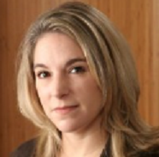
Meet Cheryl McGuire
Microsoft Technical Writer
Cheryl McGuire is a technical writer on the Windows Azure documentation team at Microsoft. She's a Microsoft Certified Trainer (MCT) and also holds MCSE and MCSA certifications. She thinks networking is pretty cool and spends way too much time tinkering with network gadgets.

Slide 3
Meet Ronald Beekelaar
Founder, Virsoft Solutions
Ronald Beekelaar is founder of Virsoft Solutions, which provides hosted lab, demo, and training services. He is a Microsoft Certified Trainer (MCT) and Most Valuable Professional (MVP) in Hyper-V technologies. Ronald often speaks at industry conferences about Hyper-V and Windows Azure.

Slide 4
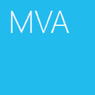
Course Topics
Windows Azure IT Pro IaaS Jump Start
01 | Virtual Machine Fundamentals
02 | More Virtual Machines
03 | Storage
04 | Virtual Network Basics
05 | Creating Virtual Networks and Cross-Premises Connectivity
06 | Active Directory in VMs

Slide 5
Setting Expectations
Target Audience
IT Pros –IT Implementers, Technical Decision Makers, Architects
Suggested Prerequisites
Familiarity with Windows Server and Active Directory

Slide 6
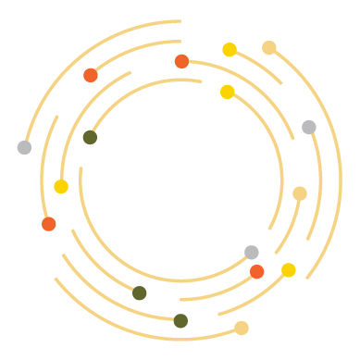
What is Cloud?
An approach to computing that’s about internet scale and connecting to a variety of devices and endpoints

Slide 7
Windows Azure- Global
24 x 7 x 365 support Over 1 billion customers, 20 million businesses 76 markets worldwide
280 years of combined industry experience in infrastructure, security, product dev, and global ops

Slide 8
SaaS / PaaS / IaaS
SaaS
PaaS
IaaS
Software-as-a-Service
Platform-as-a-Service
Infrastructure-as-a-Service
consume
build
host

Slide 9
Cloud Computing
IaaS
PaaS
SaaS
Applications
You manage
Applications
Applications
You manage
Data
Data
Data
Runtime
Runtime
Runtime
Managed by vendor
Middleware
Middleware
Middleware
Managed by vendor
O/S
O/S
O/S
Virtualization
Managed by vendor
Virtualization
Virtualization
Servers
Servers
Servers
Storage
Storage
Storage
Networking
Networking
Networking

Slide 10
What is unique about Windows Azure?
Familiar tools for management with System Center
IaaS + PaaS: build for the future while addressing today’s needs
Better durability with geo replication
Consistent on and off-premises experience:
VM portability with VHD
Direct Microsoft support for validated workloads – i.e. SharePoint and SQL Server
Variety of support plans
Local enterprise and SMSP and support teams
Familiar development tools with VS and TFS
Better together
Better by design
Transparent SLAs: calculated monthly for Virtual Machines and Virtual Network
SLA across more services (gateway, storage and more)
No lock-in
Better support
Single consistent price point across in all regions
Local presence in 89 countries, support for 19 currencies
Enterprise ready business practices and procurement
Better presence
Familiar identity with AD
More than one view of the world: cloud, on-premises, hybrid

Slide 11
(Terminology)
PaaS – Platform as a service –
You don’t manage or control the network servers or operating system. PaaS can be more efficient in some ways, but is less flexible. More developer oriented.
IaaS – Infrastructure as a service –
What we’re focusing on today. You have control over your VMs and the network configuration, but don’t have to worry about hardware.
Cloud Service (in this context) –
A container or management grouping. Every virtual machine is contained within a cloud service.
Windows Azure Virtual Machines – IaaS.
You can provision, migrate, and manage VMs. VMs can run Windows, Linux, and enterprise applications.
Windows Azure Virtual Network –
The networking overlay that allows you to create and manage virtual networks in Windows Azure and securely connect them to your own on-premises network.

Slide 12
Management Portal
- Demo (logon, navigate)

Slide 13
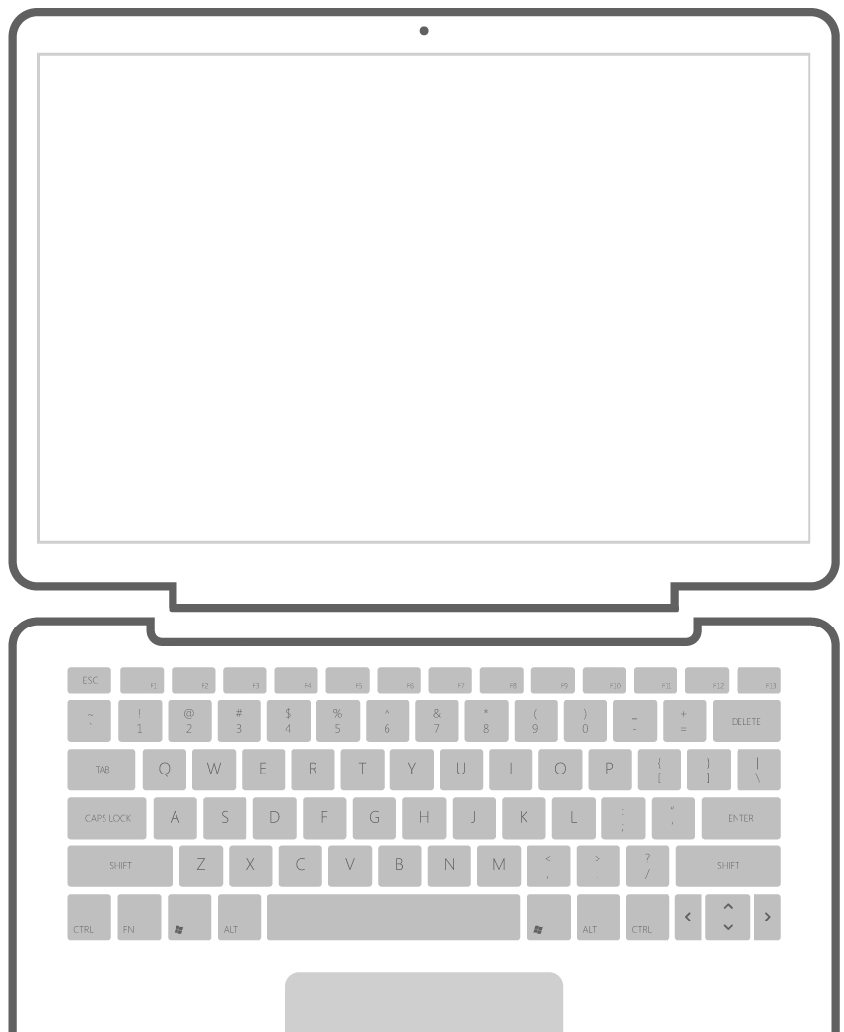
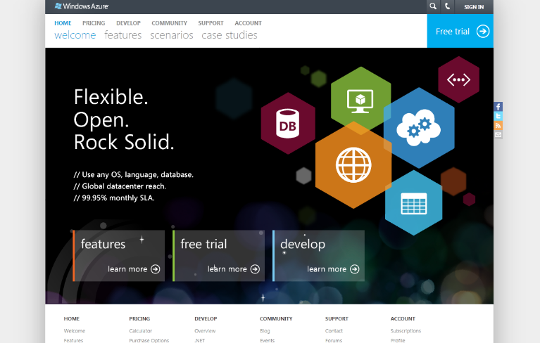
Sign Up for a Trial
Start now.
http://WindowsAzure.com

Slide 14
Azure Virtual Machines
1

Slide 15
Lessons
Using VMs in Azure
Communication between VMs

Slide 16
Virtual Machines in Azure

Slide 17
Overview
Create your first VM
What is a Cloud Service?
Connect to your VM
Start / Stop / Deallocate / Delete VM
Create your second VM
Communicate with first VM

Slide 18
Getting started with VMs
Create VM based on VHD-file
VM is a Hyper-V VM
Azure runs thousands of physical Hyper-V servers
VHD-file (disk) can be:
Provided by Azure (= "image")
Provided by customer (= "uploaded vhd-file")

Slide 19
Persistent VM
IaaS VMs are persistent
Different then PaaS VMs
Different then "VM Role"

Slide 20
Security Considerations for new VM
VM is connected to the Internet
RDP inbound is enabled by default
Do not use default RDP port 3389
Do not use an easy-to-guess password
VM also has unlimited outbound network access
Who can control VM?

Slide 21
VMs and Sizes
VMs have different sizes
Determines assigned memory and assigned processors
Name | Memory | Cores
ExtraSmall (A0) | 0.8 GB | (Shared)
Small (A1) | 1.7 GB | 1
Medium (A2) | 3.5 GB | 2
Large (A3) | 7.0 GB | 4
ExtraLarge (A4) | 14 GB | 8
A5 | 14 GB | 2
A6 | 28 GB | 4
A7 | 56 GB | 8

Slide 22
Creating Your First VM in Azure
Very easy to create a VM in Azure
Use Wizard or "Quick Create" (= super-wizard)
Will encounter several new concepts:
Gallery
Image
Disk
VM name
VM size
New user
+ Password
Cloud service
+ DNS name
Location
( Affinity Group )
Storage account
Availabiliy set
Endpoints

Slide 23
Examining Your First VM
VM has:
VM size
Disk (= lock on vhd-file)
DNS name (= cloud service name: *.cloudapp.net) - worldwide unique
Host name
Public Virtual IP - VIP (= cloud service IP) - worldwide unique
Internal IP - DIP (example: 192.168.1.4)
VM is connected to Internet
Endpoints (= map public port 59143 to internal port on VM 3389)
Note the importance of avoiding common name+password (!)

Slide 24
Communications between Virtual Machines

Slide 25
What is a Cloud Service?
Cloud Service = Grouping of VMs with single public IP
+ Stop/Start/Delete operations
Cloud Service has:
DNS name (*.cloudapp.net) - worldwide unique
Public Virtual IP - worldwide unique
List of input endpoint

Slide 26
Creating your Second VM
Difference with First VM:
How to enable communication between VMs?
Internet communication vs "internal" communication

