Slide 1
Office 365 Fundamentals
March 2014

Slide 2
About the Presenters
Jeff Medford
Senior Technical Product Manager
Office Deployment, Adoption & Readiness Team
Microsoft Corporation
Bullet
Bullet
Bullet
Optional link about you

Slide 3
Course Modules
Office 365 ProPlus Deployment for IT Pros
01 | Introduction An overview of Office 365
02 | Office 365 for IT Professionals Get an inside look at how the Office 365 team innovates towards delivering an enterprise class service
03 | Getting started with Office 365 In-depth about the Office Telemetry infrastructure, capacity planning, performance, and the Telemetry Dashboard Administration Tool
04 | Deploying Office 365 Details the options and considerations when expanding a pilot Office 365 environment into a production deployment
05 | Office 365 Service Communications
06 | Office 365 Change Management

Slide 4
Deploying Office 365 in Production
Jeff Medford
Technical Product Manager
Microsoft

Slide 5
Session Overview - Deploying Office 365 in Production
This session details the options and considerations when expanding a pilot Office 365 environment into a production deployment. Unlike on-premises implementations, IT professionals can scale out their Office 365 tenants with ease. However, with added scale, it is important to start to automate user provisioning, add a production domain and set up the desired workloads.

Slide 6
Agenda - Office 365 for IT Professionals
Verifying Your Domain
Identity Management Quick Overview
Active Directory Remediation
Understanding Synchronization
Password Synchronization
Understanding Coexistence
Migration Options

Slide 7
Pilot
Deploy
Enhance
1
2
3
Experience Value Early
New Cloud Experience
Real World Benefits
Broad Production Use
Full Feature Value
Meet your needs
Exchange, SharePoint & Lync Online, Office ProPlus, Yammer, and WA Active Directory

Slide 8
First use in hours, Onboarding in days Exchange, SharePoint, Lync, Office 365 ProPlus, WA Active Directory
Full Office 365 service
Pilot in hours
Persist to deployment
User led migration
Deploy
Core onboarding
Deploy in days
Companywide cloud use
IT led migration
Optional integration
Extend in weeks
Meet business needs
Customized to landscape
Pilot
2
Enhance
1
3
What
What
What
Office 365 Service Exchange, SharePoint, Lync, Office Web Apps, Office 365 ProPlus, Mobile
All Pilot Features + Shared namespace, simple coexistence, external sites
Deploy + Federation, Hybrid Delegation, and more
How
How
How
Service domain
Cloud Identity
Web Client
Office client
Self Service
Pilot +
IT led migration *
Customer domain
Directory sync
Password sync
Admin migrations
OnRamp
Deploy+ *
Configure adv. features
Federated Identity
Exchange Hybrid
Corporate app store
SharePoint Hybrid
Lync Hybrid
3rd party migration tools
Pilot complete
Deploy Complete
Adopt new features

Slide 9
Deploy Experience – what’s added
Setup in days
Adds on-premises integration
Pilot user and info is sustained
IT driven migration
Mail migration that best fits environment
Sign-on
Integrated identity management
Sign-on with the same user and password as on premises
Mail
Integrated mail flow and migration
Global address list
Full mail content migration – mail, calendar, contacts
From EX 2010 Mail Servers
Managed mail moves (MRS)
Free/busy cross premises
Use existing OST
From EX 2007/03 Mail Servers
Staged mail migration
New mail file download
From Others
User migration (PST import) or IMAP Migration
New mail file
Collaboration
Sharing and working with others
Lync business partner federation
Site governance and provisioning support
Setup of Apps for Office corporate app catalog
Clients
IT managed client productivity
Office 365 ProPlus deployed to user desktop via IT process
Mobile
Managed mobile connectivity
Send and receive mail from mobile device as on-prem email
Administration
Control & monitor
Data loss prevention configuration (limited)
Exchange Online Protection mail protection configuration (limited)

Slide 10
Deploy – what’s required
Unique requirements per mail platform
Dedicated customer IT team
Change management readiness
Identity
What’s Required
Directory Sync server/s
AD meets service requirements for hygiene
Same password on-prem and in cloud via password sync
Network
What you need to connect
Network access to service from client end points
Network bandwidth availability
Access to maintain DNS entries for share domains
Mail
Required to setup and migrate
Admin access
From EX 2010 Mail Servers
Exchange 2010 SP3
Certificates - public
From EX 2007/03 Mail Servers
Outlook Anywhere Access
From Others
PST requirement
Clients
Required to connect and deploy
Web client – minimum browser
Office 365 Pro Plus – clients running Windows 7 +

Slide 11
Verifying Your Domain

Slide 12
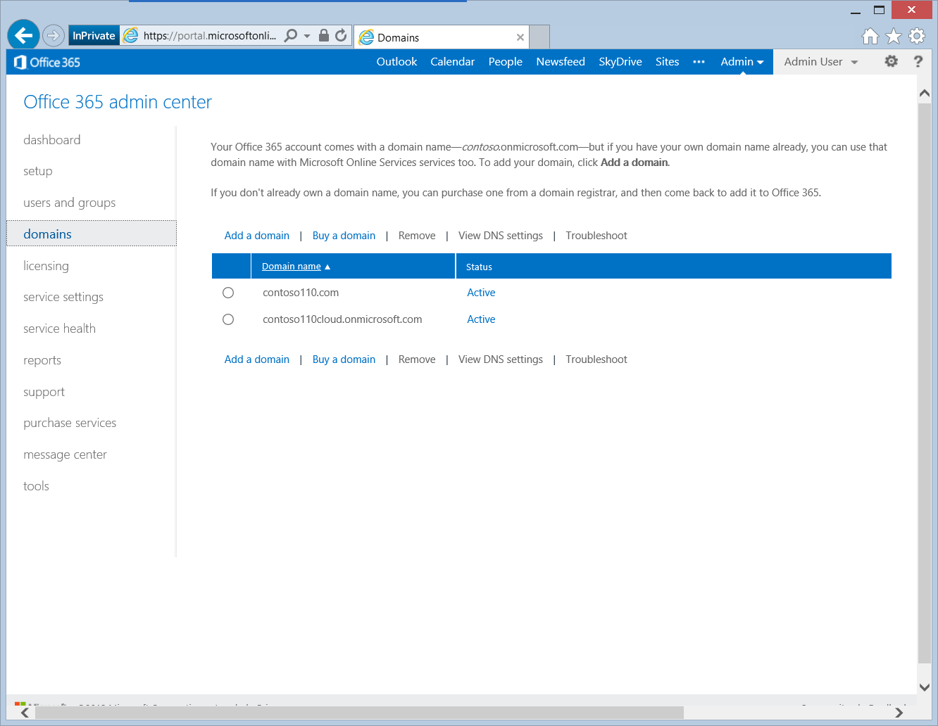
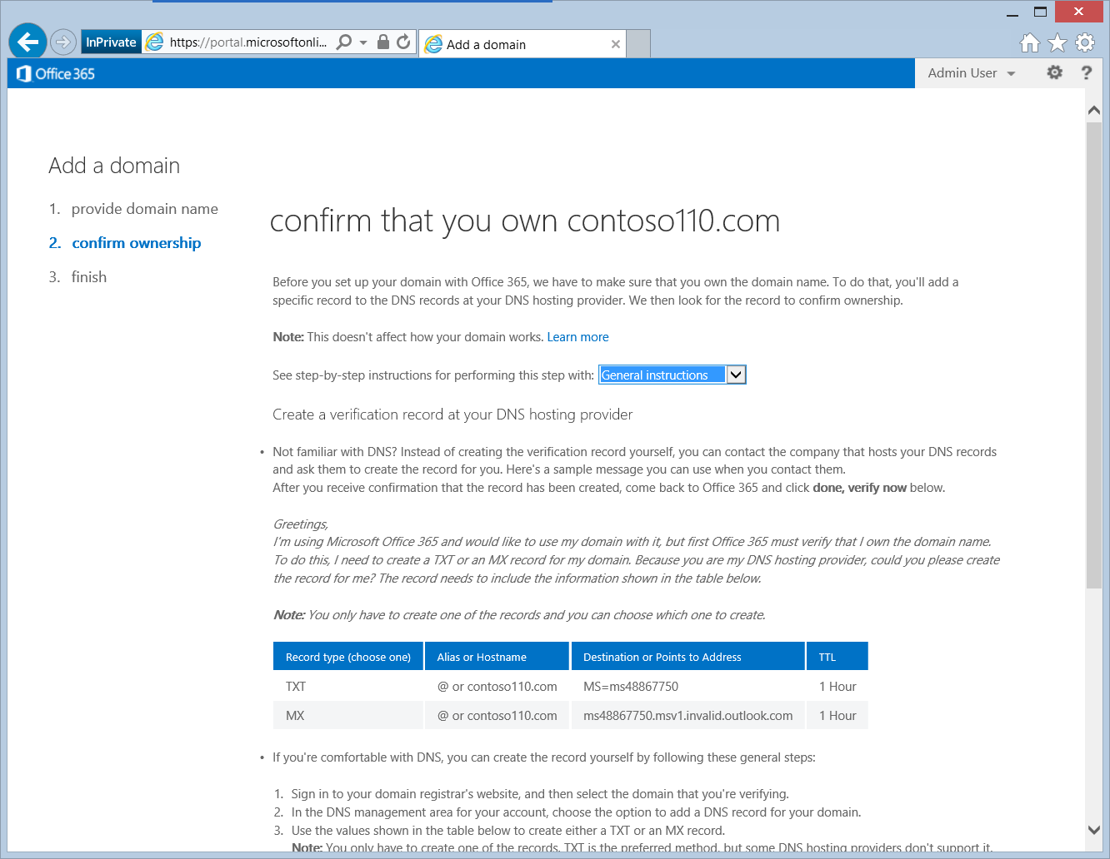
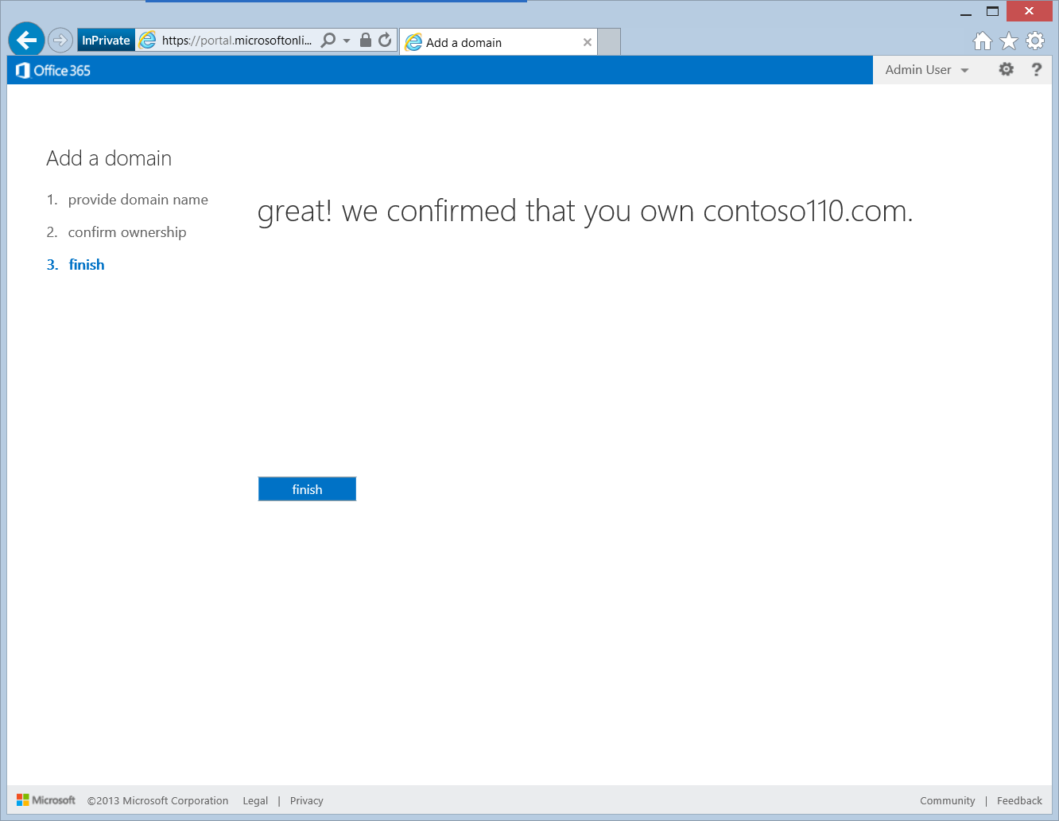
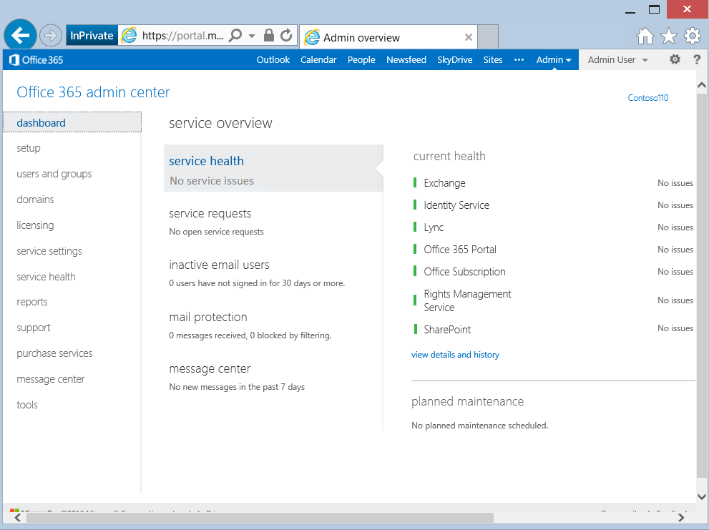
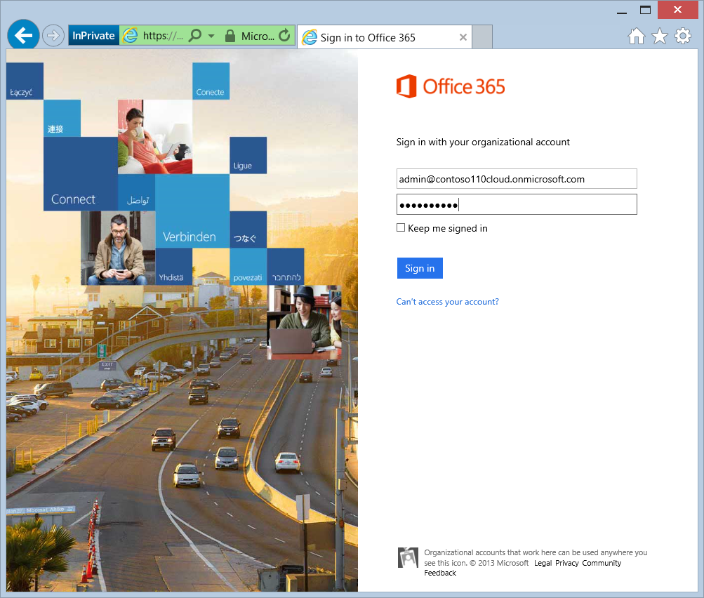
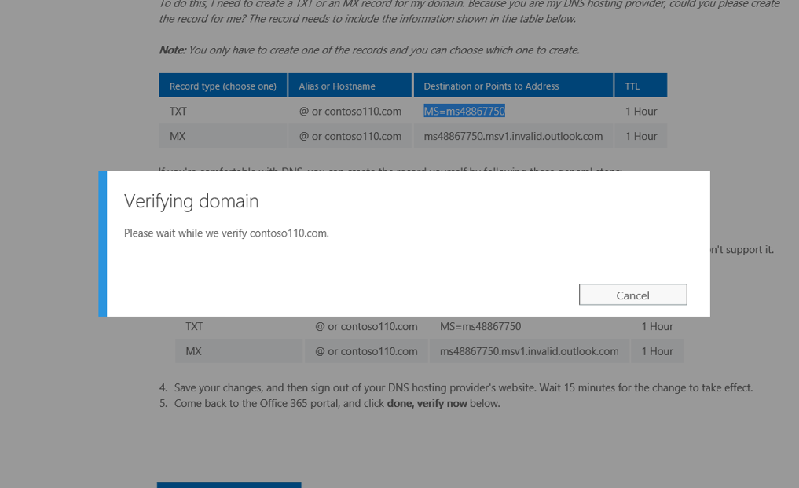
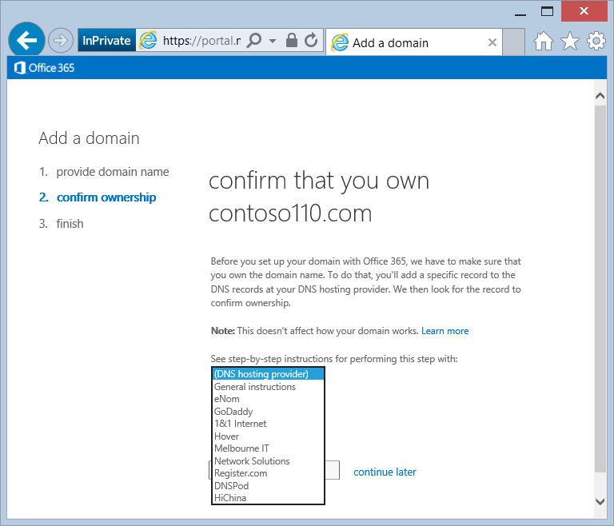
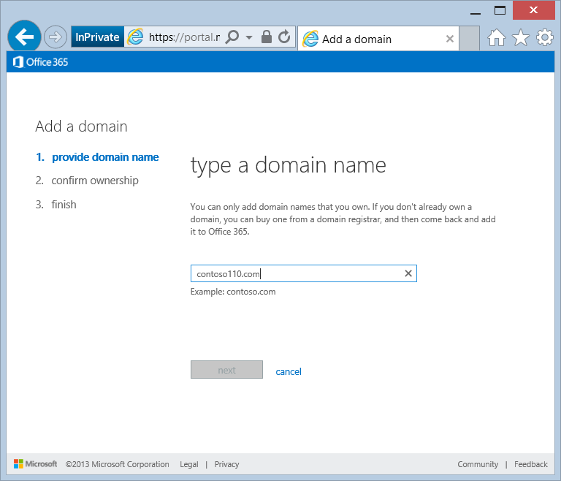
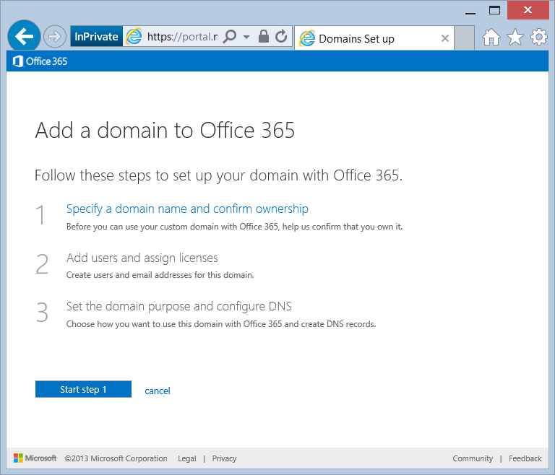
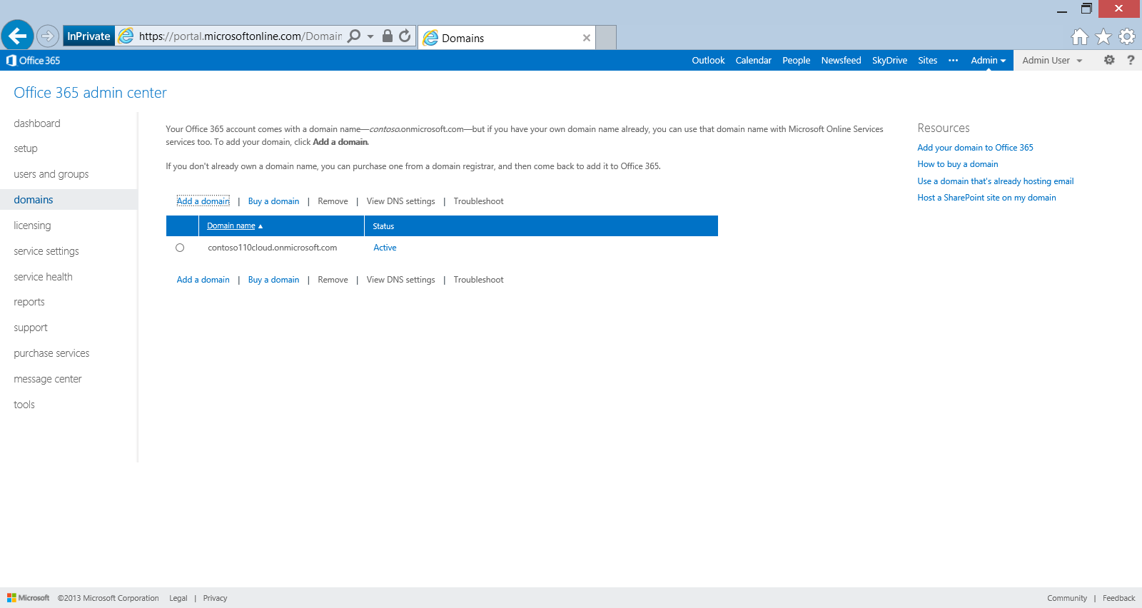
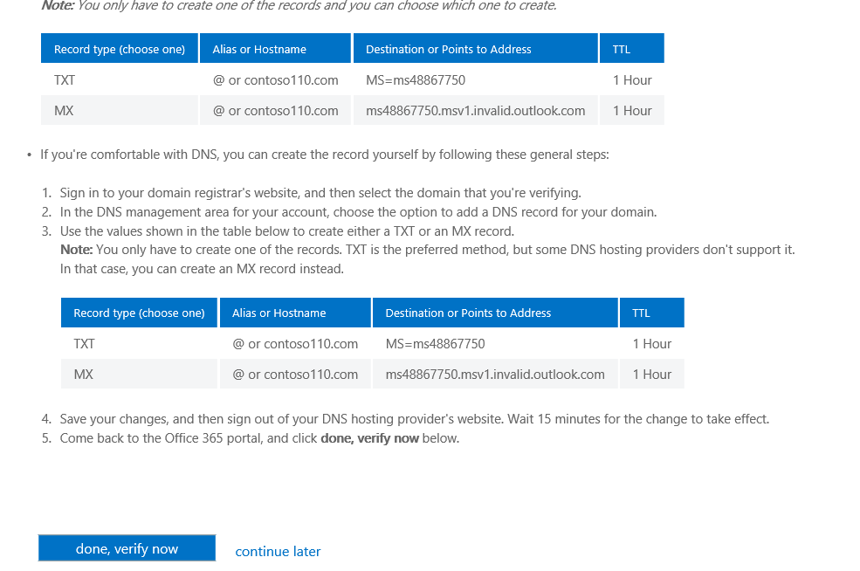
Add and Verify a Domain
Logon to the Portal
Select domains
Select Add Domain
Start Step 1 and specify domain name
Select preferred instructions
Add verification DNS record
Verify domain
Complete domain configuration
Notes:
Walkthrough of adding a Managed Domain using the Microsoft Online Portal

Slide 13
Identity Management Quick Overview

Slide 14
One Cloud Directory for every organization
Windows Azure Active Directory
What it is:
the identity platform behind Office 365 & other Microsoft Cloud Services
Able to integrate with enterprise identity platforms
Enabler of single sign-on for Office 365 and other apps
What it isn’t:
Windows Azure Active Directory is not your AD Domain Controllers running in the Windows Azure
We do support AD running as a role on a VM in Windows Azure IaaS – but that is a separate discussion
Notes:
Introducing Windows Azure Active Directory as the underlying Identity platform for Office 365 Services
Windows Azure Active Directory provides directory services and authentication
What does the Identity platform offer?
Flexibility to create organizational identities in the cloud or use on-premises identities to access office 365 services
Token based authentication to provide secure access to rich office apps
Potential to enable new applications and services in the future with a rich eco-system

Slide 15
Cloud Identity Management
Authentication
Office 365 Admin Portal
Windows Azure Active Directory
OAuth2
Office Activation Service
Metadata
SAML-P
Authorization
Exchange Mailbox Access
Graph API
WS-Federation
…
CSV Import
Spreadsheet

Slide 16
Directory & Password Hash Synchronization
Authentication
Office 365 Admin Portal
Windows Azure Active Directory
OAuth2
Office Activation Service
Metadata
SAML-P
Authorization
Exchange Mailbox Access
Graph API
WS-Federation
…
On Premises
DirSync
Active Directory

Slide 17
Identity Federation
Authentication
Office 365 Admin Portal
Windows Azure Active Directory
OAuth2
Office Activation Service
Metadata
SAML-P
Authorization
Exchange Mailbox Access
Graph API
WS-Federation
…
One way trust
On Premises
DirSync
Active Directory Federation Services
Active Directory

Slide 18
Deploy Identity Scenario
Pilot
Deploy
Enhance
1
2
3
Cloud Identity
Directory & Password Synchronization
Federated Identity
Windows Azure Active Directory
Windows Azure Active Directory
Windows Azure Active Directory
Dirsync & Password Sync
Federation
Directory Sync
On-Premises Identity
On-Premises Identity
Single federated identity and credentials
Single identity in the cloud
Single identity without federation

Slide 19
Active Directory Remediation
Engineering service adoption enhancements

Slide 20
IdFix DirSync Error Remediation Tool
Identifies and remediates AD object issues that will fail Windows Azure AD DirSync
Built on analysis of DirSync daily error volumes and is targeted at fixing the majority of errors quickly
Provides a data grid with the ability to scroll, sort and edit
Suggested fixes are provided for known errors
Customer change confirmation change and undo/rollback functionality
IdFix
JoE SmoTh
tIm CLarK??
Ca’RLy RobErts
KeVIn S*to*kS
Joe Smoth
Tim Clark
Carly Roberts
Kevin Stokes

Slide 21
Understanding Synchronization

Slide 22
What is DirSync?
Application that synchronizes on-premises Active Directory with Office 365
Designed as a software based “appliance”
“Set it and forget it”
Bundled with SQL Server 2008 R2 Express Edition

Slide 23
What is DirSync?
Enables coexistence
Provisions objects in Office 365 with same email addresses as the objects in the on-premises environment
Provides a unified Global Address List experience between on-premises and Office 365
Objects hidden from the GAL on-premises are also hidden from the GAL in Office 365
Enables coexistence for Exchange
Works in both simple and hybrid deployment scenarios
Enabler for mail routing between on-premises and Office 365 with a shared domain namespace
Enables coexistence for Microsoft Lync

Slide 24
What is DirSync?
Enables “run state” administration and management of users, groups, and contacts
Synchronizes adds/deletes/modifications of users, groups, and contacts from on-premise to Office 365
Enabler for Single Sign-On
Mandatory component for ADFS / Federated Identities deployments
Not intended as a single use bulk upload tool

Slide 25
Synchronization
User Objects
Mail-enabled/mailbox-enabled users are synchronized as mail-enabled users (not mailbox-enabled users)
Visible in the Office 365 GAL (unless explicitly hidden from GAL)
Logon enabled, but not automatically licensed to use services
Target address is synchronized for mail-enabled users
Regular NT users are synchronized as regular NT users
Not automatically provisioned as mail-enabled in Office 365
Resource mailboxes are synchronized as resource mailboxes
Synchronized users are not automatically assigned a license

Slide 26
Synchronization
Group Objects
Mail-enabled groups are synchronized as mail-enabled
Group memberships are synchronized
Security groups are synchronized as security groups
Dynamic Distribution Groups are NOT synchronized
Contacts Objects
Only mail-enabled contacts are synchronized
Target address is synchronized to Office 365

Slide 27
Synchronization
Once implemented, on-premises AD becomes the “source of authority” for synchronized objects
Modifications to synchronized objects must occur in the on-premises AD
Synchronized objects cannot be modified or deleted via the portal unless DirSync is disabled for the tenant
Scoping/Filtering
Custom scoping of default management agents is officially supported

Slide 28
Azure AD DirSync Scoping Options
Ability to Dirsync to Windows Azure AD only a subset of your users
Options for Filtering
OU
Domain-based
User Attribute

Slide 29
Password Synchronization

Slide 30
Password Synchronization
A feature of Windows Azure Directory Sync as an alternative to Federated Authentication
Benefits:
You can use a “single set of credentials” (same username and password) to access both on-premises and online resources
This single set of credentials is managed in the customer’s Active Directory and is synchronized with Office 365 (username + password)
Password Sync is fully integrated in the DirSync appliance, no additional sw/hw, or changes to the on-premises AD are required
No requirement to deploy and maintain Active Directory Federation Services.
Keeps the deployment simple and eliminates IT costs associated with ADFS

Slide 31
Password Synchronization
Does not require nor access the plain text password
No requirement for AD reversible encrypted format
AD user password hash is hashed again using a non-reversible encryption function and digest is synchronized into Azure AD
The digest in Azure AD cannot be used to access resources in the customer’s on-premises environment

Slide 32
Password Synchronization
Password Sync is one-way synchronization from on-premises to the cloud
Password Complexity Policy implemented in the on-premises AD is the master policy
Password Expiration Policy on the Azure AD is set to “Never Expire”
Password expiration and sync to Azure AD is driven by on-premises events

Slide 33
Understanding Coexistence

Slide 34
What is Coexistence?
Some users are provisioned in Office 365 while the remaining users are provisioned in the on-premises environment
Office 365 users see the same objects in the Global Address List as the on-premises users
Email messages are routed seamlessly from Office 365 users to on-premises users, and vice-versa

Slide 35
Simple Coexistence Deployment
Uses Directory Synchronization for GAL synchronization
Enables mail routing between on-premises and Office 365 using a shared DNS namespace
Provides a unified GAL experience
Can be used with cloud identities or federated identities
Does not require an on-premises Hybrid server

Slide 36
Staged Exchange Migration Architecture
On-premises Exchange Org
Office 365
Users, Groups, Contacts via DirSync
Office 365 Directory Synchronization
App
Mailbox Data via Outlook Anywhere (RPC over HTTP)
Exchange 2003 or 2007

Slide 37
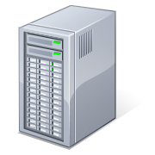
Mail Routing: Pre-Coexistence
On-premises
MX Record:
contoso.com
Active Directory
Exchange
User Object
Mailbox-Enabled
ProxyAddresses: SMTP: John.Doe@contoso.com
Message Filtering

Slide 38
Mail Routing: On-Premises To Office 365
On-premises
Office 365
MX Record:
contoso.com
Active Directory
Exchange
Exchange Online
Online Directory
User Object
Mail-Enabled (not mailbox-enabled)
ProxyAddresses: SMTP: John.Doe@contoso.com
TargetAddresses: SMTP: John.Doe@contoso.mail.onmicrosoft.com
Message Filtering
Exchange Online Protection
Logon Enabled User
Mailbox-Enabled
ProxyAddresses: SMTP: John.Doe@contoso.com
smtp: John.Doe@contoso.onmicrosoft.com
smtp: John.Doe@contoso.mail.onmicrosoft.com
MX Record:
contoso.onmicrosoft.com
contoso.mail.onmicrosoft.com
DirSync
DirSync Web Service

Slide 39
Mail Routing: Office 365 To On-Premises
On-premises
Office 365
MX Record:
contoso.com
Active Directory
Exchange
Exchange Online
Online Directory
User Object
Mailbox-Enabled
ProxyAddresses: SMTP: Jane.Doe@contoso.com
Logon Enabled User
Mail-Enabled (not mailbox-enabled)
ProxyAddresses: SMTP: Jane.Doe@contoso.com
smtp: Jane.Doe@contoso.onmicrosoft.com
smtp: Jane.Doe@contoso.mail.onmicrosoft.com
TargetAddresses: SMTP: Jane.Doe@contoso.com
Message Filtering
Exchange Online Protection
MX Record:
contoso.onmicrosoft.com
contoso.mail.onmicrosoft.com
DirSync
DirSync Web Service

Slide 40
Migration Options

Slide 41
FastTrack Step 2 Migration Options
Migration | PST Migration Import of Archived/Offline Mail
 | IMAP migration Supports wide range of email platforms Email only (no calendar, contacts, or tasks)
 | Staged Exchange migration No server required on-premises Identity federation with on-premises directory
Hybrid | Hybrid deployment Manage users on-premises and online Enables cross-premises calendaring, smooth migration, and easy off-boarding
 | PST Migration | IMAP migration | Staged migration | Hybrid
Exchange 5.5 | X | X
Exchange 2000 | X | X
Exchange 2003 | X | X | X
Exchange 2007 | X | X | X
Exchange 2010 | X | X |  | X
Exchange 2013 | X | X |  | X
Notes/Domino | X | X
GroupWise | X | X
Other | X | X
* Additional options available with tools from migration partners

Slide 42
IMAP Features and Benefits
Works with a large number of source mail systems
Works with on-premises or hosted systems
Users can be migrated in batches
On-premises migration tool is not required

Slide 43
IMAP Requirements and Limitations
Access to IMAP ports (TCP/143/993)
SMTP domains configured in O365 tenant
Users + mailboxes must be provisioned prior to migration
Bulk provisioning, CSV parser, manual, etc.
Gather user credentials or setup admin credentials
Prepare a CSV file with list of users
EmailAddress, UserName, Password
Max of 50,000 rows
Max 10 MB in size
Very limited data migration scope (mail items only)

Slide 44
IMAP Data Migration Scope
Migrated
Mail messages (Inbox and other folders)
Maximum of 500,000 items
Possible to exclude specific folders from migration (e.g. Deleted Items, Junk E-Mail)
Not Migrated
Contacts, Calendars, Tasks, etc.
Excluded folders
Folders with a forward slash ( / ) in the folder name
Messages larger than 25 MB

Slide 45
Staged Exchange Migration Features and Benefits
Simple and flexible migration solution
High-fidelity solution – all mailbox content is migrated
Typically best suited to medium and large organizations
Users are provisioned with Directory Sync prior to migration
No limit on the number of mailboxes
Users can be migrated in batches (up to 1000 per batch)
Works with Exchange 2003 and 2007 only, on-premises or hosted
Identity management on-premises
On-premises migration tool is not required

Slide 46
Staged Exchange Migration User Experience
Admin needs to distribute new passwords to users
Users create their new Outlook profile using O365 username and new passwords (Autodiscover)
All mail is downloaded from the Office 365 mailbox
(i.e. the OST file must be recreated)
Note: IT Admins must convert on-premises mailbox-enable user to mail-enable user (which will delete on-premises content)

Slide 47
Staged Exchange Migration Data Migration Scope
Partial migrations are not possible (no folder exclusion, no time range selection, etc.)
Mailboxes enabled for Unified Messaging cannot be migrated
Hidden mailboxes (not visible to tool) cannot be migrated
New cloud mailbox is created (new GUID) and data is copied
Existing cached-mode files (OST files) cannot be preserved

Slide 48
Staged Exchange Migration Data Migration Scope
Migrated
Mail messages and folders
Rules and categories
Calendar (normal, recurring)
Out-of-Office settings
Contacts
Tasks
Delegates and folder perms
Outlook settings (e.g. favorites)
Not Migrated
Security Groups, DDLs
System mailboxes
Dumpster
Send-As Permissions
Messages larger than 25 MB

Slide 49
Exchange 2010 SP3 Hybrid
Customers with Exchange 2010 SP3 or Exchange 2013 on-premises can deploy Exchange Hybrid in Step 2
The built in Hybrid Configuration Wizard automates the process and allows hybrid configuration to be completed within timelines and effort requirements of Step 2

Slide 50
Pilot
Deploy
Enhance
1
2
3
Experience Value Early
New Cloud Experience
Real World Benefits
Broad Production Use
Full Feature Value
Meet your needs
Exchange, SharePoint & Lync Online, Office ProPlus, Yammer, and WA Active Directory

Slide 51
First use in hours, Onboarding in days Exchange, SharePoint, Lync, Office 365 ProPlus, WA Active Directory
Full Office 365 service
Pilot in hours
Persist to deployment
User led migration
Deploy
Core onboarding
Deploy in days
Companywide cloud use
IT led migration
Optional integration
Extend in weeks
Meet business needs
Customized to landscape
Pilot
2
Enhance
1
3
What
What
What
Office 365 Service Exchange, SharePoint, Lync, Office Web Apps, Office 365 ProPlus, Mobile
All Pilot Features + Shared namespace, simple coexistence, external sites
Deploy + Federation, Hybrid Delegation, and more
How
How
How
Service domain
Cloud Identity
Web Client
Office client
Self Service
Pilot +
IT led migration *
Customer domain
Directory sync
Password sync
Admin migrations
OnRamp
Deploy+ *
Configure adv. features
Federated Identity
Exchange Hybrid
Corporate app store
SharePoint Hybrid
Lync Hybrid
3rd party migration tools
Pilot complete
Deploy Complete
Adopt new features

Slide 52
Resources

Slide 53
Summary
Verifying Your Domain
Identity Management Quick Overview
Active Directory Remediation
Understanding Synchronization
Password Synchronization
Understanding Coexistence
Migration Options

Slide 54
© 2013 Microsoft. All rights reserved. Microsoft, Windows and other product names are or may be registered trademarks and/or trademarks in the U.S. and/or other countries. The information herein is for informational purposes only and represents the current view of Microsoft Corporation as of the date of this presentation. Because Microsoft must respond to changing market conditions, it should not be interpreted to be a commitment on the part of Microsoft, and Microsoft cannot guarantee the accuracy of any information provided after the date of this presentation. MICROSOFT MAKES NO WARRANTIES, EXPRESS, IMPLIED OR STATUTORY, AS TO THE INFORMATION IN THIS PRESENTATION.

