Slide 1
Windows Server 2012 R2
The Essentials Experience
Part 2 of 7
Deployment Options and
Licensing Overview

Slide 2
Agenda
Deployment options
  Using the Essentials edition
  Using the Windows Server Essentials Experience role
Licensing overview
  Server license assignment
  Client access licenses (CALs)
  Upgrade and downgrade rights
  In-place license transition for Essentials
  Services Provider License Agreement (SPLA)

Slide 3
Deployment options
Notes:
Windows Server Essentials 2012 R2 has made some exciting enhancements that expand the possibilities for various deployment scenarios.

Slide 4

New deployment options
  Windows Server 2012 R2 Essentials as its own Hyper-V host server
  Windows Server Essentials Experience
Notes:
Key Message: There is now new flexibility in deploying the Windows Server Essentials edition and the Windows Server Essentials Experience on other editions.
Choose the option based on which license model makes sense for your organization, whether your organizational objectives make virtualization a priority, and the number of workloads (server instances) you need to run. For two or more workloads, consider Standard. For a hoster scenario, consider Datacenter.
The first new deployment option is Windows Server 2012 R2 Essentials as its own Hyper-V host. Previous versions of Windows Server Essentials did not include the Hyper-V role. This meant that you had to obtain a hypervisor separately in order to run it a virtual machine. With Windows Server 2012 R2 Essentials, the product licensing terms have been expanded, making the Hyper-V role available as part of Windows Server 2012 R2 Essentials. Installation wizards are provided via select OEM partners to simplify deployment as a virtual machine by automating the steps necessary to set up and configure the parent partition. This capability helps you take advantage of Hyper-V and its features, such as Live Migration and Hyper-V Replica. Volume License and retail customers can also perform a virtualized deployment using steps similar to those used when deploying the Standard or Datacenter editions.
The second new option is to implement the Windows Server Essentials Experience role on Windows Server 2012 R2 Standard or Datacenter. The Windows Server Essentials Experience role offers the value-added features that were previously only found in the Essentials edition of Windows Server. Now however, those features have been encapsulated into a new server role. The Windows Server Essentials Experience role and its availability across the Windows Server family greatly increases the number of deployment scenarios that can now take advantage of these features, including in larger organizations and those with branch locations.
From a licensing perspective, there are two important points to keep in mind:
When you purchase the Standard or Datacenter editions of Windows Server 2012 R2 and use them to run the Windows Server Essentials Experience role, you need Windows Server CALs for each end user. You also need Remote Desktop Service CALs (RDS CALs) for each end user that connects remotely to client computers or uses the Remote Dashboard, which are capabilities of Remote Web Access that leverage RDS functionality.
The Standard or Datacenter editions of Windows Server 2012 R2 enable downgrade rights to the Essentials edition. However, the licensing terms of the edition you purchase are the ones that apply, regardless of whether or not you choose to exercise downgrade rights.

Slide 5
Deployment options
  Windows Server Essentials edition:
  Physical deployment
  Windows Server 2012 R2 Essentials
  Windows Server Essentials edition:
  Virtual deployment
  Windows Server 2012 R2 Essentials and Hyper-V
Windows Server Essentials Experience role
Windows Server 2012 R2 Standard or Datacenter edition
Notes:
As mentioned earlier, you have more deployment options.
Choose the option based on which license model makes sense for your organization, whether your organizational objectives make virtualization a priority, and the number of workloads (server instances) you need to run. For two or more workloads, consider Standard. For a hoster scenario, consider Datacenter.
As before, you can deploy Windows Server 2012 R2 Essentials directly onto your server’s physical hardware. This traditional approach gives up the advantages of virtualization.
The first new deployment option is Windows Server 2012 R2 Essentials as its own Hyper-V host. Previous versions of Windows Server Essentials did not include the Hyper-V role. This meant that you had to obtain a hypervisor separately in order to run it a virtual machine. With Windows Server 2012 R2 Essentials, the product licensing terms have been expanded, making the Hyper-V role available as part of Windows Server 2012 R2 Essentials. Installation wizards are provided via select OEM partners to simplify deployment as a virtual machine by automating the steps necessary to set up and configure the parent partition. This capability helps you take advantage of Hyper-V and its features, such as Live Migration and Hyper-V Replica. Volume License and retail customers can also perform a virtualized deployment using steps similar to those used when deploying the Standard or Datacenter editions.
The second new option is to implement the Windows Server Essentials Experience role on Windows Server 2012 R2 Standard or Datacenter. The Windows Server Essentials Experience role offers the value-added features that were previously only found in the Essentials edition of Windows Server. Now however, those features have been encapsulated into a new server role. The Windows Server Essentials Experience role and its availability across the Windows Server family greatly increases the number of deployment scenarios that can now take advantage of these features, including in larger organizations and those with branch locations.
From a licensing perspective, there are two important points to keep in mind:
When you purchase the Standard or Datacenter editions of Windows Server 2012 R2 and use them to run the Windows Server Essentials Experience role, you need Windows Server CALs for each end user. You also need Remote Desktop Service CALs (RDS CALs) for each end user that connects remotely to client computers or uses the Remote Dashboard, which are capabilities of Remote Web Access that leverage RDS functionality.
The Standard or Datacenter editions of Windows Server 2012 R2 enable downgrade rights to the Essentials edition. However, the licensing terms of the edition you purchase are the ones that apply, regardless of whether or not you choose to exercise downgrade rights.

Slide 6
Typical primary server deployment
No Hyper-V parent partition
Windows Server 2012 R2 Essentials
Running directly on the physical hardware
  Replacement for peer-to-peer networking and PC-as-a-server
  Often deployed pre-installed on physical hardware
  Apps run on the server
  Messaging and collaboration in the cloud
  Other cloud-based apps and services
No hypervisor
Hardware
Together with optional online apps and services
Notes:
Key Message: For many small customers, Windows Server 2012 R2 Essentials is typically deployed pre-installed on a physical server and combined with cloud-based apps and services. This traditional deployment option remains as a completely supported, viable option; but it does give up all the advantages of virtualization.

Slide 7
Essentials edition includes the Hyper-V role
Windows Server 2012 R2 Essentials
Parent partition to run and manage the Hyper-V role
Windows Server 2012 R2 Essentials
Child partition running a virtual machine
  Deployment model uses a single Windows Server Essentials license
  Hyper-V server role is now available with the Essentials edition
  Install Hyper-V in the server’s parent partition and run Windows Server Essentials as a guest virtual machine
  Enables capabilities that require running as a virtual machine, such as Hyper-V Replica
Hyper-V hypervisor
Hardware
Together with optional online apps and services
Notes:
Key Message: Windows Server 2012 R2 Essentials can be deployed as a virtual machine without having to obtain a hypervisor separately.
Windows Server 2012 R2 Essentials as its own Hyper-V host. Unlike previous versions of the Windows Server Essentials edition that did not have the Hyper-V role, now the Hyper-V role is included with Essentials and the licensing terms have been expanded to allow for one virtual instance running Essentials.
Choose to use Hyper-V is simple with offerings from select OEM partners: the setup process can install Windows Server and Hyper-V on the server, create a virtual machine for you, create the networking based on your hardware configuration, and then roll into setup of the Essentials edition as a virtual machine. As previously mentioned, no additional purchases are necessary for this functionality. You end up with Hyper-V on the host and a virtual machine that is running Essentials, with the result being a very transparent experience that makes it easy to get up and running with a virtual environment.
Volume License and retail customers can also perform a virtualized deployment using steps similar to those used when deploying the Standard or Datacenter editions.

Slide 8

Case study: Law office
New York law firm avoids disaster during hurricane by using failover system
“Had we not had Hyper-V Replica in place when the hurricane struck, we would’ve easily lost a week’s worth of business, but more importantly, we would’ve lost clients.”
- Aaron I. Katsman, Owner,
Law Offices of Aaron I. Katsman, P.C.
Situation:
During Hurricane Sandy the Law Offices of Aaron I. Katsman, continued to operate after losing power. Employees who had power at home were able to access applications and work.
Benefits:
More flexible IT and cost savings
Greater ability to grow the business
View this and other case studies at http://www.microsoft.com/casestudies
Notes:
Full case study at http://www.microsoft.com/casestudies/Windows-Server-2012-Datacenter/Law-Offices-of-Aaron-I.-Katsman-P.C/New-York-Law-Firm-Avoids-Disaster-During-Hurricane-by-Using-Failover-System/710000001728
Partner: WorkITSafe, Steve Rubin
Customer:
45 employees, Valley Stream, NY
During Hurricane Sandy the New York Law Offices of Aaron I. Katsman, P.C. continued to operate, even after losing power. The hurricane knocked out power to the firm’s offices and the homes of many employees. But employees who weren’t as severely affected and still had power at home logged on to their applications and continued to work. The firm says that instead of losing a week’s worth of business, with Windows Server 2012, they were back up and running within 20 minutes.

Slide 9
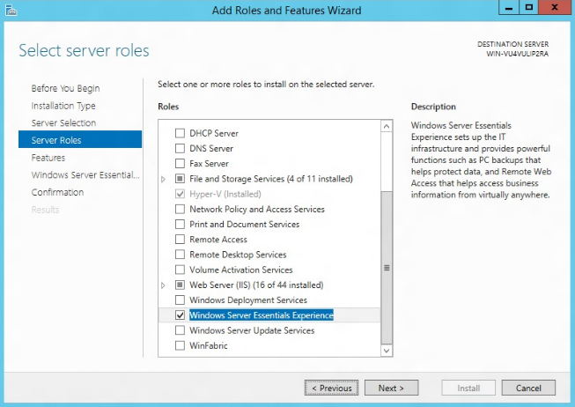
Windows Server Essentials Experience role
Windows Server Essentials functionalities are enabled with a server role across all mainstream Windows Server editions
Familiar seamless deployment experience sets up the most fundamental roles for the primary server
Optional unattended deployment and configuration using Windows PowerShell
Notes:
Key Message: The Windows Server Essentials Experience can be deployed as a role in both the Standard and Datacenter editions of Windows Server 2012 R2.
We have taken and encapsulated the Essentials experience into a role. What that means is this role is now available across the entire family of Windows Server 2012 R2 (except for Foundation edition). The Essentials edition has this turned on by default. If you buy Standard or Datacenter, you can choose to turn on the Windows Server Essentials Experience role and get access to the set of features which previously were only available in the Essentials edition. While it was possible to exercise downgrade rights from Windows Server 2012 Standard to Essentials, this was far more cumbersome to deploy—and now much, much easier with R2!
Just like any other server role, during setup (or later) the admin can add the Windows Server Essentials Experience role and effectively “turn on” the great features that Windows Server Essentials provides without changing their topology or hardware setup. The Windows Server Essentials Experience role also supports remote and batch deployment via PowerShell and the Server Manager console, which can significantly help to simplify IT management for hosters and larger IT organizations.
In terms of scalability of Essentials Experience, there are maximum technical supportability limits for the features. For example, the client PC backup will not scale indefinitely, and the guideline is use the Essentials Experience features for up to 100 users and 200 devices. Once you scale beyond that, we recommend you transition over to using the native tools, such as using Active Directory Users and Computers vs. using the Dashboard. More information on the scalability limits is available on TechNet, http://technet.microsoft.com/en-US/sbs/jj159331.

Slide 10
Standard or Datacenter editions help you scale
Windows Server 2012 R2 Standard
Parent partition to run and manage the Hyper-V role
Windows Server 2012 R2 Standard with WSEE role
Child partition running a virtual machine
Windows Server 2012 R2 Standard
Child partition running a virtual machine
  Deployment model uses Windows Server 2012 R2 Standard or Datacenter license
You can enable the new Windows Server Essentials Experience (WSEE) role
New deployment scenarios are now possible, for example multiple servers can run the WSEE role
Hyper-V hypervisor
Hardware
Together with optional online apps and services
Notes:
Key Message: The Windows Server Essentials Experience can be deployed as a role in the Standard and Datacenter editions of Windows Server 2012 R2.
When you are deploying Essentials with the Standard or Datacenter editions, keep in mind that Standard has two virtual instances you can use while Datacenter provides for unlimited virtual instances. So when installing Standard as a virtualized environment, you could use one instance to run the Windows Server Essentials Experience (with Remote Web Access, Client PC backup, Email integration, the dashboard and so on); and in your second instance, you could run any workload that you need, such as Exchange Server, SharePoint, SQL Server and so on.
From a hoster perspective, you can use Datacenter as the basis for all your instances, and have a custom instance with the Windows Server Essentials Experience turned on to create a targeted offering to multiple isolated SMB customers--all within one host. Of course you’d want network virtualization here to isolate the networks and other multi-tenancy best practices. This provides a much cleaner way for hosters to offer the Essentials Experience to small business customers.

Slide 11
Sample deployment scenario with Standard
Creating a Windows SBS-like environment
First virtual machine
Second virtual machine
Virtual instance running
Windows Server 2012 R2 Standard
with the Windows Server Essentials
Experience role enabled
Virtual instance running
Windows Server 2012 R2 Standard
Remote Web Access
Client computer backup
Email integration
Dashboard, etc.
Can be used for additional workloads, such as Exchange Server, SharePoint, WSUS, SQL Server, Remote Desktop Services, etc.
Notes:
Here’s another look at the two virtualization deployment options. The Windows Server Essentials Experience can be deployed as a role in both the Standard and Datacenter editions of Windows Server 2012 R2.

Slide 12
Hoster solution for SMB customers
Hosters can offer a solution specifically for their SMB customers
Each virtual machine is completely separate and isolated from the others
Essentials Experience is available in the Azure gallery
Windows Server 2012 R2 Datacenter
Parent partition to run and manage the Hyper-V role
Windows Server 2012 R2 Datacenter with WSEE role
Child partition for SMB Customer #1
Windows Server 2012 R2 Datacenter with WSEE role
Child partition for SMB Customer #2
Windows Server 2012 R2 Datacenter with WSEE role
Child partition for SMB Customer #n
…
Hyper-V hypervisor
Hardware
Notes:
Key Message: The Windows Server Essentials Experience can be deployed as a role in the Standard and Datacenter editions of Windows Server 2012 R2.
When you are deploying Essentials with the Standard or Datacenter editions, keep in mind that Standard has two virtual instances you can use while Datacenter provides for unlimited virtual instances. So when installing Standard as a virtualized environment, you could use one instance to run the Windows Server Essentials Experience (with Remote Web Access, Client PC backup, Email integration, the dashboard and so on); and in your second instance, you could run any workload that you need, such as Exchange Server, SharePoint, SQL Server and so on.
From a hoster perspective, you can use Datacenter as the basis for all your instances, and have a custom instance with the Windows Server Essentials Experience turned on to create a targeted offering to multiple isolated SMB customers--all within one host. Of course you’d want network virtualization here to isolate the networks and other multi-tenancy best practices. This provides a much cleaner way for hosters to offer the Essentials Experience to small business customers.

Slide 13
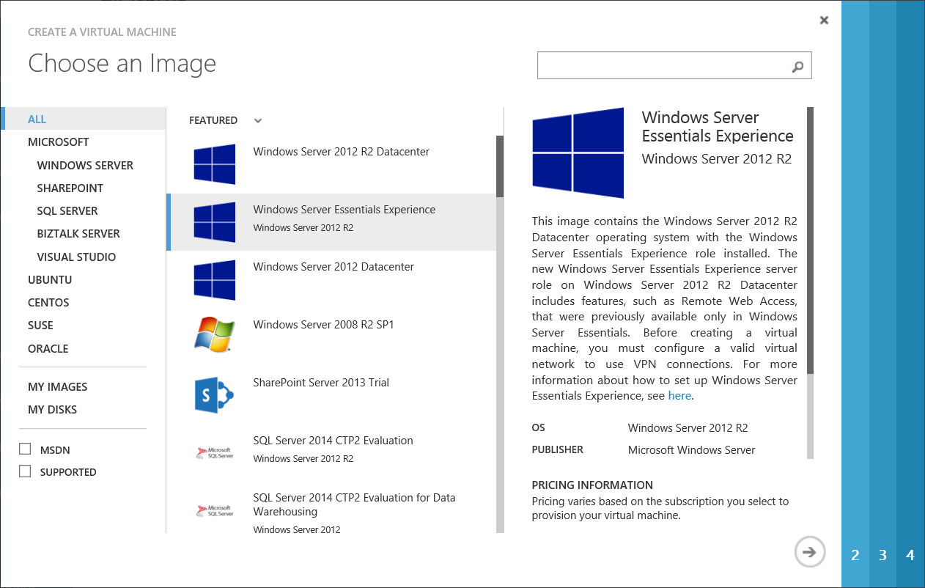
Essentials Experience in Windows Azure
Benefits of running as a virtual machine in Windows Azure
  Create your first server in minutes and easily adjust the scale of your VM as your needs change
  With the pay-as-you-go approach, you only pay for what you use, and there are no up-front capital expenses
  Your server running Windows Server Essentials Experience is deployed into a multi-zone production environment that is commercially backed with an SLA
Installation guidance is available at http://msdn.microsoft.com/en-us/library/dn520828.aspx
Notes:
Key Message: Quickly get started with the Windows Server Essentials Experience running in Windows Azure
Running Windows Server Essentials Experience as a virtual machine in Windows Azure provides the following benefits:
You can create your first server that is running Windows Server Essentials Experience in your office in minutes and adjust your usage as your needs change.
With the pay-as-you-go approach, you only pay for what you use, and there are never any penalties for changing your virtual machine configurations.
Your server running Windows Server Essentials Experience is deployed into a multizone production environment that is commercially backed with a service level agreement (SLA).
You can seamlessly integrate Windows Server Essentials Experience with other cloud-based services.
To learn more about virtual machines in Windows Azure, see Windows Azure Virtual Machines.

Slide 14
Licensing overview

Slide 15

Server license assignment
Windows Server licenses are assigned to physical servers (hardware)
  Multiple licenses can be assigned to a single server (stacking)
  You then have the right to run as many instances on that server as
  the license(s) allow
License mobility
  Volume licenses can be reassigned to new hardware once every 90 days
  OEM licenses cannot be reassigned unless you purchase SA
Using Hyper-V Replica or Live Migration does not reassign licenses
  You can replicate/migrate VMs from one OEM server to another
  The destination server must have sufficient licensing to run the
  instance that is being migrated to it
Windows Azure Virtual Machine pricing includes the licensing

Slide 16
Client access licenses
Windows Server 2012 R2 Essentials
  The server license provides rights for up to 25 user accounts and 50 devices to access the Essentials edition server
  The Essentials edition does not have Windows Server CALs
  RDS CALs are not required when remotely connecting to client computers via Remote Web Access (RWA)
Windows Server 2012 R2 Standard and Datacenter use CALs
  Each user or device needs a CAL
  RWA leverages the RD Gateway role service of the Remote Desktop Services role, so RDS CALs are needed for those users who connect to client computers remotely via RWA
Windows Azure Virtual Machine pricing includes the CALs

Slide 17

Upgrade and downgrade rights
Upgrade rights for customers with Software Assurance
  Each edition of Windows Server 2012 upgrades to the same edition of Windows Server 2012 R2 at a 1:1 ratio
Downgrade rights
  Windows Server 2012 R2 Essentials can be downgraded to Windows SBS 2011 Essentials (based on WS 2008 R2)
  The Standard and Datacenter editions can be downgraded to previous versions and lower editions
  The licensing terms of the product you purchased always apply, regardless of whether or not downgrade rights are exercised

Slide 18
Growing beyond 25 user accounts
In-place license transition
Businesses that grow beyond 25 users can perform an in-place license transition to Windows Server 2012 R2 Standard
Windows Server Essentials value-add features remain, with a maximum supportability limit of 100 users and 200 devices
Windows Server 2012 R2 Standard licensing would then apply, including the use of the CAL licensing model
The value-add features can
be removed entirely for businesses that grow larger than 100 users
http://blogs.technet.com/b/sbs/archive/2012/12/12/using-windows-server-2012-essentials-with-more-than-25-users.aspx
Notes:
Key Message: Customers who initially purchase the Windows Server Essentials edition and perform an in-place license transition to Windows Server Standard if their future needs require it.
Grow your business. One of the major pieces of feedback about Windows Small Business Server 2011 Essentials was that after a customer had grown beyond the 25-user limit, they had to migrate to Windows Server Standard. After the migration, key Windows Small Business Server–specific features that they had come to depend on (such as client backup or Remote Web Access), were no longer available. We addressed this issue in Windows Server 2012 R2 Essentials, so we now allow customers to do an in-place license transition to Windows Server 2012 R2 Standard. After the transition, customers are running Windows Server 2012 R2 Standard without any of the licensing limitations of Windows Server 2012 R2 Essentials, but the majority of Windows Server 2012 R2 Essentials functionality continues to operate and is fully supported for up to 100 users and devices. (Note that while there are no restrictions placed on the number of users/devices that can be added to a Windows Server 2012 R2 Standard environment, there are maximum supportability limits for the Windows Server 2012 R2 Essentials features.)
Ability to perform an in-place license transition from Windows Server 2012 R2 Essentials to Windows Server 2012 R2 Standard
Most of the value-added features of Essentials will remain, but the locks and limits will be removed, e.g., gaining the ability to have Active Directory trust relationships
The value-added features of Essentials will not scale indefinitely, but for supportability purposes, it will be subject to a maximum of 100 users and 200 devices
Customers will need to purchase a full copy of Windows Server 2012 R2 Standard and the appropriate number of CALs for their users/devices to be license-compliant
Windows Server 2012 R2 Standard and Datacenter include downgrade (or “down-edition”) rights for running Essentials as one of their virtual instances (no separate purchase required)

Slide 19

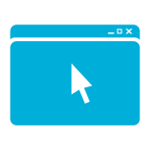


Host your own solutions with SPLA
Microsoft hosting solutions—based on one common platform (Windows Server, System Center & SQL Server)
Service Offerings & Managed Services
VM Hosting
Database Hosting
Application Hosting
Web Hosting
Desktop Hosting
Examples
Rented Virtual Servers Shared or Dedicated
Disaster Recovery
Rented virtual database servers
Database-as-a-Service
Lync, SharePoint, Exchange, Dynamics
CRM, ERP, LOB apps
Custom LOB apps
Ecommerce sites
Company websites
Gaming & entertainment
Windows desktops for students or call centers
Mobile sales team apps
To become an authorized SPLA Hoster, follow these 6 easy steps:
1
2
3
Contact your SPLA-Disti
for further assistance
Join the Microsoft
Partner Network
Join the Microsoft
Hosting Community
4
5
6
Sign the Microsoft Business
and Services Agreement
Build your offer and start selling to customers
Provide monthly reporting
and payment
For full detail requirements, please see http://www.microsoft.com/licensing/licensing-options/spla-program.aspx
Notes:
The Microsoft Services Provider License Agreement (SPLA) gives hosting providers the flexibility to build affordable solutions with the features your customers want. Based on a common platform that includes Windows Server, System Center, and SQL Server, SPLA supports a range of service offerings and managed services:
VM Hosting
Virtual Machine Hosting is the core IaaS offer from hosting service providers, that vary from $5 a month to $500 a month. VM hosting involves both hosted private clouds on dedicated server hardware as well as VM hosting on shared, multi-tenant server hardware. End-customers – IT Pros, Enterprise developers and ISVs purchase VMs to host production applications, databases, web sites, data (files, photos, media) and for test-dev scenarios. Windows Server is the top operating system running at service providers and we are focused on driving adoption of System Center components and Hyper-V components as the core infrastructure for both hosted dedicated and shared servers.
Server and Application Management
Most hosting service providers offer for both entry-level and premium services. Hosting service providers can offer premium “white-glove” application and OS management and SLAs based on System Center 2012
Database Hosting
Cloud database built on SQL Server to enable end customers to scale up and scale down their usage without managing physical systems
High Availability / Business Continuity
BI as a Service
SQL in the Private Cloud
Application Hosting
Application hosting – whether Exchange, Lync, Sharepoint, SAP, IBM, Oracle or custom ISV or Enterprise applications – is a high margin business for a significant number of hosting service providers. Windows Server, System Center and Hyper-V provide an integrated application hosting infrastructure that delivers end-to-end management capabilities across HW, hypervisor, OS, and application at low total-cost-of-operations from the commodity hardware, automated operations and licensing perspectives.
Web Hosting
Enabling windows based hosting for web workloads such as:
Hosted websites
Web applications
Web commerce
Desktop Hosting
Comprehensive suite of solutions to enable organizations to provide their employees flexibility to work everywhere on any device, on a compliant management infrastructure:
SMB/Enterprise Hosted Desktop
Backup
Antivirus
Disaster recovery

Slide 20



Learn more about SPLA
Plan
Optimize & Build
Sell
  Take advantage the momentum. Plan and expand your service offerings
  on Microsoft Cloud OS
  Build and optimize your services offerings by leveraging new capabilities
  Expand your reach with investments in marketing and sales
Download and Try: Windows Server 2012 R2, System Center 2012 R2, Windows Azure Pack
Learn more about Cloud OS
TechNet Virtual Labs
Hosting Resources on MS.COM/hosting
Microsoft Partner Network Hosting Community
Data Center and Data Platform Hosting Competency
Technical Deployment Camp: Cloud Infrastructure and SQL Server
Hosting Days Events
Cloud OS Hosting Service Provider Programs: Hyper-V Ignite, COSN, Cloud OS Network
Technical Reference Architecture
Microsoft Services Provider License Agreement (SPLA)
License Mobility through Software Assurance
Microsoft Partner Network
Resources
Partner Marketing Center
Hosting Service Provider Campaign
Notes:
There are a range of resources available to help hosting partners, from planning your offerings, to building and optimizing them, to marketing and selling to grow your revenue and customer base.

Slide 21
Next steps

Slide 22
Resources
Windows Server Essentials Tech Center
http://technet.microsoft.com/en-US/sbs/jj159331
Windows Server Essentials and Small Business Server blog
http://blogs.technet.com/b/sbs/
Windows Server Essentials support forum
http://social.technet.microsoft.com/forums/en-us/
winserveressentials/threads
Windows Server 2012 R2 product page
http://www.microsoft.com/en-us/server-cloud/products/
windows-server-2012-r2/default.aspx
Windows Server 2012 R2 Essentials product page
http://www.microsoft.com/en-us/server-cloud/products/
windows-server-2012-r2-essentials/default.aspx

Slide 23
Ahead of the Game Campaign Resources
Leverage Server and Cloud Solutions to dramatically increase margin and keep SMB customers ahead of the game
Be Lean & Stay Lean
    Understand how virtualization opens the door to value-added services and offerings.
Business Anywhere
    Find out how you can support the expanding SMB remote and mobile workforce.
    Tap Your Data Goldmine
    Help SMBs use data to their advantage in three easy steps.
Get started today! Visit http://aka.ms/AheadoftheGame to find the marketing materials and sales tools you need get SMB customers ahead of the game.
Notes:
Leverage Server and Cloud Solutions to dramatically increase margin and keep SMB customers ahead of the game. The Ahead of the Game campaign can help you reach business and IT decision makers in small and midsize companies with solution-based messaging that spans across Windows Server, Windows Azure, SQL Server, Intune, Office 365, Windows 8 and more.
Get started at http://aka.ms/AheadoftheGame to find the marketing materials and sales tools you need get SMB customers—and your business—ahead of the game.

Slide 24

Additional Partner Resources
Ahead of the Game Marketing Content
http://aka.ms/AheadoftheGame
SMB and Midmarket Competencies
  http://partner.Microsoft.com
Partner Learning Center:
  https://mspartner.microsoft.com/en/us/Pages/Training/partner-learning-center.aspx
Microsoft Virtual Academy
http://www.microsoftvirtualacademy.com/
ISV Upgrade Support
Email isvupgrade@microsoft.com with app name and name of ISV
Notes:
The following resources are available to help you grow your business in SMB with Microsoft products and technologies.

Slide 25
How to Buy Windows Server 2012 R2
Choose from four editions of Windows Server, based on the size of the customer organization and their requirements for virtualization and cloud computing.
Edition
Ideal for…
Feature Comparison
Licensing Model
Datacenter
Highly virtualized private and hybrid cloud environments
Full Windows Server functionality with unlimited virtual instances
Processor + CAL*
Standard
Low density or non-virtualized environments
Full Windows Server functionality with two virtual instances
Processor + CAL*
Essentials
Small business environments for servers with up to two processors
Simpler interface, pre-configured connectivity to cloud-based services; one virtual instance of Essentials
Server (25 User Limit)
Foundation
Economical general purpose server with a single processor
General purpose Server functionality with no virtualization rights
Server (15 User Limit)
Windows Server 2012 R2 Standard and Datacenter editions include the new Windows Server Essentials Experience server role, offering features such as Remote Web Access and client computer backup that previously were only available through the Windows Server Essentials edition.
*CALs are required for every user or device accessing a server. See the Product Use Rights for details
Notes:
The Windows Server 2012 R2 product is streamlined and simple, making it easy for customers to choose the edition that is right for their needs.
Datacenter edition is ideal for highly-virtualized private cloud environments.
Standard edition is for non-virtualized or lightly virtualized environments.
Essentials edition is for small businesses with up to 25 users running on servers with up to two processors.
Foundation edition is for small businesses with up to 15 users running on single processor servers.
One important update with R2: Windows Server 2012 R2 Standard and Datacenter editions include the new Windows Server Essentials Experience server role, offering features such as Remote Web Access and client computer backup that previously were only available through the Windows Server Essentials edition.

Slide 26
Product & Licensing Resources
Windows
Server
2012 R2
  Windows Server Partner Resources:
  https://mspartner.microsoft.com/en/us/Pages/Solutions/microsoft-windows-server.aspx
  Windows Server Technical Resources:
  http://technet.microsoft.com/en-us/windowsserver
Windows
Azure
Windows Azure Partner Resources:
https://mspartner.microsoft.com/en/us/pages/solutions/windows-azure-platform.aspx
Windows Azure Technical Resources:
http://msdn.microsoft.com/en-us/library/windowsazure/
Microsoft
Volume
Licensing
Microsoft Volume Licensing Resources:
http://www.microsoft.com/licensing/
Microsoft Licensing Advisor:
http://mla.microsoft.com/
Notes:
Visit the following pages on Microsoft.com for a range of additional resources, including additional product and licensing information, free trial downloads, and more.

Slide 27
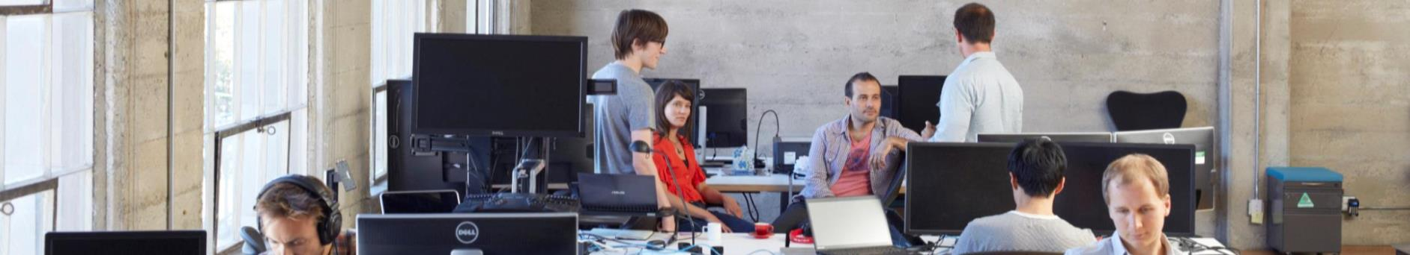
Windows Server 2012 R2 Licensing for SMBs
Open Value
Open Value Subscription*
Open License
Select Plus
Services Provider License Agreement (SPLA)
Software Assurance
Simplified license management
Annual payment structure
Three options: organization-wide, non–organization-wide, and subscription
Gives customers the option to subscribe to Microsoft product licenses
Provides the lowest up-front costs of the Open Programs with the flexibility to meet changing demands
“Pay-as-you-go” model
Allows customers to change their licensing program as their business grows
For midsize and large organizations with 250 or more desktop PCs
Can license software and services at a business unit level with the price saving advantages of a single organization
For hosting providers
No upfront costs or volume license commitments
Pay only for what you provided customers in the previous month
Access the latest versions of software
Benefits
* Available in select countries and regions
Notes:
Licensing Options for Small and Midsize Organizations
Microsoft offers a number of licensing programs designed to help you sell to small and midsize organizations.
Microsoft Open Programs provide volume discounts for a minimal up-front cost and are widely available through the worldwide partner channel. Open Programs provide the following three purchasing license options for commercial businesses:
Open Value offers the advantages of Software Assurance, simplified license management, and an annual payment structure. The Open Value program offers three options: Organization-wide, Non–Organization-wide, and Open Value Subscription.
Open Value Subscription is for customers who want to subscribe to, rather than acquire, Microsoft product licenses. Available in select countries or regions, Microsoft Open Value Subscription provides the lowest up-front costs of the Open Programs with the flexibility to reduce their total licensing costs in years when their desktop PC count declines.
Open License is ideal for customers that prefer a “pay-as-you-go” model and plan to change their licensing program as their business grows.
For larger organizations, Microsoft also offers Select Plus:
Microsoft Select Plus is for midsize and large organizations with 250 or more desktop PCs with multiple affiliates that want to license software and services at any business unit level while still getting the price saving advantages of being a single organization
For organizations that offer hosted software and services to end customers:
Microsoft Services Provider License Agreement (SPLA) is for hosters providing services such as Web hosting, hosted applications, messaging, collaboration, and platform infrastructure. SPLA partners have the ability to deliver a customized service with a flexible cost structure. There are no startup costs, no monthly sales minimums or required term of commitment. Pay only for what you were providing to your customer in the previous month. With SPLA, you also have access to the latest versions of software, and you can sell your services worldwide.

Slide 28

© 2013 Microsoft Corporation. All rights reserved. Microsoft, Windows and other product names are or may be registered trademarks and/or trademarks in the U.S. and/or other countries.
The information herein is for informational purposes only and represents the current view of Microsoft Corporation as of the date of this presentation. Because Microsoft must respond to changing market conditions, it should not be interpreted to be a commitment on the part of Microsoft, and Microsoft cannot guarantee the accuracy of any information provided after the date of this presentation. MICROSOFT MAKES NO WARRANTIES, EXPRESS, IMPLIED OR STATUTORY, AS TO THE INFORMATION IN THIS PRESENTATION.

Slide 29
Deployment options matrix
Deployment Type
together with
Deployment Location
together with
Virtualization
together with
Active Directory
Windows Server 2012 R2 Essentials edition
On-Premises
Virtual Machine
Domain Controller
Windows Server Essentials Experience server role
Windows Azure
Physical Server
Member Server
3rd Party Hoster
Notes:
Windows Server 2012 R2 introduces a number of different deployment options that can be combined together in various ways to meet the specific needs of a broad range of customer scenarios.
Deployment Type
Windows Server 2012 R2 Essentials edition provides a simplified experience for up to 25 users and 50 devices.
The Windows Server Essentials Experience role can be used with the Standard or Datacenter editions of Windows Server 2012 R2 to offer the feature set of Essentials that can scale up to 100 users and 200 devices.
Deployment Location
Most customer environments will reflect a Hybrid IT approach, with applications and services running both on-premises and in the cloud. Both the Essentials edition and the Essentials Experience can be run on-premises.
Also, the Essentials Experience role can be run on Windows Server instances in hosted environments, whether that is Windows Azure or at a 3rd party hoster. While possible to run the Essentials edition in a hosted environment, from both a licensing and deployment perspective, it will make much more sense to run the role.
Virtualization
Both the Essentials edition and the Essentials Experience can be run virtualized. This provides the greatest degree of flexibility and agility for managing and maintaining the IT infrastructure.
Both the Essentials edition and the Essentials Experience can also be run directly on physical hardware, but this would in almost all cases mean running on-premises rather than in the cloud.
Active Directory
As with previous versions, the Essentials edition must be a domain controller.
With the introduction of the Essentials Experience server role, it is now much easier to make this feature set available as part of a larger organization that already has an Active Directory infrastructure in place. In these environments, the server running the Essentials Experience does not need to be a domain controller.

