Slide 1

Monitoring and Troubleshooting Servers
Module 4

Slide 2
Objectives
Skills/Concepts | Objective Domain Description | Objective Domain Number
Understanding Performance | Understand performance monitoring. | 5.2
Using the Event Viewer | Understand logs and alerts. | 5.3
Booting the System | Identify steps in the startup process. | 6.1
Introducing Business Continuity | Understand business continuity. | 6.2
Introducing Troubleshooting Methodology | Understand troubleshooting methodology. | 6.4
Notes:
This should also be a review for the 70-642.

Slide 3
ITIL
  The Information Technology Infrastructure Library (ITIL) is a set of concepts and practices for managing Information Technology (IT) systems, IT Service Management (ITSM), IT development, and IT operations.
  ITIL gives detailed descriptions of a number of important IT practices and provides comprehensive checklists, tasks, and procedures that any IT organization can tailor to its needs.

Slide 4
Servers, Services and Applications
  When you want to start using a server, service, or application, you should follow certain steps to implement it properly.
  Those steps include:
    Collecting requirements
    Designing and planning
    Implementing
    Managing and monitoring

Slide 5
Troubleshooting Methodology
  As a computer technician, a server administrator, or a network administrator, you will eventually have to deal with problems.
  Some problems will have obvious solutions and be easy to fix.
  Many problems will need to be figured out by following a troubleshooting methodology to efficiently resolve a problem.

Slide 6
Troubleshooting Methodology
  Discover the problem
  Evaluate system configuration
  List or track possible solutions and try to isolate the problem by removing or disabling hardware or software components
  Execute a plan
  Check results
  Take a proactive approach

Slide 7
Troubleshooting Tools
  Device Manager
  System Information
  Event Viewer
  Task Manager
  Resource Monitor
  Performance Monitor
  System Configuration
  Memory Diagnostics tool
  Troubleshooting Wizard
  Boot Menu including Safe mode
  Windows Repair

Slide 8
DEMO: System Information
Notes:
System Information (also known as msinfo32.exe) shows details about your computer’s hardware configuration, components, and software, including drivers.
It was originally included with Windows to assist Microsoft support people in determining what a particular machine contains, especially when talking to end users.
System Information lists categories in the left pane and details about each category in the right pane.

Slide 9
DEMO: Event Viewer
Notes:
The Event Viewer is a Microsoft Management Console (MMC) snap-in that enables you to browse and manage event logs. It is included in the Computer Management and Server Manager MMC and is included in Administrative Tools as a stand-alone console.
You can also execute the eventvwr.msc command.
Event Viewer enables you to perform the following tasks:
View events from multiple event logs
Save useful event filters as custom views that can be reused
Schedule a task to run in response to an event
Create and manage event subscriptions

Slide 10
DEMO: Task Manager
Notes:
Task Manager is one of the handiest programs you can use to take a quick glance at performance to see which programs are using the most system resources on your computer.
You can see the status of running programs and programs that have stopped responding, and you can stop a program running in memory using Task Manager.

Slide 11
DEMO: Performance Monitor
Notes:
Windows Performance Monitor is a Microsoft Management Console (MMC) snap-in that provides tools for analyzing system performance.
From a single console, you can monitor application and hardware performance in real time, specify which data you want to collect in logs, define thresholds for alerts and automatic actions, generate reports, and view past performance data in a variety of ways.

Slide 12
Getting Help
  When troubleshooting issues within Windows and related programs, you will eventually deal with problems that you do not know how to fix.
  Therefore, you may have to ask co-workers and do some research on the Internet. A good search engine such as Bing can provide an almost limitless amount of help and support.
  You will also need to check the vendor Web sites including Microsoft’s (www.microsoft.com).

Slide 13
Booting the System
  One of the most frustrating problems to troubleshoot is when Windows does not boot and you cannot log in to Windows.
  To overcome these problems, you need to understand how the computer boots and be familiar with the tools available during boot up.
  Every time you turn on a computer, it goes through the Power-On Self Test (POST), which initializes hardware and finds an operating system to load.

Slide 14
Master Boot Record
  A master boot record (MBR) is the first 512-byte boot sector of a partitioned data storage device such as a hard disk.
    It is used to hold the disk’s primary partition table, contains the code to bootstrap an operating system, which usually passes control to the volume boot record and uniquely identifies the disk media.
  A volume boot record (VBR) is a type of boot sector, stored in a disk volume on a hard disk, floppy disk, or similar data storage device that contains code for booting an operating system such as NTLDR and BOOTMGR.

Slide 15
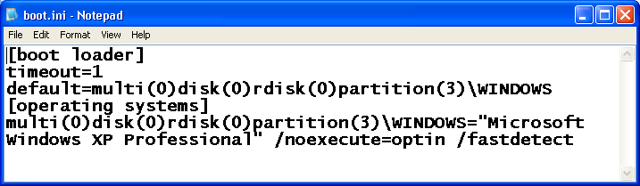
The Old Way! - Boot.ini File
Notes:
The Windows XP and Windows Server 2003 NTLDR will read the boot.ini file to determine which operating system to load even if your system only has one operating system.
If your system has multiple operating systems, the boot.ini file can display a boot menu so that you can choose which operating system to load and automatically select a default operating system if one is not selected during boot up.

Slide 16
The New Way! - BCDEdit
  Boot Configuration Data (BCD) is a firmware-independent database for boot-time configuration data used by Microsoft’s Windows Boot Manager found with Windows Vista and later and Windows Server 2008 and later.
  To edit the Boot Configuration, you typically use Bcdedit.exe.

Slide 17
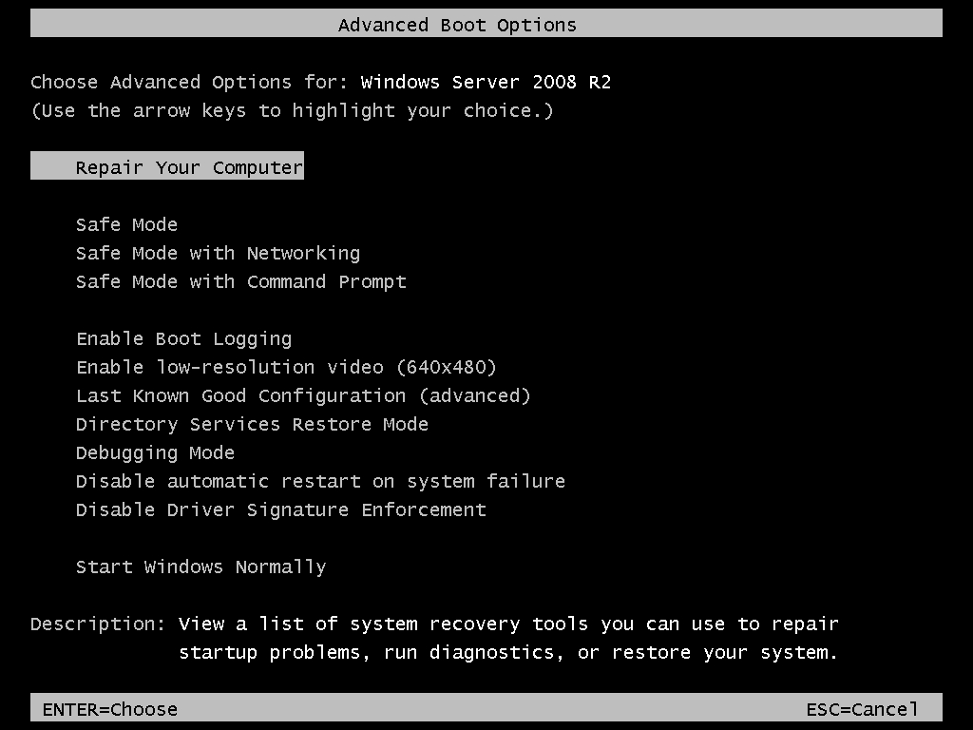
Advanced Boot Options
Notes:
When problems occur during boot up, you may need to take some extra steps to get the computer into a usable state so that you can fix the problem.
Since the release of Windows XP, you can access the Advanced Boot Options to get to advanced troubleshooting modes.
To access the Advanced Boot Options screen you turn your computer on and press F8 before the Windows logo appears.

Slide 18
DEMO: System Configuration
Notes:
System Configuration (msconfig.exe) is a tool that can help you identify problems that might prevent Windows from starting correctly.
When a problem occurs, assuming you can successfully start and log in to Windows, you can open System Configuration and disable certain startup programs or services.
If the problem goes away when you restart Windows, you know that the problem is caused by the program or service that you disabled.

Slide 19
DEMO: Virtual Memory and Paging File
Notes:
If your computer lacks the RAM needed to run a program or perform an operation, Windows uses virtual memory to compensate.
Virtual memory combines your computer’s RAM with temporary space on your hard disk.
When RAM runs low, virtual memory moves data from RAM to a space called a paging file.
Unfortunately, when something needs to be accessed from the virtual memory on disk, it is much slower than accessing it directly from RAM.

Slide 20
Business Continuity
  Keeping servers running and services available.
  When a server goes down, it will most likely cause your company to lose money.
  If your network contains an external Web site or database that controls your sales, ordering, inventory, or production, server downtime can be detrimental to these business needs.
  If it is an internal server, it may not allow your users to perform their jobs.

Slide 21
High Availability
Availability % | Downtime per Month | Downtime per Year
99 | 7.20 hours | 3.65 days
99.9 | 43.2 minutes | 8.76 hours
99.99 | 4.32 minutes | 52.6 minutes
99.999 | 25.9 seconds | 5.26 minutes
99.9999 | 2.59 seconds | 31.5 seconds
Notes:
High availability is a system design protocol and associated implementation that ensures a certain degree of operational continuity during a given measurement period.
Generally, the term downtime is used to refer to periods when a system is unavailable.
Availability is usually expressed as a percentage of uptime

Slide 22
Fault Tolerance
  To make a server more fault tolerant, you should first look at what components are the most likely to fail and implement technology to make a system less likely to fail.
  Some of the components that are made redundant within a system are usually:
    Disks: Use some form or RAID and hot spares.
    Power supplies: Use redundant power supplies.
    Network cards: Use redundant network cards.

Slide 23
Clustering
  A computer cluster is a group of linked computers that work together as one computer.
  Based on the technology used, clusters can provide fault tolerance (often referred to as availability), load balancing, or both.
  If the system fails, including the processor, memory, or motherboard, a cluster that provides fault tolerance can still service requests.
  The two most popular forms of clusters are failover clusters and load-balancing clusters.
Notes:
A failover cluster for back end servers such as a database (such as SQL Server) or mail server (such as Exchange Server).
A load-balancing cluster for the front end that provides the web interface to the back end servers.

Slide 24
Power
  Without electricity, the server will not run. Even if you have redundant power supplies, they cannot protect against a power outage or other forms of power fluctuations.
  In these situations, your company should look at uninterruptible power supplies and power generators to provide power when no power is available from the power company.

Slide 25
Protecting Data
  Data stored on a computer or stored on the network is vital to the users and the organization.
  It represents hours of work and its data is sometimes irreplaceable. One of the most essential components of any server design is the backup process.
  No matter how much effort, hardware, and software you put into a system, you will eventually have a failure.
  Sometimes when the downtime occurs, you may have data loss.

Slide 26
Backups
  A backup is a copy of data kept somewhere so that data can be restored after a data-loss event.
  They can be used to restore entire systems following a disaster or to restore small sets of files that were accidentally deleted or corrupted.
  When planning backups, you should isolate your program files and your data files. Program files usually do not change, so they do not have to be backed up often or at all. Data files should be backed up frequently.
Notes:
With early networks and servers, a backup was done with floppy disks.
Unfortunately, floppy disks were very limited in size, speed, and life span.
Eventually, magnetic tapes were developed and become the standard mechanism used by corporations to perform backup and storage.
More recently, competing technology has been hard disk storage, and optical disks have become more common for backups.

Slide 27
System State
  The Windows system state is a collection of system components that are not contained in a simple file but can be backed up easily. It includes:
    Boot files (boot.ini, NTLDR, NTDetect.com)
    DLLScache folder
    Registry (including COM settings)
    SYSVOL (Group Policy and log on scripts)
    Active Directory NTDS.DIT (domain controllers)
    Certificate Store (if the service is installed)
    User profiles
    COM+ and WMI information
    IIS metabase

Slide 28
Media Management Methods
  When you plan a backup, your plan needs to balance between accessibility, security, and cost. Larger organizations will often combine one of the following management methods:
    On-line
    Near-line
    Off-line
    Backup site or DR site

Slide 29
Types of Backups
  When planning and performing a backup, specialized backup software will usually include different types of backups, each varying in the amount of time it takes to do a backup and restore.
  Traditional backups include:
    Full backup
    Full backup with incremental backups
    Full backup with differential backup

Slide 30
Backup Rotations
  One of the questions you should ask yourself is “How often should I do a backup?”
    The answer will vary based on your needs.
    You must first look at how important your data is and how much effort would be required to re-create it.
  One common backup rotation scheme is the grandfather-father-son (GFS).

Slide 31
DEMO: Windows Backup
Notes:
Windows includes Microsoft Windows Backup, which will allow you to back up a system.
However, third-party backup software packages usually offer more features and options.

Slide 32
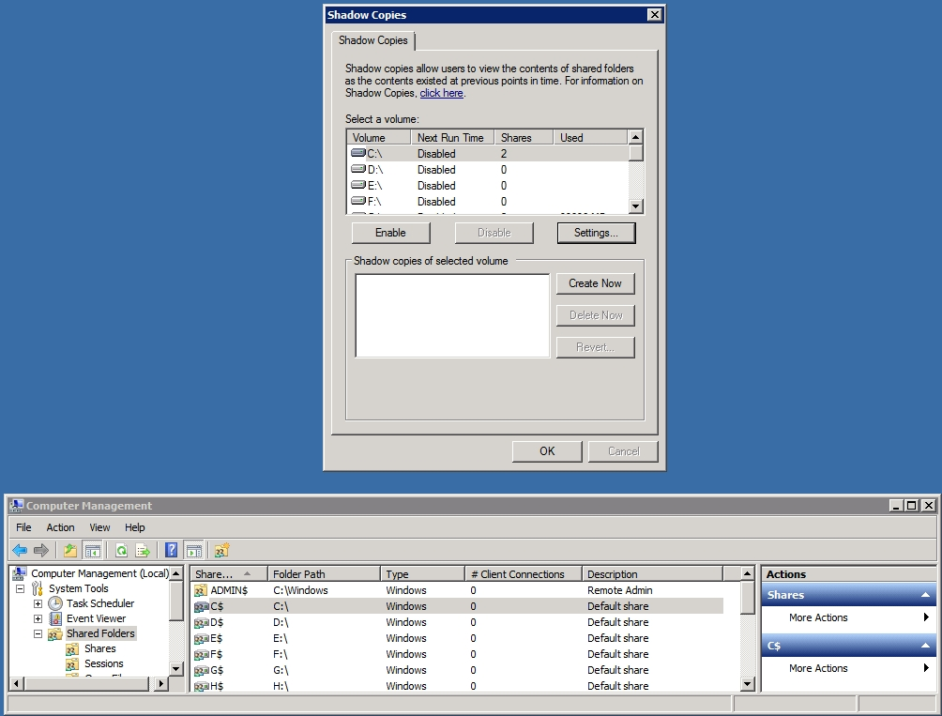
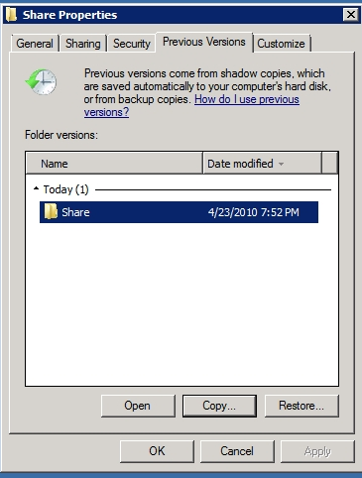
Shadow Copies
Notes:
Windows Server 2003 introduces a new feature called shadow copies of shared folders, which is also used in Windows Server 2008.
Shadow copies, when configured, automatically create backup copies of the data stored in shared folders on specific NTFS drive volumes at scheduled times.
Shadow copies allow users to retrieve previous versions of files and folders on their own, without requiring IT personnel to restore files or folders from backup media.
Of course, you need to have sufficient disk space to store the shadow copies, at least 100 MB of free space.

Slide 33
Pre-Boot Recovery Tools
  Recovery Console (2008 R2)
  System Repair (2008 R2)
  Windows Recovery Environment (2012 & 2012 R2)
Notes:
For computers running Windows Server 2003, you can use the Recovery Console.
The Recovery Console is a command-line tool that you can use to repair Windows if the computer does not start correctly.
You can start the Recovery Console from the Windows Server 2003 CD, or at startup through the startup menu if you previously installed the Recovery Console on the computer.

Slide 34
Additional Resources & Next Steps
Instructor-Led Courses
  40033A: Windows Operating System and Windows Server Fundamentals: Training 2-Pack for MTA Exams 98-349 and 98-365 (5 Days)
  40349A: Windows Operating System Fundamentals: MTA Exam 98-349 (3 Days)
  40032A: Networking and Security Fundamentals: Training 2-Pack for MTA Exams 98-366 and 98-367 (5 Days)
  40366A: Networking Fundamentals: MTA Exam 98-366
Books
Exam 98-365: MTA Windows Server Administration Fundamentals (Microsoft Official Academic Course)
Exams & Certifications
  Exam 98-365: Windows Server Administration Fundamentals

Slide 35

© 2012 Microsoft Corporation. All rights reserved. Microsoft, Windows, Windows Vista and other product names are or may be registered trademarks and/or trademarks in the U.S. and/or other countries.
The information herein is for informational purposes only and represents the current view of Microsoft Corporation as of the date of this presentation. Because Microsoft must respond to changing market conditions, it should not be interpreted to be a commitment on the part of Microsoft, and Microsoft cannot guarantee the accuracy of any information provided after the date of this presentation.
MICROSOFT MAKES NO WARRANTIES, EXPRESS, IMPLIED OR STATUTORY, AS TO THE INFORMATION IN THIS PRESENTATION.

